Slide 1
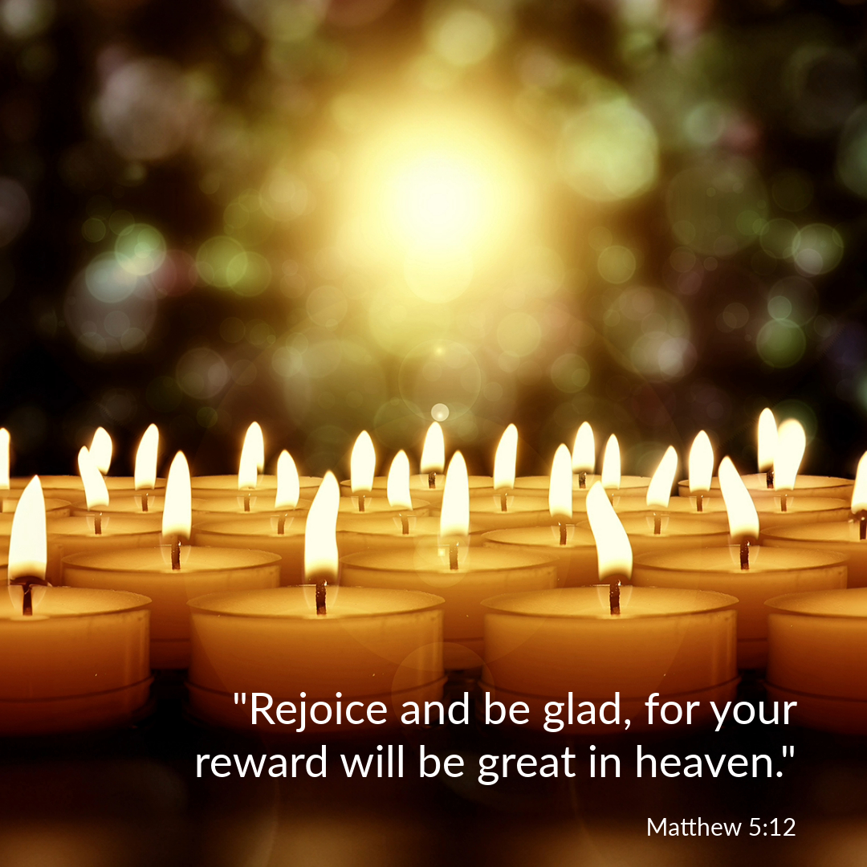

Welcome to St. Luke’s Church Lalor Parish ALL SAINTS
1 November 2026

Slide 2
ENTRANCE SONGS

Slide 3
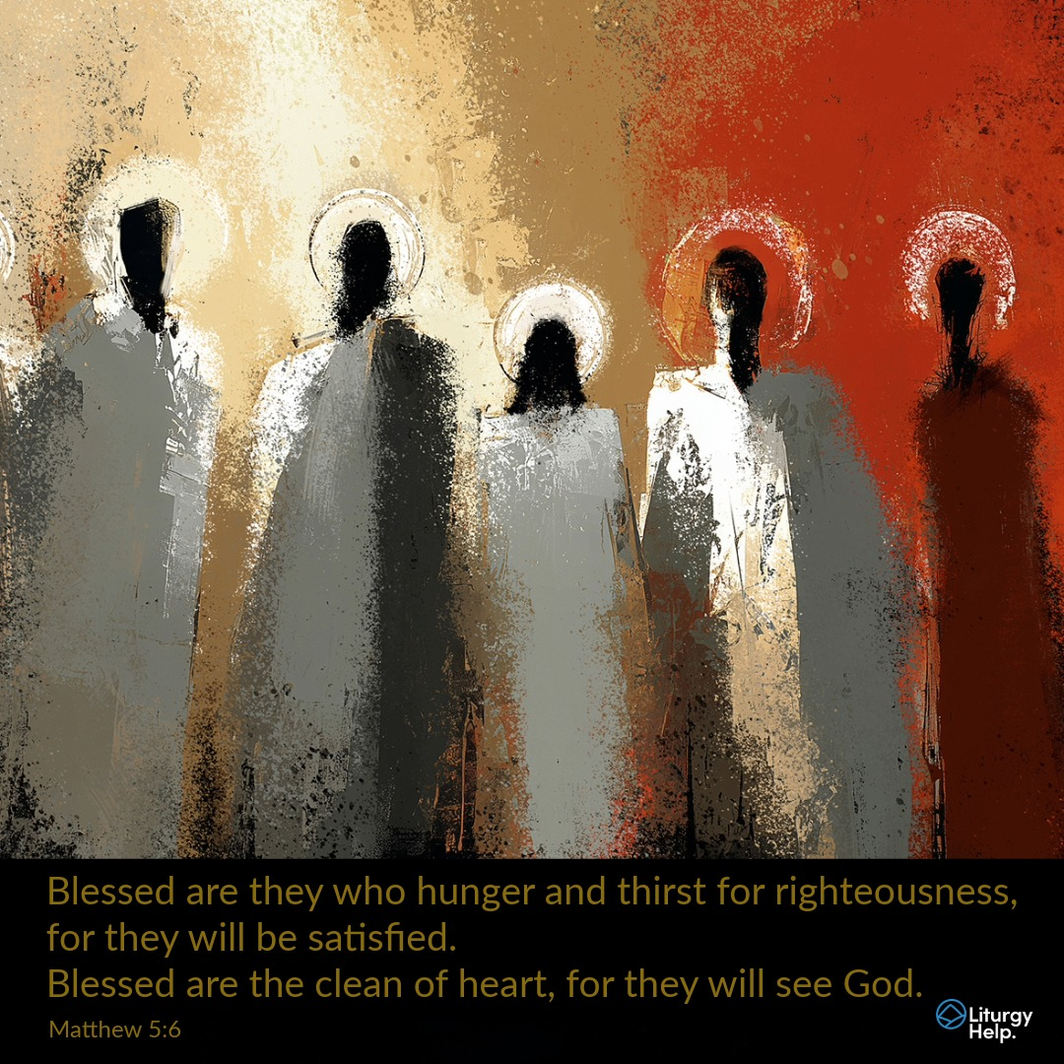

Slide 4
C: In the name of the Father, and of the Son and of the Holy Spirit.
A: Amen
C: The grace of our Lord Jesus Christ, and the love of God, and the communion of the Holy Spirit be with you all.
A: And with your Spirit

Slide 5
1 of 2
PENITENTIAL ACT
I confess to Almighty God, And to you, my brothers and sisters, That I have greatly sinned, in my thoughts and in my words, In what I have done and in what have failed to do. Through my fault, through my fault, Through my most grievous fault;

Slide 6
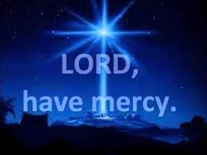
2 of 2
Therefore I ask blessed Mary ever-Virgin, All the Angels and Saints, And you, my brothers and sisters, To pray for me to the Lord our God.

Slide 7
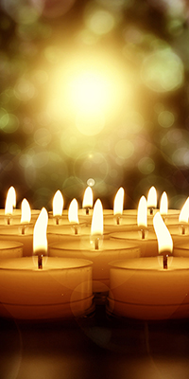
C- Lord have mercy
A- Lord have mercy
C - Christ have mercy
A - Christ have mercy
C- Lord have mercy
A- Lord have mercy

Slide 8

1 of 3
GLORY TO GOD
Glory to God in the highest
And on earth peace to people of good will
We praise You, we bless You, We adore You, we glorify You, We give You thanks for Your great glory. Lord God heavenly King, O God almighty Father.

Slide 9
2 of 3
Lord Jesus Christ, Only Begotten Son. Lord God, Lamb of God, Son of the Father, you take away the sins of the world, Have mercy on us; you take away the sins of the world, receive our prayer; You are seated at the right hand of the Father, Have mercy on us.

Slide 10

3 of 3
For You alone are the Holy One,
You alone are the Lord,
You alone are the Most High, Jesus Christ,
with the Holy Spirit, in the glory of God the Father. Amen….

Slide 11
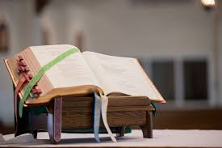

Slide 12
Liturgy of the Word
First Reading (Revelation 7:2-4. 9-14)
A reading from the book of the Apocalypse
I, John, saw another angel rising where the sun rises, carrying the seal of the living God; he called in a powerful voice to the four angels whose duty was to devastate land and sea, ‘Wait before you do any damage on land or at sea or to the trees, until we have put

Slide 13
the seal on the foreheads of the servants of our God.’ Then I heard how many were sealed: a hundred and forty-four thousand, out of all the tribes of Israel. After that I saw a huge number, impossible to count, of people from every nation, race, tribe and language; they were standing in front of the throne and in front of the Lamb, dressed in white robes and holding palms in their

Slide 14
hands. They shouted aloud, ‘Victory to our God, who sits on the throne, and to the Lamb!’ And all the angels who were standing in a circle round the throne, surrounding the elders and the four animals, prostrated themselves before the throne, and touched the ground with their foreheads, worshipping God with these words, ‘Amen. Praise and glory and wisdom and One of the elders then spoke, and asked me, ‘Do you know who these people are, dressed in white robes, and where they have come from?’ I answered him, ‘You can tell me, my Lord.’ Then he said, ‘These are the people who have been through the great persecution, and they have washed their robes white again in the blood of the Lamb.’

Slide 15
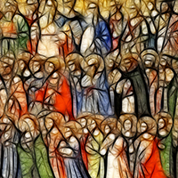
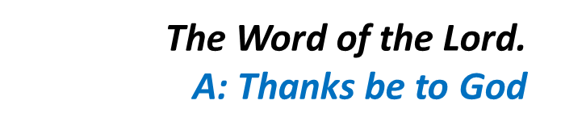
thanksgiving and honour and power and strength to our God for ever and ever. Amen.’

Slide 16
Responsorial Psalm (Ps 23:1-6. R. see v.6)
(R.) Lord, this is the people that longs to see your face.
1. The Lord’s is the earth and its fullness, the world and all its peoples. It is he who set it on the seas; on the waters he made it firm. (R.)

Slide 17
(R.) Lord, this is the people that longs to see your face.
2. Who shall climb the mountain of the Lord? Who shall stand in his holy place? The man with clean hands and pure heart, who desires not worthless things. (R.)
3. He shall receive blessings from the Lord and reward from the God who saves him. Such are the men who seek him, seek the face of the God of Jacob. (R.)

Slide 18
Second Reading (1 John 3:1-3)
A reading from the first letter of St John
Think of the love that the Father has lavished on us, by letting us be called God’s children; and that is what we are. Because the world refused to acknowledge him, therefore it does not acknowledge us. My dear people, we are already the children of God but what

Slide 19
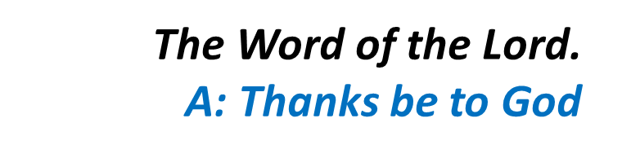
we are to be in the future has not yet been revealed; all we know is, that when it is revealed, we shall be like him because we shall see him as he really is. Surely everyone who entertains this hope must purify himself, must try to be as pure as Christ.

Slide 20
Gospel Acclamation
Alleluia, alleluia!
Come to me, all you that labour and are burdened, and I will give you rest, says the Lord.
Alleluia!

Slide 21
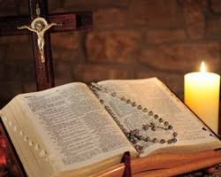
C: The Lord be with you.
A: And with your spirit
C: A reading from the holy Gospel according to Matthew
A: Glory to you Lord

Slide 22
Gospel (Matthew 5:1-12)
Seeing the crowds, Jesus went up the hill. There he sat down and was joined by his disciples. Then he began to speak. This is what he taught them: ‘How happy are the poor in spirit: theirs is the kingdom of heaven. Happy the gentle: they shall have the earth for their heritage. Happy those

Slide 23
who mourn: they shall be comforted. Happy those who hunger and thirst for what is right: they shall be satisfied. Happy the merciful: they shall have mercy shown them. Happy the pure in heart: they shall see God. Happy the peacemakers: they shall be called sons of God. Happy those who are persecuted in the cause of right: theirs is the kingdom of heaven. ‘Happy are you when people abuse

Slide 24

you and persecute you and speak all kinds of calumny against you on my account. Rejoice and be glad, for your reward will be great in heaven.’

Slide 25
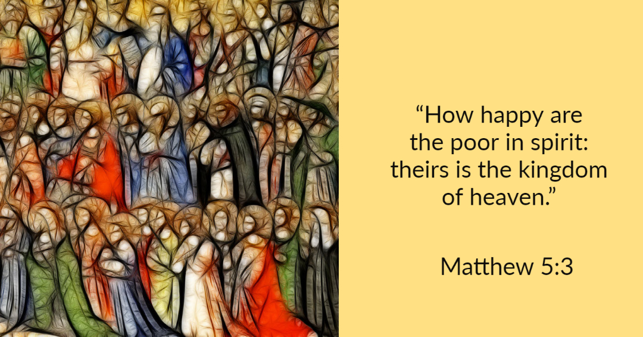

Slide 26
Nicene Creed
I believe in one God, the Father almighty, maker of heaven and earth, of all things visible and invisible. I believe in one Lord, Jesus Christ, the Only Begotten Son of God, born of the Father before all ages. God from God, Light from Light, true God from true God, begotten, not made, consubstantial with the Father; through Him all things were made.

Slide 27
For us men and for our salvation. He came down from heaven, and by the Holy Spirit was incarnate of the Virgin Mary, and became man.
For our sake He was crucified under Pontius Pilate, He suffered death and was buried, and rose again on the third day in accordance with the Scriptures. He ascended into heaven and is seated at the right hand of the Father. He will come again in glory to judge the living and the dead, and His Kingdom will have no end.

Slide 28
I believe in the Holy Spirit, the Lord, the giver of life, who proceeds from the Father and the Son, who with the Father and the Son is adored and glorified, who has spoken through the prophets.
I believe in one, Holy, Catholic and Apostolic Church. I confess one Baptism for the forgiveness of sins and I look forward to the resurrection of the dead, and the life of the world to come. Amen.

Slide 29
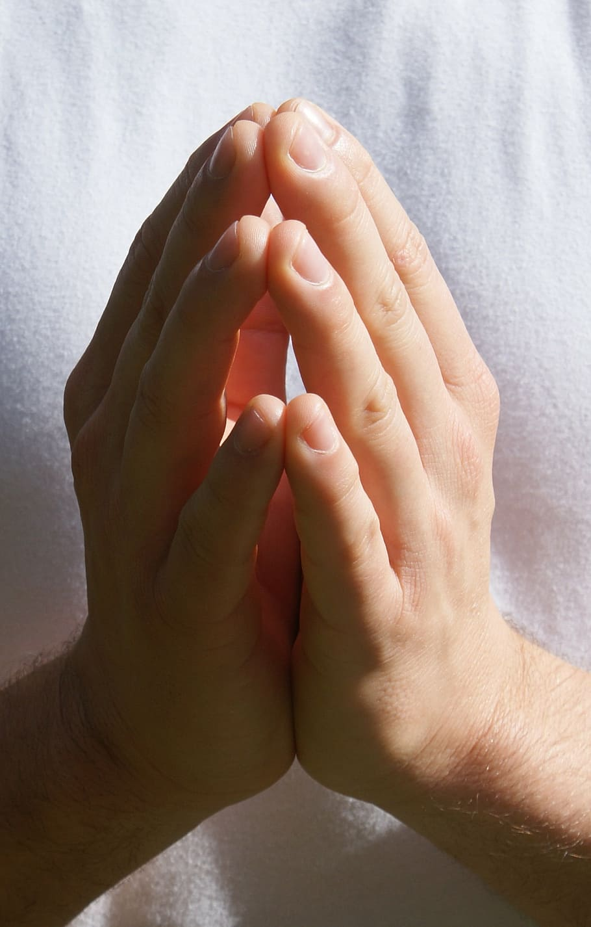
Reader: We pray for…
Let us pray to the Lord.
People: Lord hear our prayer.

Slide 30
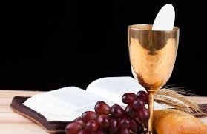

Slide 31
OFFERTORY SONGS

Slide 32
The Liturgy of the Eucharist
C: Pray, brethren that my sacrifice and yours may be acceptable to God, the almighty Father.
A: May the Lord accept the sacrifice at your hands for the praise and glory of his name, for our good the good of all his holy Church.

Slide 33
The Eucharistic Prayer
C: The Lord be with you.
A: And with your spirit.
C: Lift up your hearts.
A: We lift them up to the Lord.
C: Let us give thanks to the Lord our God.
A: It is right and just.

Slide 34
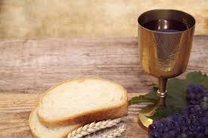

Slide 35

SANCTUS
Holy, holy, holy Lord God of hosts.
Heaven and earth are full of your glory
Hosanna in the highest,
blessed is he who comes in the name of the Lord
Hosanna in the highest…

Slide 36
MYSTERY OF FAITH
We proclaim your death O Lord
And profess your resurrection
Until you come again…

Slide 37
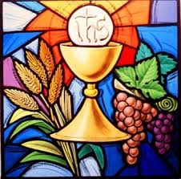

Slide 38

1 of 2
LORD’S PRAYER
Our Father, who art in heaven hallowed be Thy name. Thy Kingdom come, Thy will be done, on earth as it is in Heaven.
Give us this day our daily bread. And forgive us our trespasses, as we forgive those who trespass against us. And lead us not into temptation, but deliver us from evil.

Slide 39
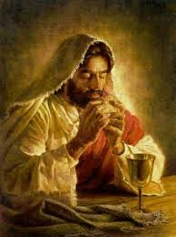
2 of 2
For thy Kingdom, the Power and the Glory are Yours
Now and forever.

Slide 40
C: Lord Jesus Christ, who said to your Apostles…..
….Who live and reign for ever and ever
A: Amen
C: The peace of the Lord be with you always.
A: And with your spirit.

Slide 41
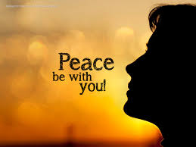

Slide 42
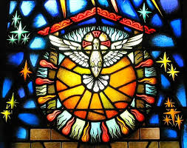
Lamb of God
Lamb of God, you take away the sins of the world, Have mercy on us.
Lamb of God, you take away the sins of the world, Have mercy on us.
Lamb of God, you take away the sins of the world,Grant us peace…

Slide 43
C: Behold the Lamb of God, behold him who takes away the sins of the world. Blessed are those called to the supper of the lamb.
A: Lord, I am not worthy that you should enter under my roof, but only say the word and my soul shall be healed.

Slide 44
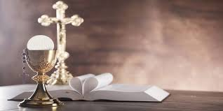

Slide 45
COMMUNION SONGS

Slide 46
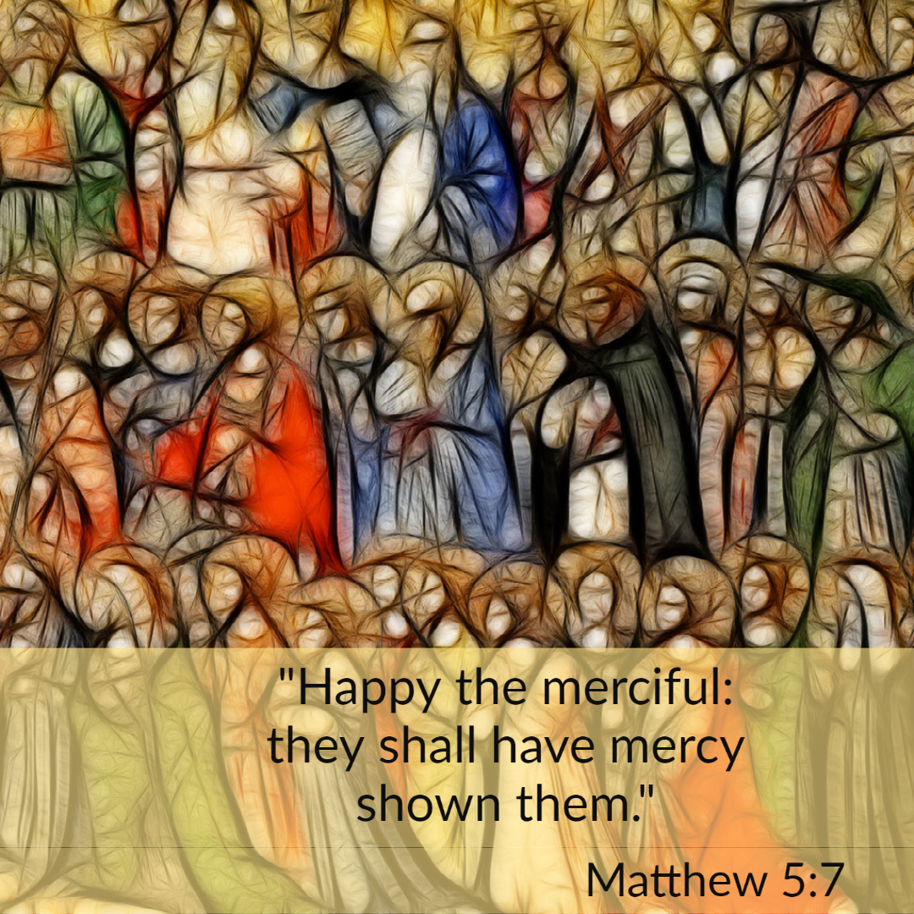

Slide 47
CONCLUDING RITES
C: The Lord be with you.
A : And with your spirit
C: May Almighty God Bless Us, Father and Son and Holy Spirit
A: Amen.
C: Go in Peace, glorifying the Lord by your life.
A: Thanks Be to God

Slide 48
FINAL SONGS

