Slide 1
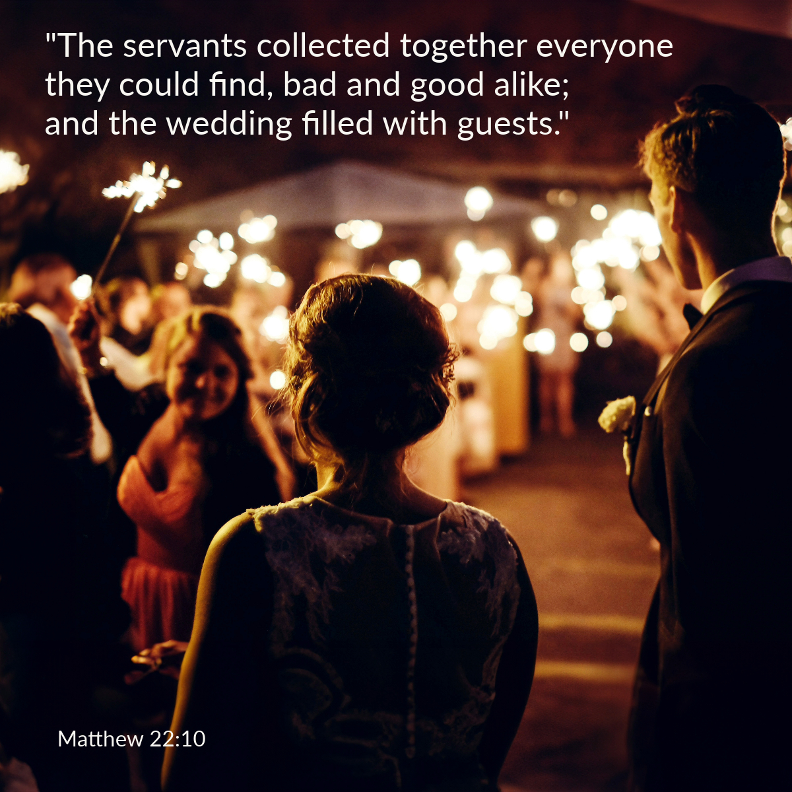

Welcome to St. Luke’s Church Lalor Parish
28th Sunday in Ordinary Time,
11 October 2026

Slide 2
ENTRANCE SONGS

Slide 3
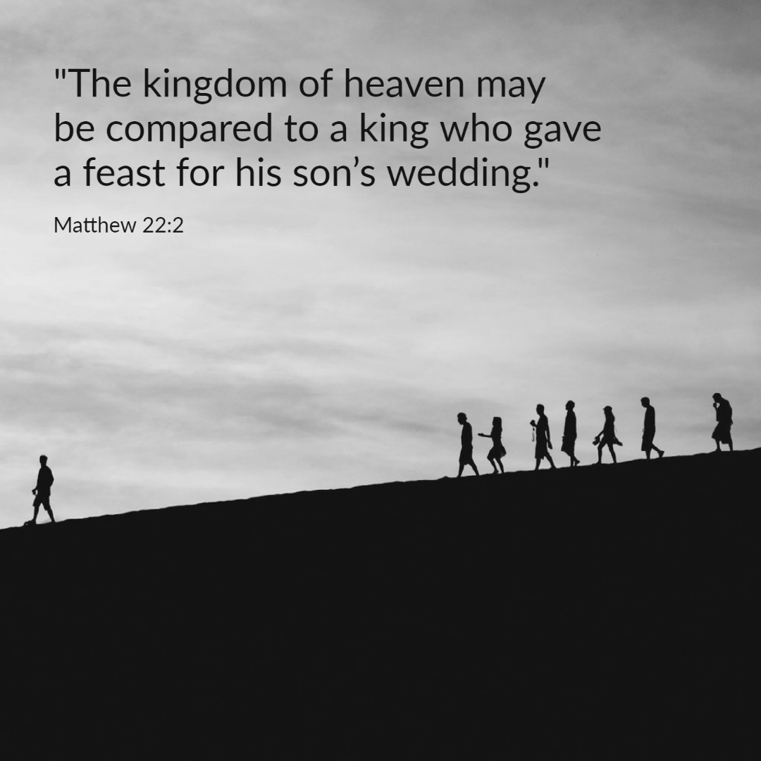

Slide 4
C: In the name of the Father, and of the Son and of the Holy Spirit.
A: Amen
C: The grace of our Lord Jesus Christ, and the love of God, and the communion of the Holy Spirit be with you all.
A: And with your Spirit

Slide 5
1 of 2
PENITENTIAL ACT
I confess to Almighty God, And to you, my brothers and sisters, That I have greatly sinned, in my thoughts and in my words, In what I have done and in what have failed to do. Through my fault, through my fault, Through my most grievous fault;

Slide 6
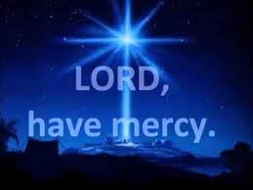
2 of 2
Therefore I ask blessed Mary ever-Virgin, All the Angels and Saints, And you, my brothers and sisters, To pray for me to the Lord our God.

Slide 7
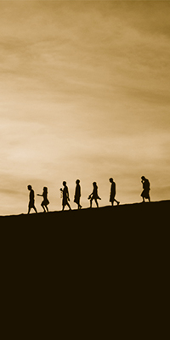
C- Lord have mercy
A- Lord have mercy
C - Christ have mercy
A - Christ have mercy
C- Lord have mercy
A- Lord have mercy

Slide 8

1 of 3
GLORY TO GOD
Glory to God in the highest
And on earth peace to people of good will
We praise You, we bless You, We adore You, we glorify You, We give You thanks for Your great glory. Lord God heavenly King, O God almighty Father.

Slide 9
2 of 3
Lord Jesus Christ, Only Begotten Son. Lord God, Lamb of God, Son of the Father, you take away the sins of the world, Have mercy on us; you take away the sins of the world, receive our prayer; You are seated at the right hand of the Father, Have mercy on us.

Slide 10

3 of 3
For You alone are the Holy One,
You alone are the Lord,
You alone are the Most High, Jesus Christ,
with the Holy Spirit, in the glory of God the Father. Amen….

Slide 11
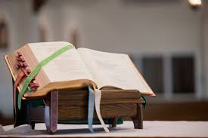

Slide 12
Liturgy of the Word
First Reading (Isaiah 25:6-10)
A reading from the prophet Isaiah
On this mountain, the Lord of hosts will prepare for all people a banquet of rich food, a banquet of fine wines, of food rich and juicy, of fine strained wines. On this mountain he will remove the mourning veil covering all peoples, and the shroud

Slide 13
enwrapping all nations, he will destroy Death for ever. The Lord will wipe away the tears from every cheek; he will take away his people's shame everywhere on earth, for the Lord has said so. That day, it will be said: See, this is our God in whom we hoped for salvation; the Lord is the one in whom we hoped. We exult and we rejoice that he has

Slide 14
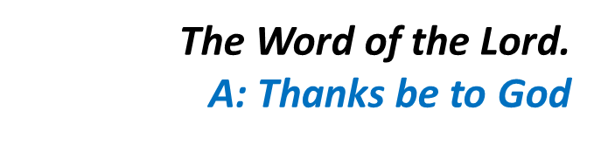
saved us; for the hand of the Lord rests on this mountain.

Slide 15
Responsorial Psalm (Ps 22. R. v.6)
(R.) I shall live in the house of the Lord all the days of my life.
1. The Lord is my shepherd; there is nothing I shall want. Fresh and green are the pastures where he gives me repose. Near restful waters he leads me, to revive my drooping spirit. (R.)
2. He guides me along the right path; he is true to his name. If I should walk in the valley of darkness no evil would I fear. You are there with your crook and your staff; with these you give me comfort. (R.)

Slide 16
(R.) I shall live in the house of the Lord all the days of my life.
3. You have prepared a banquet for me in the sight of my foes. My head you have anointed with oil; my cup is overflowing. (R.)
4. Surely goodness and kindness shall follow me all the days of my life. In the Lord’s own house shall I dwell for ever and ever. (R.)

Slide 17
Second Reading (Philippians 4:12-14. 19-20)
A reading from the letter of St Paul to the Philippians
I know how to be poor and I know how to be rich too. I have been through my initiation and now I am ready for anything anywhere: full stomach or empty stomach, poverty or plenty. There is nothing I cannot master with

Slide 18
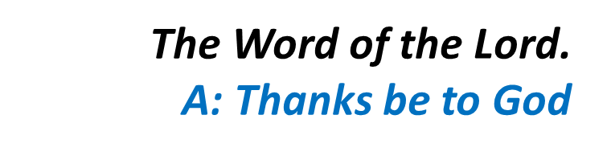
the help of the One who gives me strength. All the same, it was good of you to share with me in my hardships. In return my God will fulfil all your needs, in Christ Jesus, as lavishly as only God can. Glory to God, our Father, for ever and ever. Amen.

Slide 19
Gospel Acclamation
Alleluia, alleluia!
May the Father of our Lord Jesus Christ enlighten the eyes of our heart that we might see how great is the hope to which we are called.
Alleluia!

Slide 20
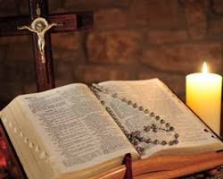
C: The Lord be with you.
A: And with your spirit
C: A reading from the holy Gospel according to Matthew
A: Glory to you Lord

Slide 21
Gospel (Matthew 22:1-10)
Jesus said to the chief priests and elders of the people: “The kingdom of heaven may be compared to a king who gave a feast for his son’s wedding. He sent his servants to call those who had been invited, but they would not come. Next he sent some more servants. “Tell those who have been invited” he said “that I have my banquet all prepared, my

Slide 22
oxen and fattened cattle have been slaughtered, everything is ready. Come to the wedding.” But they were not interested: one went off to his farm, another to his business, and the rest seized his servants, maltreated them and killed them. The king was furious. He dispatched his troops, destroyed those murderers and burnt their town. Then he said to his servants, “The wedding is ready;

Slide 23

but as those who were invited proved to be unworthy, go to the crossroads in the town and invite everyone you can find to the wedding.” So these servants went out on to the roads and collected together everyone they could find, bad and good alike; and the wedding hall was filled with guests.’

Slide 24
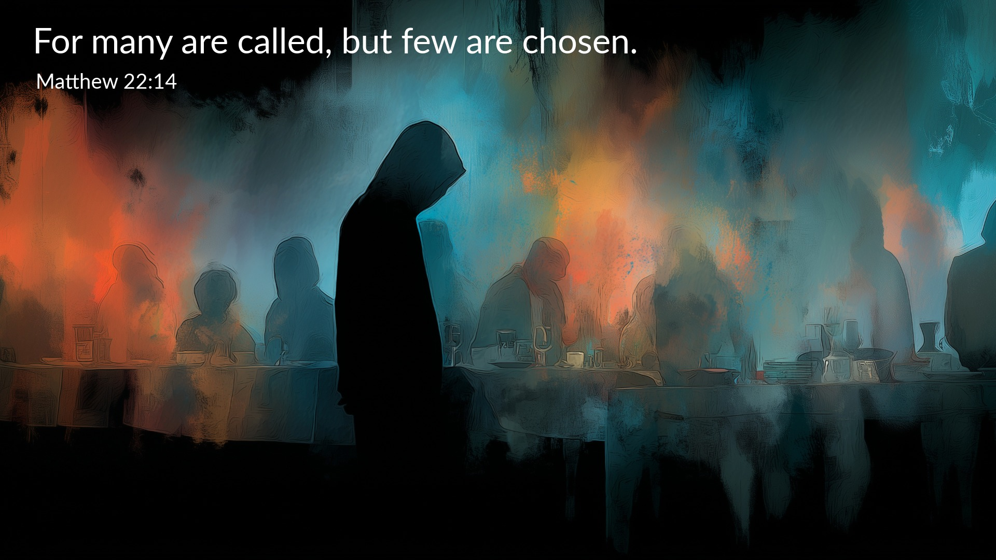

Slide 25
Nicene Creed
I believe in one God, the Father almighty, maker of heaven and earth, of all things visible and invisible. I believe in one Lord, Jesus Christ, the Only Begotten Son of God, born of the Father before all ages. God from God, Light from Light, true God from true God, begotten, not made, consubstantial with the Father; through Him all things were made.

Slide 26
For us men and for our salvation. He came down from heaven, and by the Holy Spirit was incarnate of the Virgin Mary, and became man.
For our sake He was crucified under Pontius Pilate, He suffered death and was buried, and rose again on the third day in accordance with the Scriptures. He ascended into heaven and is seated at the right hand of the Father. He will come again in glory to judge the living and the dead, and His Kingdom will have no end.

Slide 27
I believe in the Holy Spirit, the Lord, the giver of life, who proceeds from the Father and the Son, who with the Father and the Son is adored and glorified, who has spoken through the prophets.
I believe in one, Holy, Catholic and Apostolic Church. I confess one Baptism for the forgiveness of sins and I look forward to the resurrection of the dead, and the life of the world to come. Amen.

Slide 28
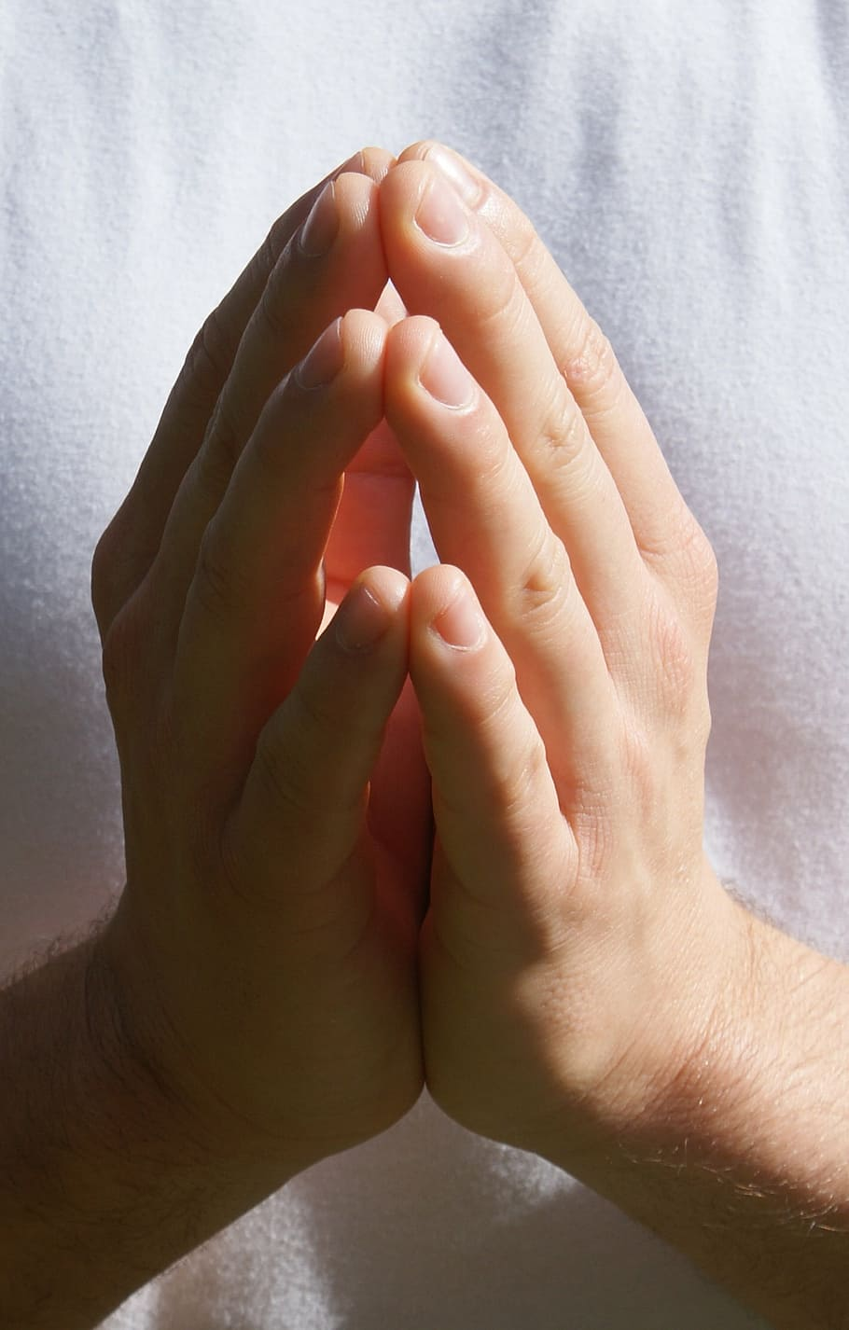
Reader: We pray for…
Let us pray to the Lord.
People: Lord hear our prayer.

Slide 29
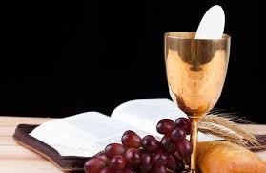

Slide 30
OFFERTORY SONGS

Slide 31
The Liturgy of the Eucharist
C: Pray, brethren that my sacrifice and yours may be acceptable to God, the almighty Father.
A: May the Lord accept the sacrifice at your hands for the praise and glory of his name, for our good the good of all his holy Church.

Slide 32
The Eucharistic Prayer
C: The Lord be with you.
A: And with your spirit.
C: Lift up your hearts.
A: We lift them up to the Lord.
C: Let us give thanks to the Lord our God.
A: It is right and just.

Slide 33
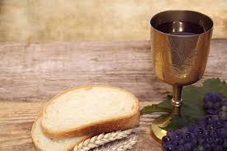

Slide 34

SANCTUS
Holy, holy, holy Lord God of hosts.
Heaven and earth are full of your glory
Hosanna in the highest,
blessed is he who comes in the name of the Lord
Hosanna in the highest…

Slide 35
MYSTERY OF FAITH
We proclaim your death O Lord
And profess your resurrection
Until you come again…

Slide 36
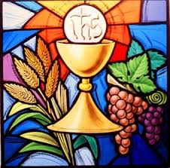

Slide 37

1 of 2
LORD’S PRAYER
Our Father, who art in heaven hallowed be Thy name. Thy Kingdom come, Thy will be done, on earth as it is in Heaven.
Give us this day our daily bread. And forgive us our trespasses, as we forgive those who trespass against us. And lead us not into temptation, but deliver us from evil.

Slide 38
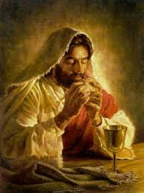
2 of 2
For thy Kingdom, the Power and the Glory are Yours
Now and forever.

Slide 39
C: Lord Jesus Christ, who said to your Apostles…..
….Who live and reign for ever and ever
A: Amen
C: The peace of the Lord be with you always.
A: And with your spirit.

Slide 40


Slide 41
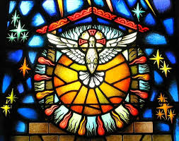
Lamb of God
Lamb of God, you take away the sins of the world, Have mercy on us.
Lamb of God, you take away the sins of the world, Have mercy on us.
Lamb of God, you take away the sins of the world,Grant us peace…

Slide 42
C: Behold the Lamb of God, behold him who takes away the sins of the world. Blessed are those called to the supper of the lamb.
A: Lord, I am not worthy that you should enter under my roof, but only say the word and my soul shall be healed.

Slide 43
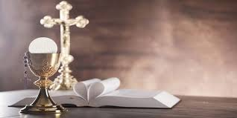

Slide 44
COMMUNION SONGS

Slide 45
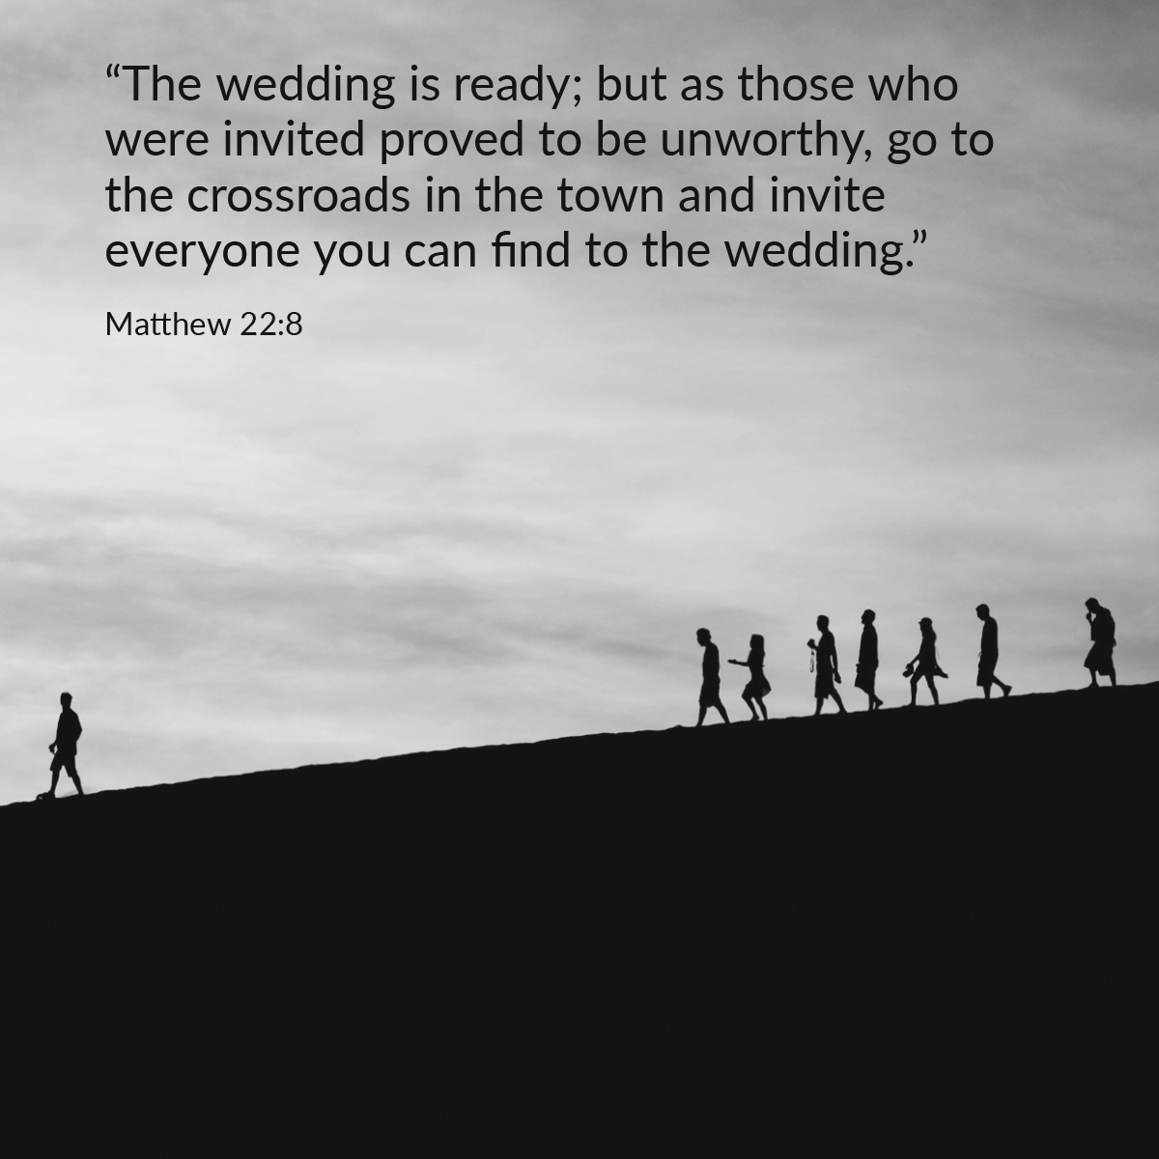

Slide 46
CONCLUDING RITES
C: The Lord be with you.
A : And with your spirit
C: May Almighty God Bless Us, Father and Son and Holy Spirit
A: Amen.
C: Go in Peace, glorifying the Lord by your life.
A: Thanks Be to God

Slide 47
FINAL SONGS

