Slide 1
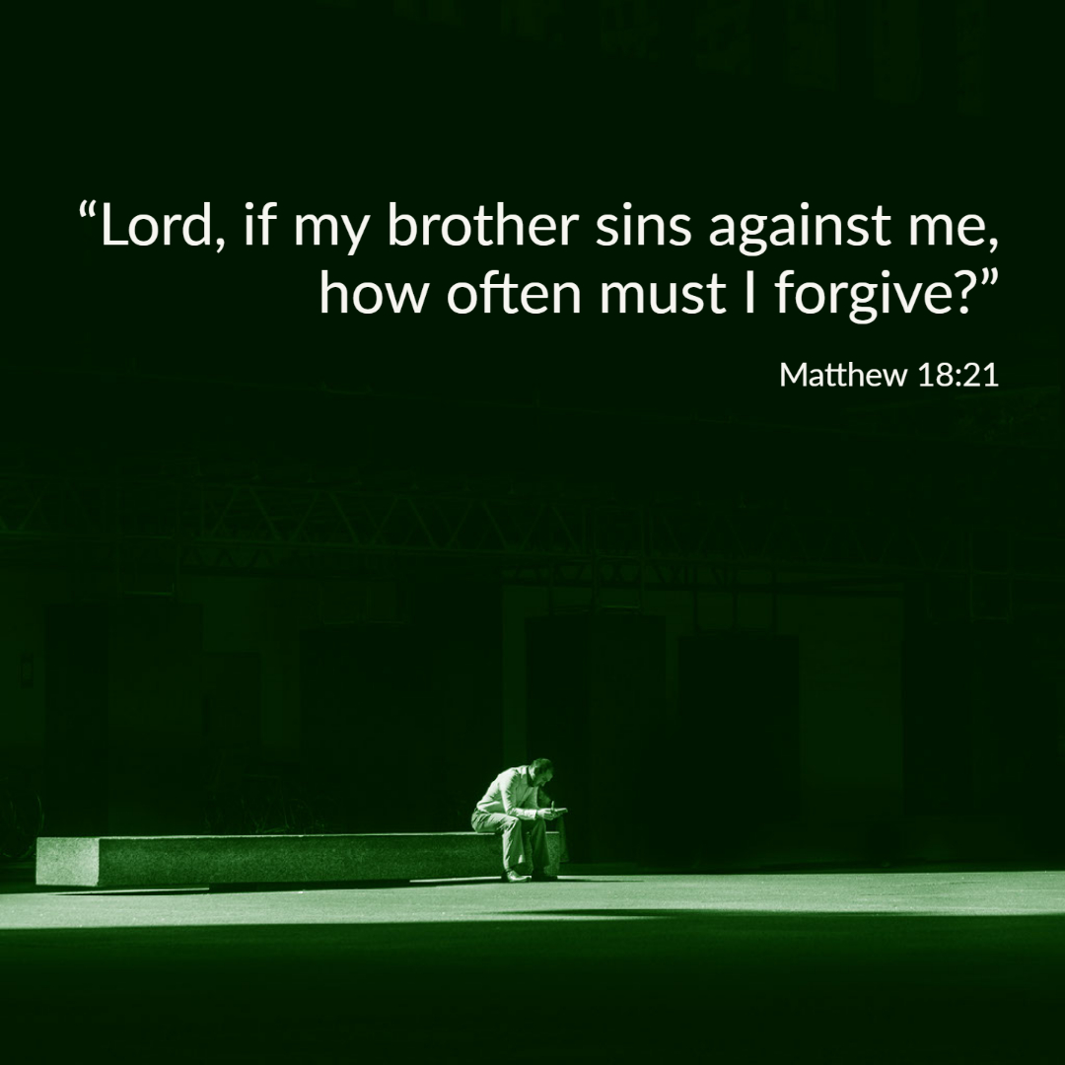

Welcome to St. Luke’s Church Lalor Parish
24th Sunday in Ordinary Time,
13 September 2026

Slide 2
ENTRANCE SONGS

Slide 3
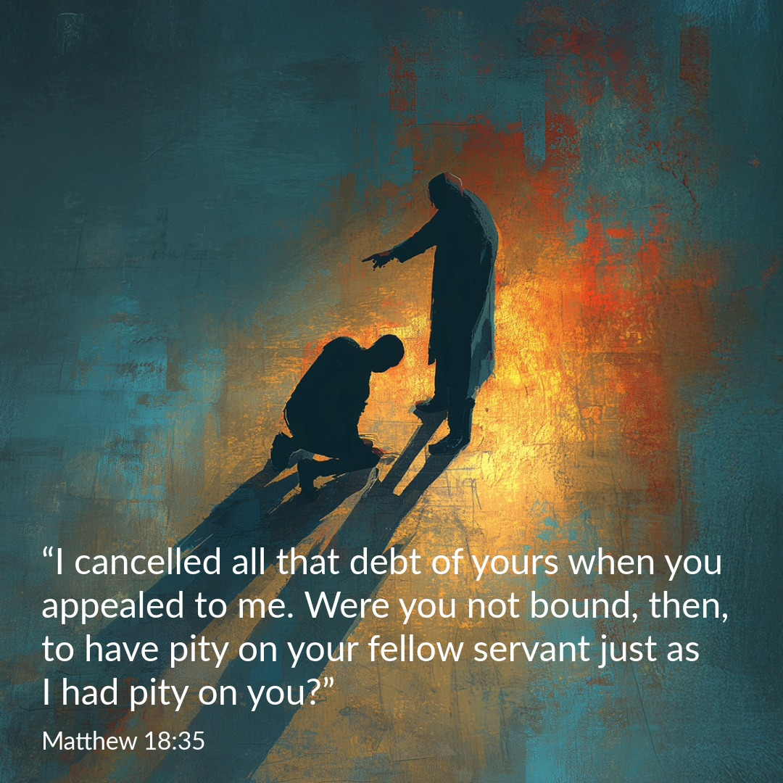

Slide 4
C: In the name of the Father, and of the Son and of the Holy Spirit.
A: Amen
C: The grace of our Lord Jesus Christ, and the love of God, and the communion of the Holy Spirit be with you all.
A: And with your Spirit

Slide 5
1 of 2
PENITENTIAL ACT
I confess to Almighty God, And to you, my brothers and sisters, That I have greatly sinned, in my thoughts and in my words, In what I have done and in what have failed to do. Through my fault, through my fault, Through my most grievous fault;

Slide 6
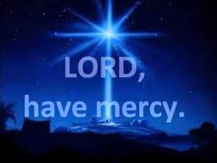
2 of 2
Therefore I ask blessed Mary ever-Virgin, All the Angels and Saints, And you, my brothers and sisters, To pray for me to the Lord our God.

Slide 7
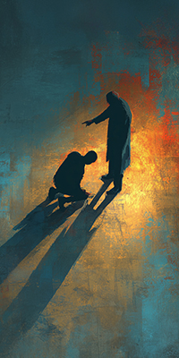
C- Lord have mercy
A- Lord have mercy
C - Christ have mercy
A - Christ have mercy
C- Lord have mercy
A- Lord have mercy

Slide 8

1 of 3
GLORY TO GOD
Glory to God in the highest
And on earth peace to people of good will
We praise You, we bless You, We adore You, we glorify You, We give You thanks for Your great glory. Lord God heavenly King, O God almighty Father.

Slide 9
2 of 3
Lord Jesus Christ, Only Begotten Son. Lord God, Lamb of God, Son of the Father, you take away the sins of the world, Have mercy on us; you take away the sins of the world, receive our prayer; You are seated at the right hand of the Father, Have mercy on us.

Slide 10

3 of 3
For You alone are the Holy One,
You alone are the Lord,
You alone are the Most High, Jesus Christ,
with the Holy Spirit, in the glory of God the Father. Amen….

Slide 11
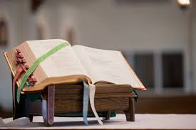

Slide 12
Liturgy of the Word
First Reading (Sirach 27:30 – 28:7)
A reading from the book of Ecclesiasticus
Resentment and anger, these are foul things, and both are found with the sinner. He who exacts vengeance will experience the vengeance of the Lord, who keeps strict account of sin. Forgive your neighbour the hurt he does you, and when you pray, your

Slide 13
sins will be forgiven. If a man nurses anger against another, can he then demand compassion from the Lord? Showing no pity for a man like himself, can he then plead for his own sins? Mere creature of flesh, he cherishes resentment; who will forgive him his sins? Remember the last things, and stop hating, remember dissolution and death, and live by the commandments. Remember the

Slide 14
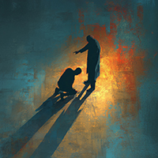
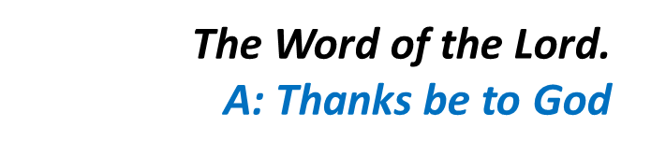
commandments, and do not bear your neighbour ill-will; remember the covenant of the Most High, and overlook the offence.

Slide 15
Responsorial Psalm (Ps 102:1-4. 9-12. R. v.8)
(R.) The Lord is kind and merciful;
slow to anger and rich in compassion.
1. My soul, give thanks to the Lord, all my being, bless his holy name. My soul, give thanks to the Lord and never forget all his blessings. (R.)
2. It is he who forgives all your guilt, who heals every one of your ills, who redeems your life from the grave, who crowns you with love and compassion. (R.)

Slide 16
(R.) The Lord is kind and merciful;
slow to anger and rich in compassion.
3. His wrath will come to an end; he will not be angry for ever. He does not treat us according to our sins nor repay us according to our faults. (R.)
4. For as the heavens are high above the earth so strong is his love for those who fear him. As far as the east is from the west so far does he remove our sins. (R.)

Slide 17
Second Reading (Romans 14:7-9)
A reading from the letter of St Paul to the Romans
The life and death of each of us has its influence on others; if we live, we live for the Lord; and if we die, we die for the Lord, so that alive or dead we belong to the Lord. This explains why Christ both died and came to

Slide 18
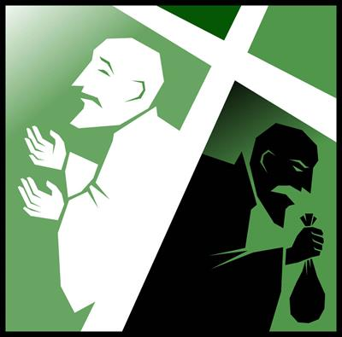
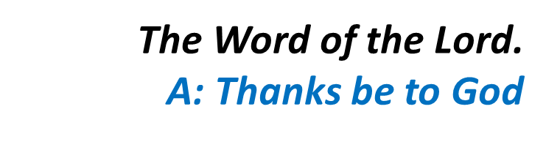
life, it was so that he might be Lord both of the dead and of the living.

Slide 19
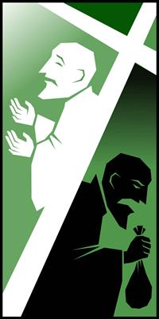
Gospel Acclamation
Alleluia, alleluia!
I give you a new commandment:
love one another as I have loved you.
Alleluia!

Slide 20
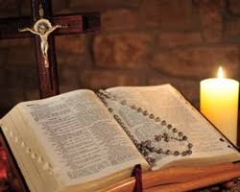
C: The Lord be with you.
A: And with your spirit
C: A reading from the holy Gospel according to Matthew
A: Glory to you Lord

Slide 21
Gospel (Matthew 18:21-35)
Peter went up to Jesus and said, ‘Lord, how often must I forgive my brother if he wrongs me? As often as seven times?’ Jesus answered, ‘Not seven, I tell you, but seventy-seven times. ‘And so the kingdom of heaven may be compared to a king who decided to settle his accounts with his servants. When

Slide 22
the reckoning began, they brought him a man who owed ten thousand talents; but he had no means of paying, so his master gave orders that he should be sold, together with his wife and children and all his possessions, to meet the debt. At this, the servant threw himself down at his master’s feet. “Give me time,” he said “and I will pay the whole sum.” And the servant’s master felt so sorry

Slide 23
for him that he let him go and cancelled the debt. Now as this servant went out, he happened to meet a fellow servant who owed him one hundred denarii; and he seized him by the throat and began to throttle him. “Pay what you owe me”, he said. His fellow servant fell at his feet and implored him, saying, “Give me time and I will pay you.” But the other would not agree;

Slide 24
on the contrary, he had him thrown into prison till he should pay the debt. His fellow servants were deeply distressed when they saw what had happened, and they went to their master and reported the whole affair to him. Then the master sent for him. “You wicked servant,” he said. “I cancelled all that debt of yours when you appealed to me.

Slide 25

Were you not bound, then, to have pity on your fellow servant just as I had pity on you?” And in his anger the master handed him over to the torturers till he should pay all his debt. And that is how my heavenly Father will deal with you unless you each forgive your brother from your heart.’

Slide 26
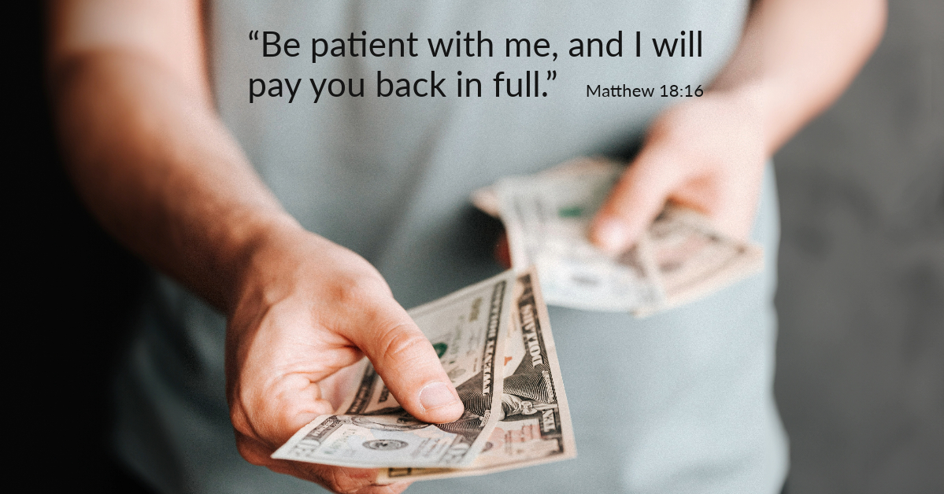

Slide 27
Nicene Creed
I believe in one God, the Father almighty, maker of heaven and earth, of all things visible and invisible. I believe in one Lord, Jesus Christ, the Only Begotten Son of God, born of the Father before all ages. God from God, Light from Light, true God from true God, begotten, not made, consubstantial with the Father; through Him all things were made.

Slide 28
For us men and for our salvation. He came down from heaven, and by the Holy Spirit was incarnate of the Virgin Mary, and became man.
For our sake He was crucified under Pontius Pilate, He suffered death and was buried, and rose again on the third day in accordance with the Scriptures. He ascended into heaven and is seated at the right hand of the Father. He will come again in glory to judge the living and the dead, and His Kingdom will have no end.

Slide 29
I believe in the Holy Spirit, the Lord, the giver of life, who proceeds from the Father and the Son, who with the Father and the Son is adored and glorified, who has spoken through the prophets.
I believe in one, Holy, Catholic and Apostolic Church. I confess one Baptism for the forgiveness of sins and I look forward to the resurrection of the dead, and the life of the world to come. Amen.

Slide 30
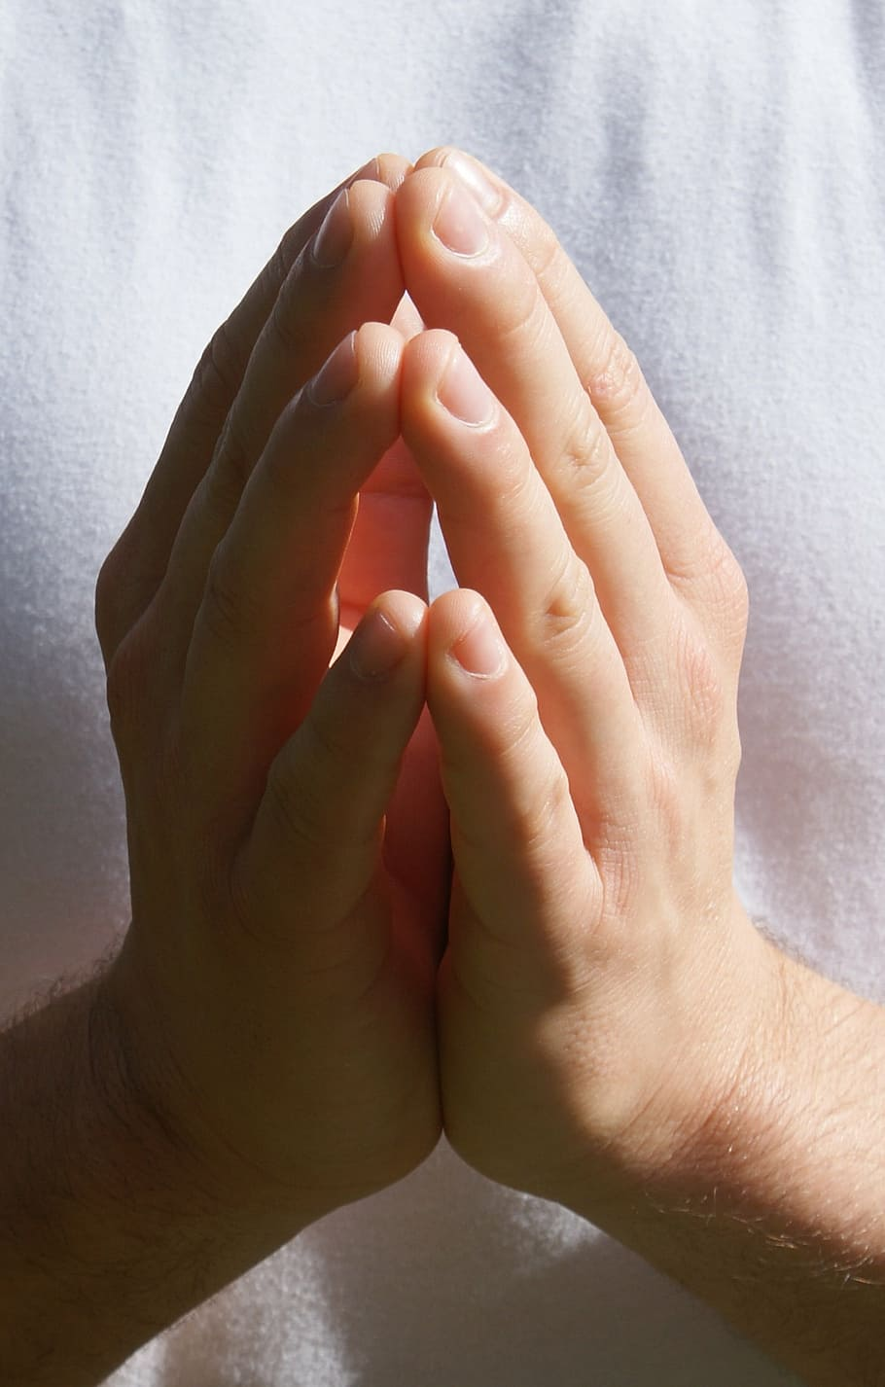
Reader: We pray for…
Let us pray to the Lord.
People: Lord hear our prayer.

Slide 31
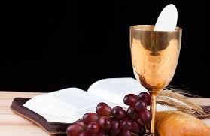

Slide 32
OFFERTORY SONGS

Slide 33
The Liturgy of the Eucharist
C: Pray, brethren that my sacrifice and yours may be acceptable to God, the almighty Father.
A: May the Lord accept the sacrifice at your hands for the praise and glory of his name, for our good the good of all his holy Church.

Slide 34
The Eucharistic Prayer
C: The Lord be with you.
A: And with your spirit.
C: Lift up your hearts.
A: We lift them up to the Lord.
C: Let us give thanks to the Lord our God.
A: It is right and just.

Slide 35
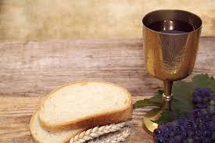

Slide 36

SANCTUS
Holy, holy, holy Lord God of hosts.
Heaven and earth are full of your glory
Hosanna in the highest,
blessed is he who comes in the name of the Lord
Hosanna in the highest…

Slide 37
MYSTERY OF FAITH
We proclaim your death O Lord
And profess your resurrection
Until you come again…

Slide 38
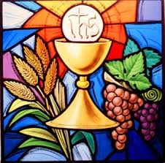

Slide 39

1 of 2
LORD’S PRAYER
Our Father, who art in heaven hallowed be Thy name. Thy Kingdom come, Thy will be done, on earth as it is in Heaven.
Give us this day our daily bread. And forgive us our trespasses, as we forgive those who trespass against us. And lead us not into temptation, but deliver us from evil.

Slide 40
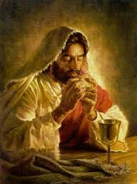
2 of 2
For thy Kingdom, the Power and the Glory are Yours
Now and forever.

Slide 41
C: Lord Jesus Christ, who said to your Apostles…..
….Who live and reign for ever and ever
A: Amen
C: The peace of the Lord be with you always.
A: And with your spirit.

Slide 42
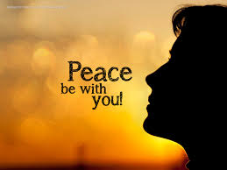

Slide 43
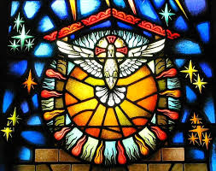
Lamb of God
Lamb of God, you take away the sins of the world, Have mercy on us.
Lamb of God, you take away the sins of the world, Have mercy on us.
Lamb of God, you take away the sins of the world,Grant us peace…

Slide 44
C: Behold the Lamb of God, behold him who takes away the sins of the world. Blessed are those called to the supper of the lamb.
A: Lord, I am not worthy that you should enter under my roof, but only say the word and my soul shall be healed.

Slide 45
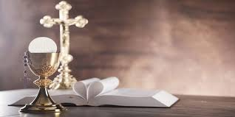

Slide 46
COMMUNION SONGS

Slide 47
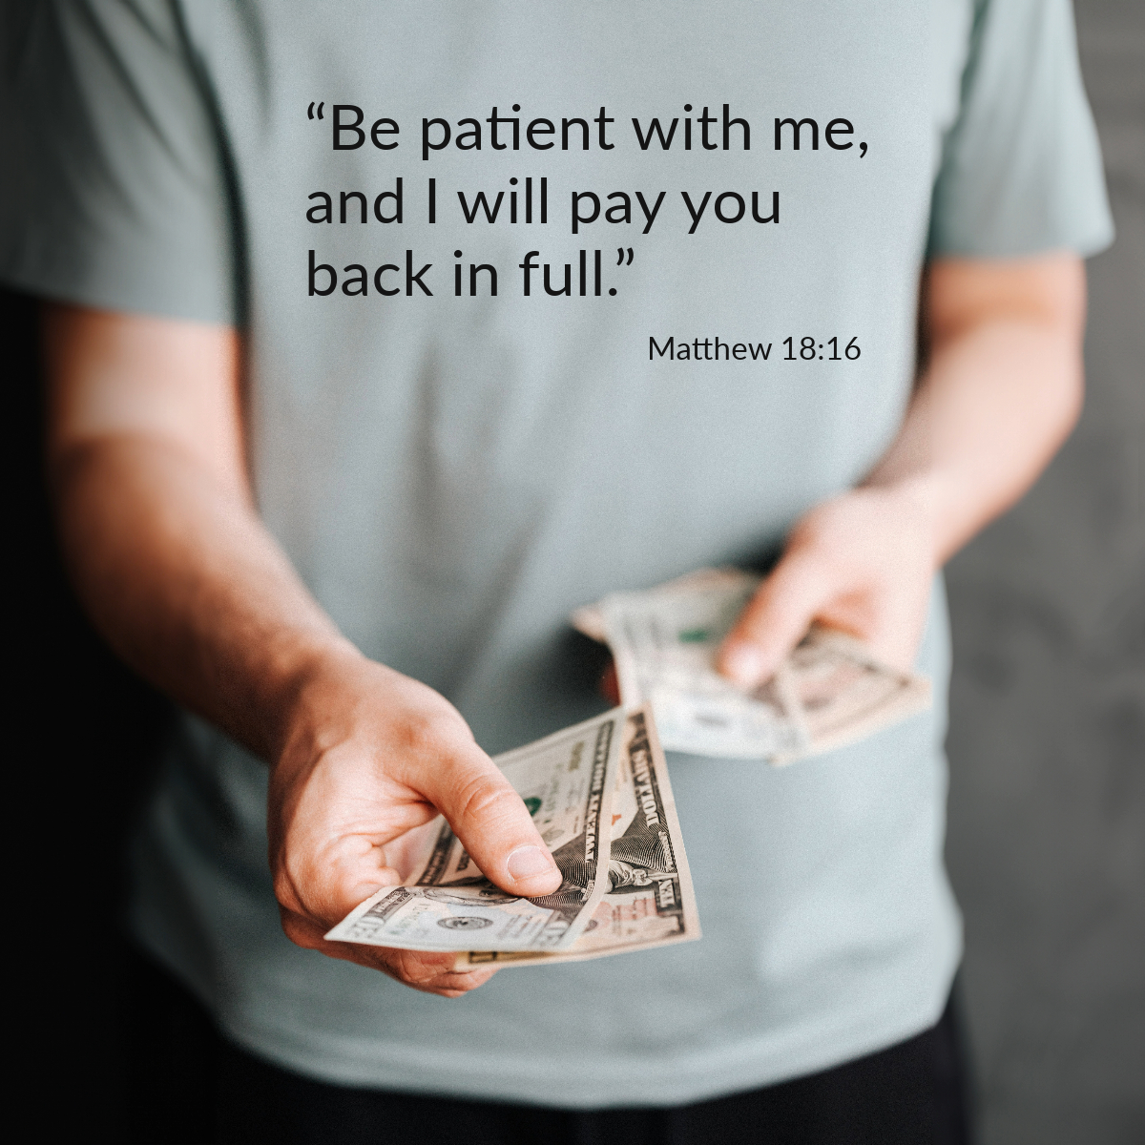

Slide 48
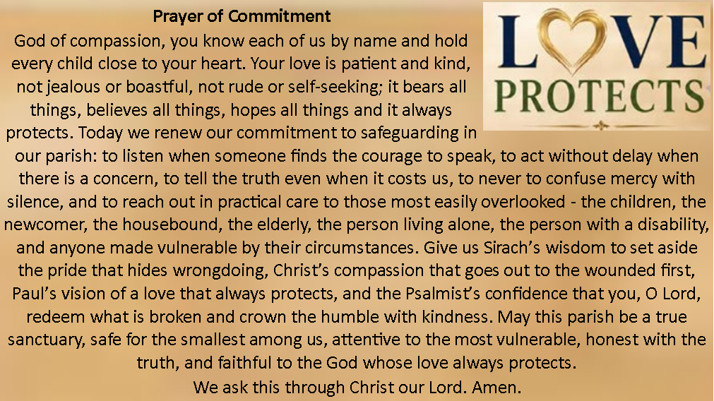

Slide 49
CONCLUDING RITES
C: The Lord be with you.
A : And with your spirit
C: May Almighty God Bless Us, Father and Son and Holy Spirit
A: Amen.
C: Go in Peace, glorifying the Lord by your life.
A: Thanks Be to God

Slide 50
FINAL SONGS

