Slide 1
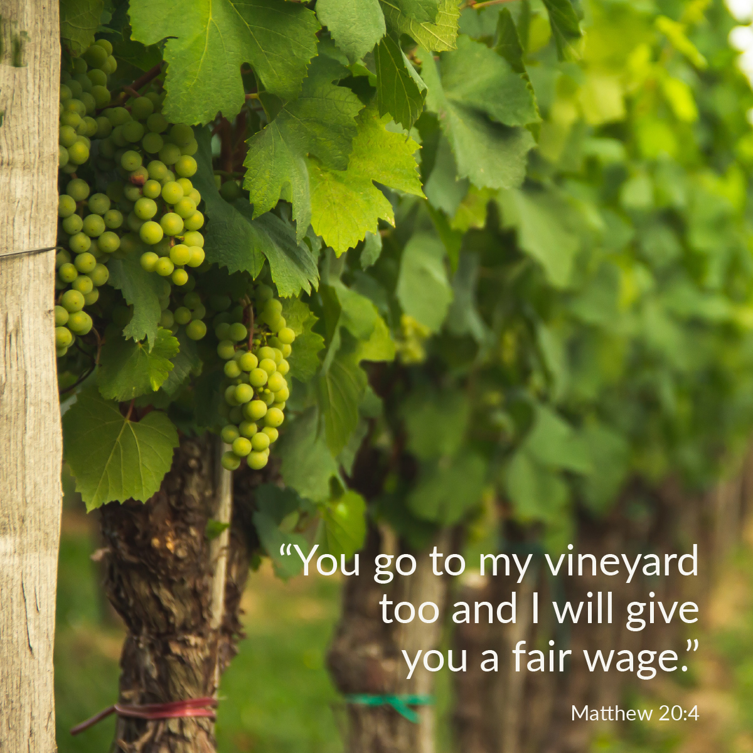

Welcome to St. Luke’s Church Lalor Parish
25th Sunday in Ordinary Time,
20 September 2026

Slide 2
ENTRANCE SONGS

Slide 3
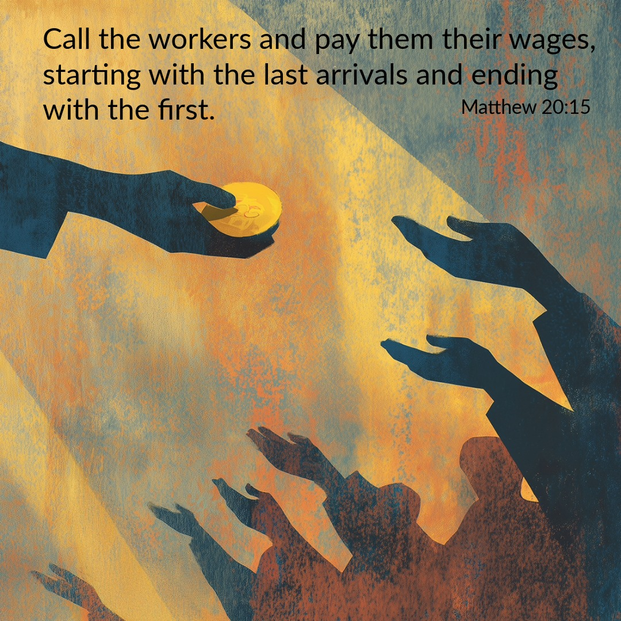

Slide 4
C: In the name of the Father, and of the Son and of the Holy Spirit.
A: Amen
C: The grace of our Lord Jesus Christ, and the love of God, and the communion of the Holy Spirit be with you all.
A: And with your Spirit

Slide 5
1 of 2
PENITENTIAL ACT
I confess to Almighty God, And to you, my brothers and sisters, That I have greatly sinned, in my thoughts and in my words, In what I have done and in what have failed to do. Through my fault, through my fault, Through my most grievous fault;

Slide 6
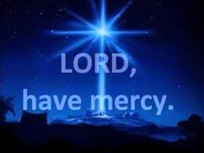
2 of 2
Therefore I ask blessed Mary ever-Virgin, All the Angels and Saints, And you, my brothers and sisters, To pray for me to the Lord our God.

Slide 7

C- Lord have mercy
A- Lord have mercy
C - Christ have mercy
A - Christ have mercy
C- Lord have mercy
A- Lord have mercy

Slide 8

1 of 3
GLORY TO GOD
Glory to God in the highest
And on earth peace to people of good will
We praise You, we bless You, We adore You, we glorify You, We give You thanks for Your great glory. Lord God heavenly King, O God almighty Father.

Slide 9
2 of 3
Lord Jesus Christ, Only Begotten Son. Lord God, Lamb of God, Son of the Father, you take away the sins of the world, Have mercy on us; you take away the sins of the world, receive our prayer; You are seated at the right hand of the Father, Have mercy on us.

Slide 10

3 of 3
For You alone are the Holy One,
You alone are the Lord,
You alone are the Most High, Jesus Christ,
with the Holy Spirit, in the glory of God the Father. Amen….

Slide 11
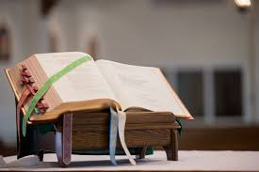

Slide 12
Liturgy of the Word
First Reading (Isaiah 55:6-9)
A reading from the prophet Isaiah
Seek the Lord while he is still to be found, call to him while he is still near. Let the wicked man abandon his way, the evil man his thoughts. Let him turn back to the Lord who will take pity on him, to our God who is rich in forgiving; for my thoughts are not

Slide 13
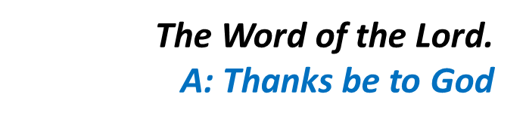
your thoughts, my ways not your ways – it is the Lord who speaks. Yes, the heavens are as high above earth as my ways are above your ways, my thoughts above your thoughts.

Slide 14
Responsorial Psalm (Ps 144:2-3. 8-9. 17-18. R. v.18)
(R.) The Lord is near to all who call him.
1. I will bless you day after day and praise your name for ever. the Lord is great, highly to be praised, his greatness cannot be measured. (R.)
2. The Lord is kind and full of compassion, slow to anger, abounding in love. How good is the Lord to all, compassionate to all his creatures. (R.)
3. The Lord is just in all his ways and loving in all his deeds. He is close to all who call him, who call on him from their hearts. (R.)

Slide 15
Second Reading (Philippians 1:20-24. 27)
A reading from the letter of St Paul to the Philippians
Christ will be glorified in my body, whether by my life or by my death. Life to me, of course, is Christ, but then death would bring me something more; but then again, if living in this body means doing work which is

Slide 16
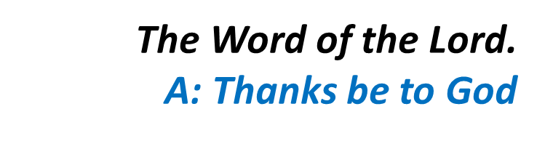
having good results – I do not know what I should choose. I am caught in this dilemma: I want to be gone and be with Christ, which would be very much the better, but for me to stay alive in this body is a more urgent need for your sake. Avoid anything in your everyday lives that would be unworthy of the gospel of Christ.

Slide 17
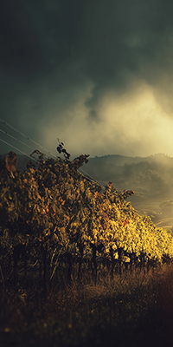
Gospel Acclamation
Alleluia, alleluia!
Open our hearts, O Lord,
to listen to the words of your Son.
Alleluia!

Slide 18
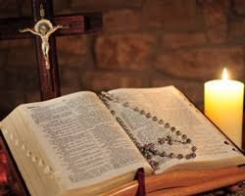
C: The Lord be with you.
A: And with your spirit
C: A reading from the holy Gospel according to Matthew
A: Glory to you Lord

Slide 19
Gospel (Matthew 20:1-16)
Jesus said to his disciples: ‘The kingdom of heaven is like a landowner going out at daybreak to hire workers for his vineyard. He made an agreement with the workers for one denarius a day, and sent them to his vineyard. Going out at about the third hour he saw others standing idle in the market place and said to them, “You go to my

Slide 20
vineyard too and I will give you a fair wage.” So they went. At about the sixth hour and again at about the ninth hour, he went out and did the same. Then at about the eleventh hour he went out and found more men standing round, and he said to them, “Why have you been standing here idle all day?” “Because no one has hired us” they answered. He said to them, “You go into my

Slide 21
vineyard too.” In the evening, the owner of the vineyard said to his bailiff, “Call the workers and pay them their wages, starting with the last arrivals and ending with the first.” So those who were hired at about the eleventh hour came forward and received one denarius each. When the first came, they expected to get more, but they too received one denarius each. They took it, but

Slide 22
grumbled at the landowner. “The men who came last” they said “have done only one hour, and you have treated them the same as us, though we have done a heavy day’s work in all the heat.” He answered one of them and said, “My friend, I am not being unjust to you; did we not agree on one denarius? Take your earnings and go. I choose to pay the last-comer as much as I pay you. Have I

Slide 23

no right to do what I like with my own? Why be envious because I am generous?” Thus the last will be first, and the first, last.’

Slide 24
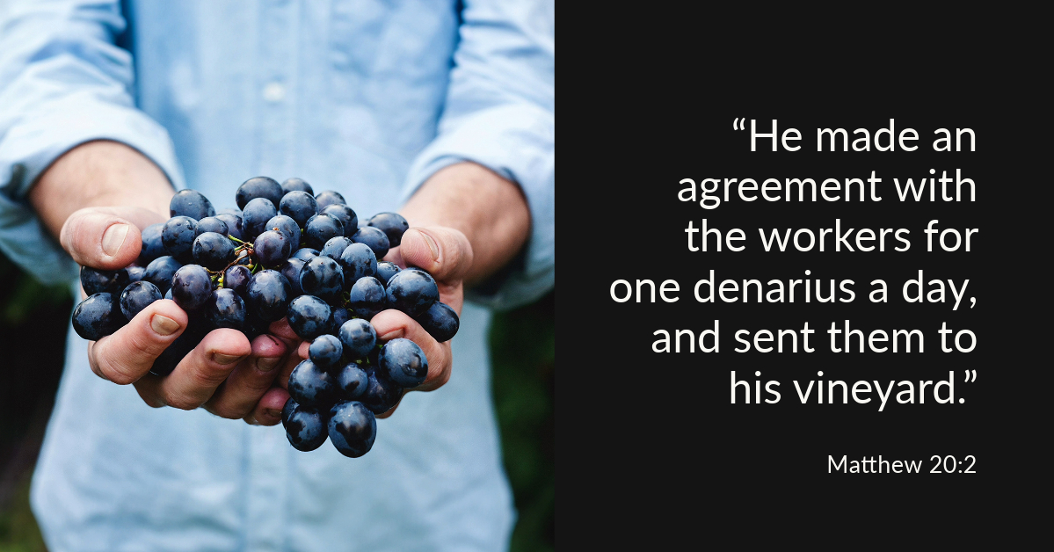

Slide 25
Nicene Creed
I believe in one God, the Father almighty, maker of heaven and earth, of all things visible and invisible. I believe in one Lord, Jesus Christ, the Only Begotten Son of God, born of the Father before all ages. God from God, Light from Light, true God from true God, begotten, not made, consubstantial with the Father; through Him all things were made.

Slide 26
For us men and for our salvation. He came down from heaven, and by the Holy Spirit was incarnate of the Virgin Mary, and became man.
For our sake He was crucified under Pontius Pilate, He suffered death and was buried, and rose again on the third day in accordance with the Scriptures. He ascended into heaven and is seated at the right hand of the Father. He will come again in glory to judge the living and the dead, and His Kingdom will have no end.

Slide 27
I believe in the Holy Spirit, the Lord, the giver of life, who proceeds from the Father and the Son, who with the Father and the Son is adored and glorified, who has spoken through the prophets.
I believe in one, Holy, Catholic and Apostolic Church. I confess one Baptism for the forgiveness of sins and I look forward to the resurrection of the dead, and the life of the world to come. Amen.

Slide 28
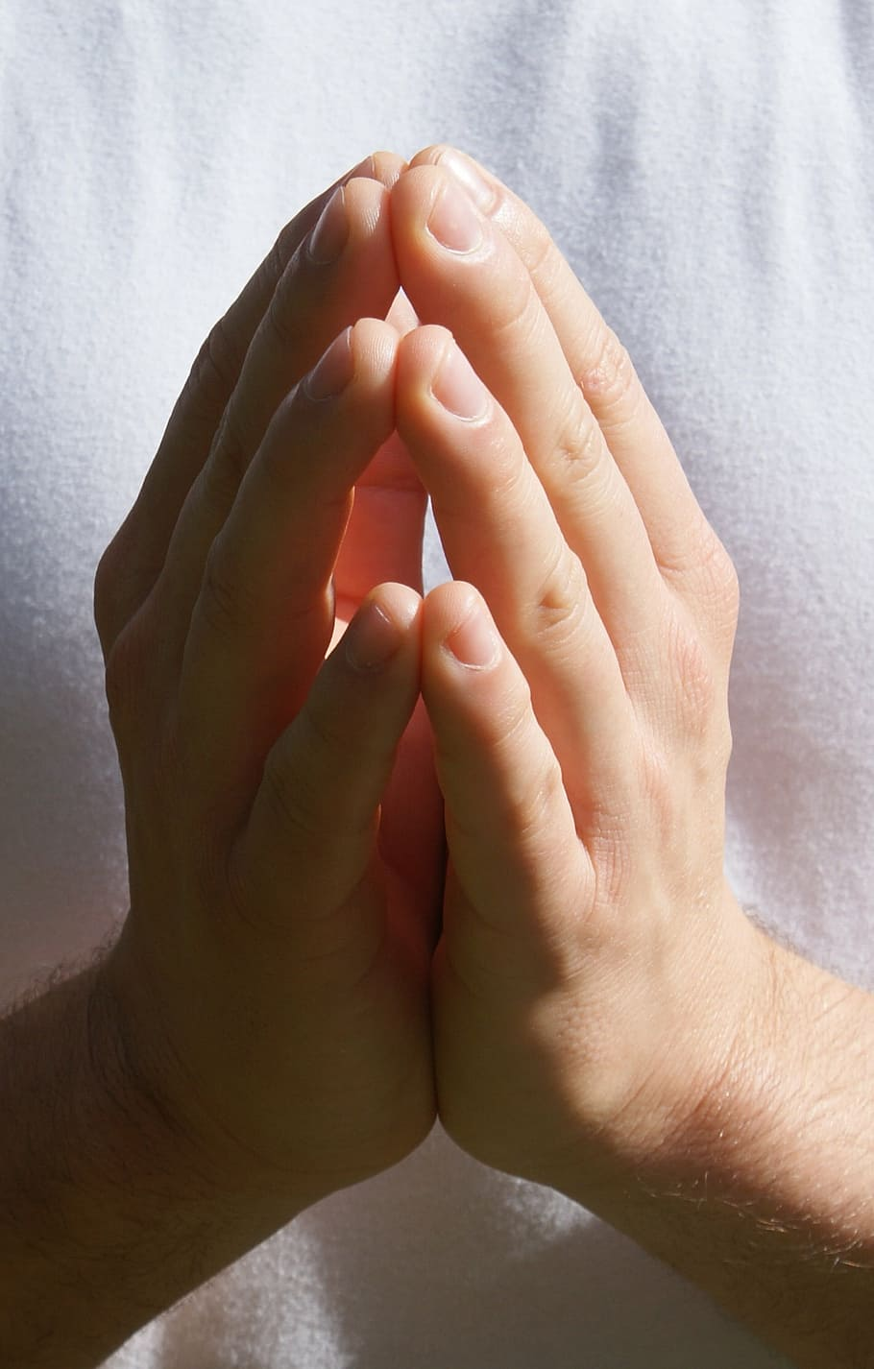
Reader: We pray for…
Let us pray to the Lord.
People: Lord hear our prayer.

Slide 29
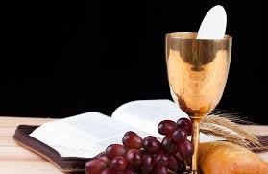

Slide 30
OFFERTORY SONGS

Slide 31
The Liturgy of the Eucharist
C: Pray, brethren that my sacrifice and yours may be acceptable to God, the almighty Father.
A: May the Lord accept the sacrifice at your hands for the praise and glory of his name, for our good the good of all his holy Church.

Slide 32
The Eucharistic Prayer
C: The Lord be with you.
A: And with your spirit.
C: Lift up your hearts.
A: We lift them up to the Lord.
C: Let us give thanks to the Lord our God.
A: It is right and just.

Slide 33
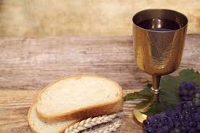

Slide 34

SANCTUS
Holy, holy, holy Lord God of hosts.
Heaven and earth are full of your glory
Hosanna in the highest,
blessed is he who comes in the name of the Lord
Hosanna in the highest…

Slide 35
MYSTERY OF FAITH
We proclaim your death O Lord
And profess your resurrection
Until you come again…

Slide 36
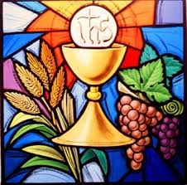

Slide 37

1 of 2
LORD’S PRAYER
Our Father, who art in heaven hallowed be Thy name. Thy Kingdom come, Thy will be done, on earth as it is in Heaven.
Give us this day our daily bread. And forgive us our trespasses, as we forgive those who trespass against us. And lead us not into temptation, but deliver us from evil.

Slide 38
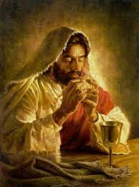
2 of 2
For thy Kingdom, the Power and the Glory are Yours
Now and forever.

Slide 39
C: Lord Jesus Christ, who said to your Apostles…..
….Who live and reign for ever and ever
A: Amen
C: The peace of the Lord be with you always.
A: And with your spirit.

Slide 40


Slide 41
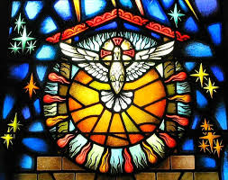
Lamb of God
Lamb of God, you take away the sins of the world, Have mercy on us.
Lamb of God, you take away the sins of the world, Have mercy on us.
Lamb of God, you take away the sins of the world,Grant us peace…

Slide 42
C: Behold the Lamb of God, behold him who takes away the sins of the world. Blessed are those called to the supper of the lamb.
A: Lord, I am not worthy that you should enter under my roof, but only say the word and my soul shall be healed.

Slide 43
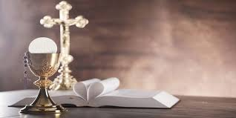

Slide 44
COMMUNION SONGS

Slide 45
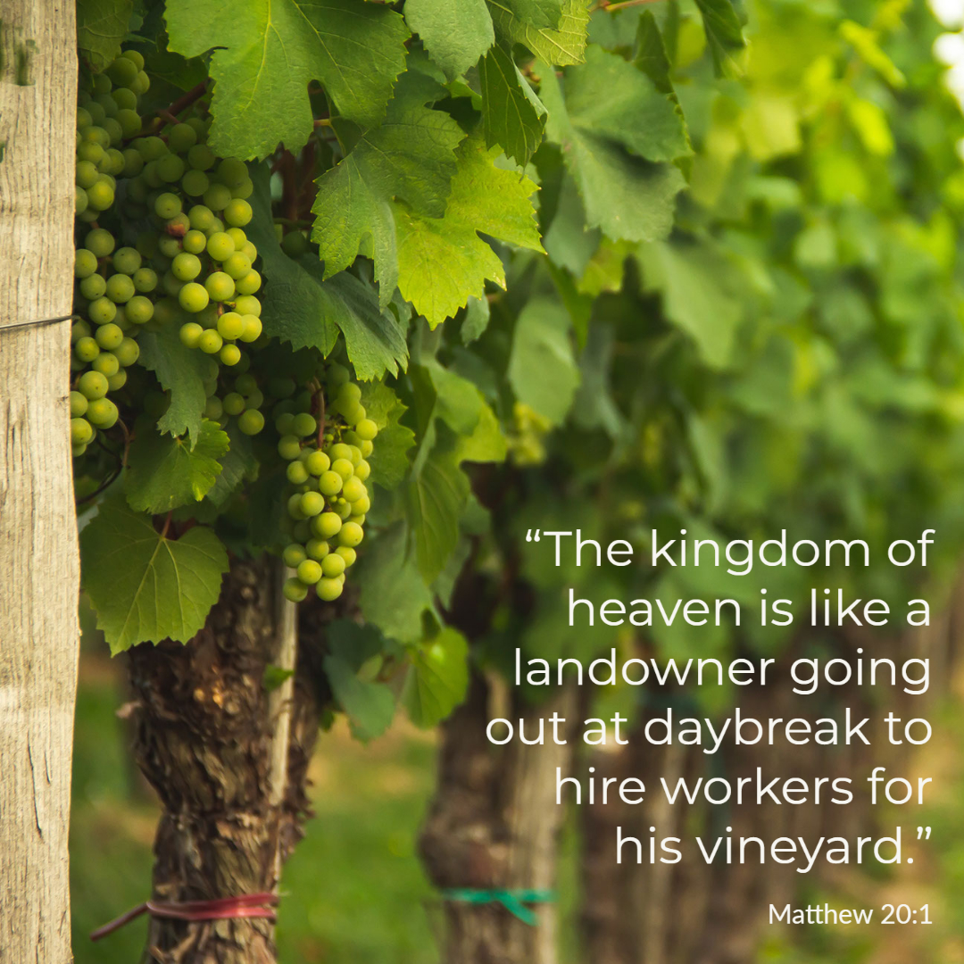

Slide 46
CONCLUDING RITES
C: The Lord be with you.
A : And with your spirit
C: May Almighty God Bless Us, Father and Son and Holy Spirit
A: Amen.
C: Go in Peace, glorifying the Lord by your life.
A: Thanks Be to God

Slide 47
FINAL SONGS

