Slide 1
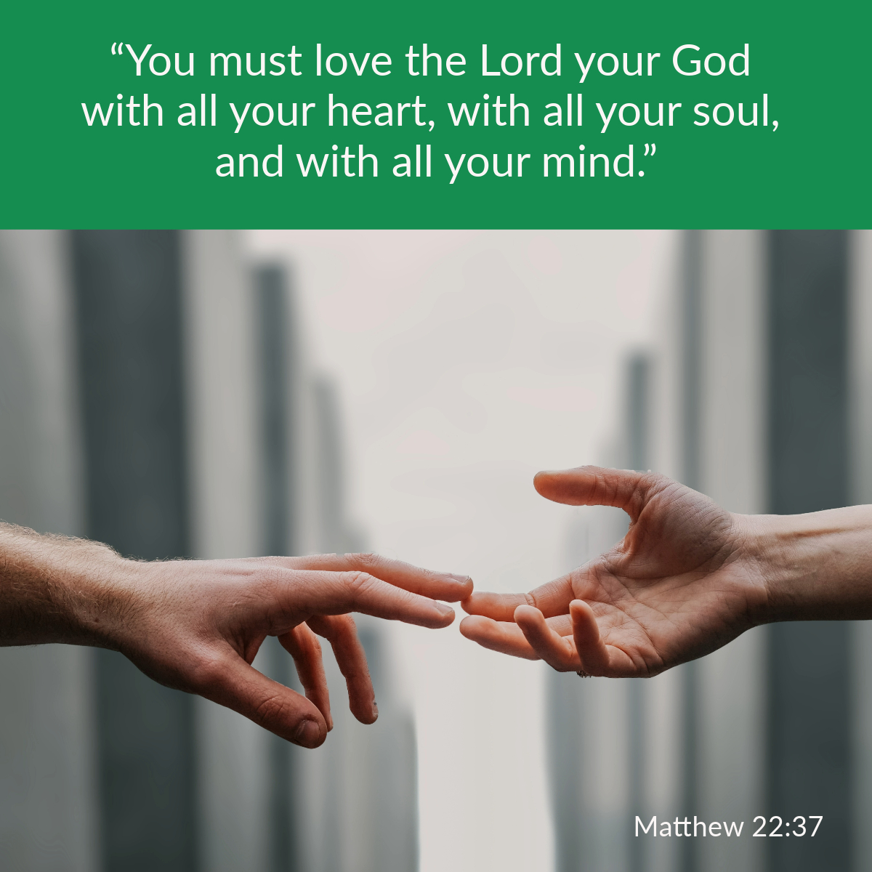

Welcome to St. Luke’s Church Lalor Parish 30th Sunday in Ordinary Time,
25 October 2026

Slide 2
ENTRANCE SONGS

Slide 3
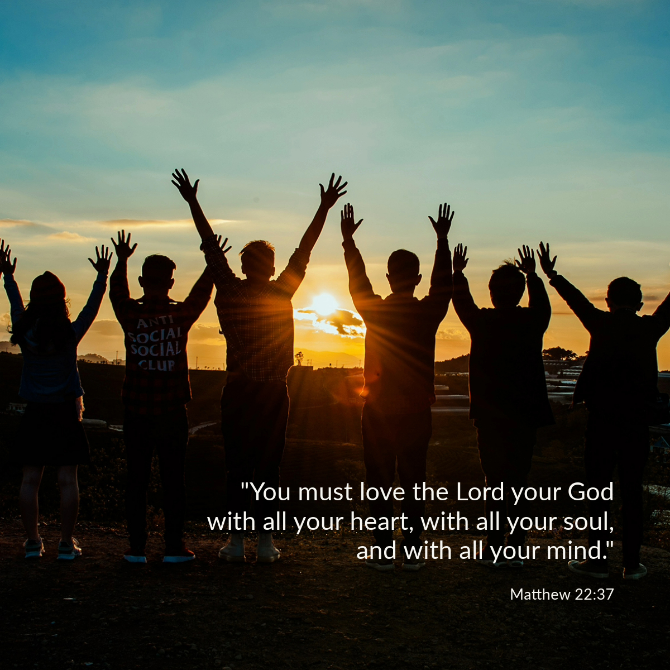

Slide 4
C: In the name of the Father, and of the Son and of the Holy Spirit.
A: Amen
C: The grace of our Lord Jesus Christ, and the love of God, and the communion of the Holy Spirit be with you all.
A: And with your Spirit

Slide 5
1 of 2
PENITENTIAL ACT
I confess to Almighty God, And to you, my brothers and sisters, That I have greatly sinned, in my thoughts and in my words, In what I have done and in what have failed to do. Through my fault, through my fault, Through my most grievous fault;

Slide 6
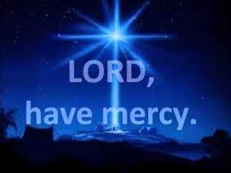
2 of 2
Therefore I ask blessed Mary ever-Virgin, All the Angels and Saints, And you, my brothers and sisters, To pray for me to the Lord our God.

Slide 7

C- Lord have mercy
A- Lord have mercy
C - Christ have mercy
A - Christ have mercy
C- Lord have mercy
A- Lord have mercy

Slide 8

1 of 3
GLORY TO GOD
Glory to God in the highest
And on earth peace to people of good will
We praise You, we bless You, We adore You, we glorify You, We give You thanks for Your great glory. Lord God heavenly King, O God almighty Father.

Slide 9
2 of 3
Lord Jesus Christ, Only Begotten Son. Lord God, Lamb of God, Son of the Father, you take away the sins of the world, Have mercy on us; you take away the sins of the world, receive our prayer; You are seated at the right hand of the Father, Have mercy on us.

Slide 10

3 of 3
For You alone are the Holy One,
You alone are the Lord,
You alone are the Most High, Jesus Christ,
with the Holy Spirit, in the glory of God the Father. Amen….

Slide 11
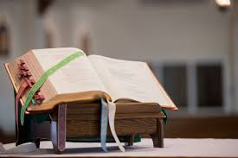

Slide 12
Liturgy of the Word
First Reading (Exodus 22:20-26)
A reading from the book of Exodus
The Lord said to Moses, ‘Tell the sons of Israel this, “You must not molest the stranger or oppress him, for you lived as strangers in the land of Egypt. You must not be harsh with the widow, or with the orphan; if you are harsh with them, they will surely cry out

Slide 13
to me, and be sure I shall hear their cry; my anger will flare and I shall kill you with the sword, your own wives will be widows, your own children orphans. “If you lend money to any of my people, to any poor man among you, you must not play the usurer with him: you must not demand interest from him. “If you take another’s cloak as a pledge, you must give it back to him before sunset. It is

Slide 14
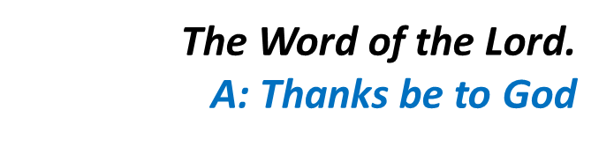
all the covering he has; it is the cloak he wraps his body in; what else would he sleep in? If he cries to me, I will listen, for I am full of pity.”’

Slide 15
Responsorial Psalm (Ps 17:2-4. 47. 51. R. v.2)
(R.) I love you, Lord, my strength.
1. I love you, Lord, my strength, my rock, my fortress, my saviour. My God is the rock where I take refuge; my shield, my mighty help, my stronghold. The Lord is worthy of all praise: when I call I am saved from my foes. (R.)
2. Long life to the Lord, my rock! Praised be the God who saves me. He has given great victories to his king and shown his love for his anointed. (R.)

Slide 16
Second Reading (1 Thessalonians 1:5-10)
A reading from the first letter of St Paul to the Thessalonians
You observed the sort of life we lived when we were with you, which was for your instruction, and you were led to become imitators of us, and of the Lord; and it was with the joy of the Holy Spirit that you took to the gospel, in spite of the great opposition

Slide 17
all round you. This has made you the great example to all believers in Macedonia and Achaia since it was from you that the word of the Lord started to spread – and not only throughout Macedonia and Achaia, for the news of your faith in God has spread everywhere. We do not need to tell other people about it: other people tell us how we started the work among you, how you broke

Slide 18
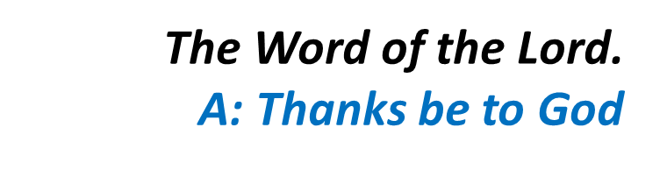
with idolatry when you were converted to God and became servants of the real, living God; and how you are now waiting for Jesus, his Son, whom he raised from the dead, to come from heaven to save us from the retribution which is coming.

Slide 19
Gospel Acclamation
Alleluia, alleluia!
All who love me will keep my words,
and my Father will love them and we will come to them.
Alleluia!

Slide 20
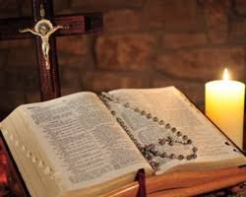
C: The Lord be with you.
A: And with your spirit
C: A reading from the holy Gospel according to Matthew
A: Glory to you Lord

Slide 21
Gospel (Matthew 22:34-40)
A reading from the holy Gospel according to Matthew
When the Pharisees heard that Jesus had silenced the Sadducees they got together and, to disconcert him, one of them put a question, ‘Master, which is the greatest commandment of the law?’ Jesus said, ‘You must love the Lord your God with all your

Slide 22

heart, with all your soul, and with all your mind. This is the greatest and the first commandment. The second resembles it: you must love your neighbour as yourself. On these two commandments hang the whole Law, and the Prophets also.’

Slide 23
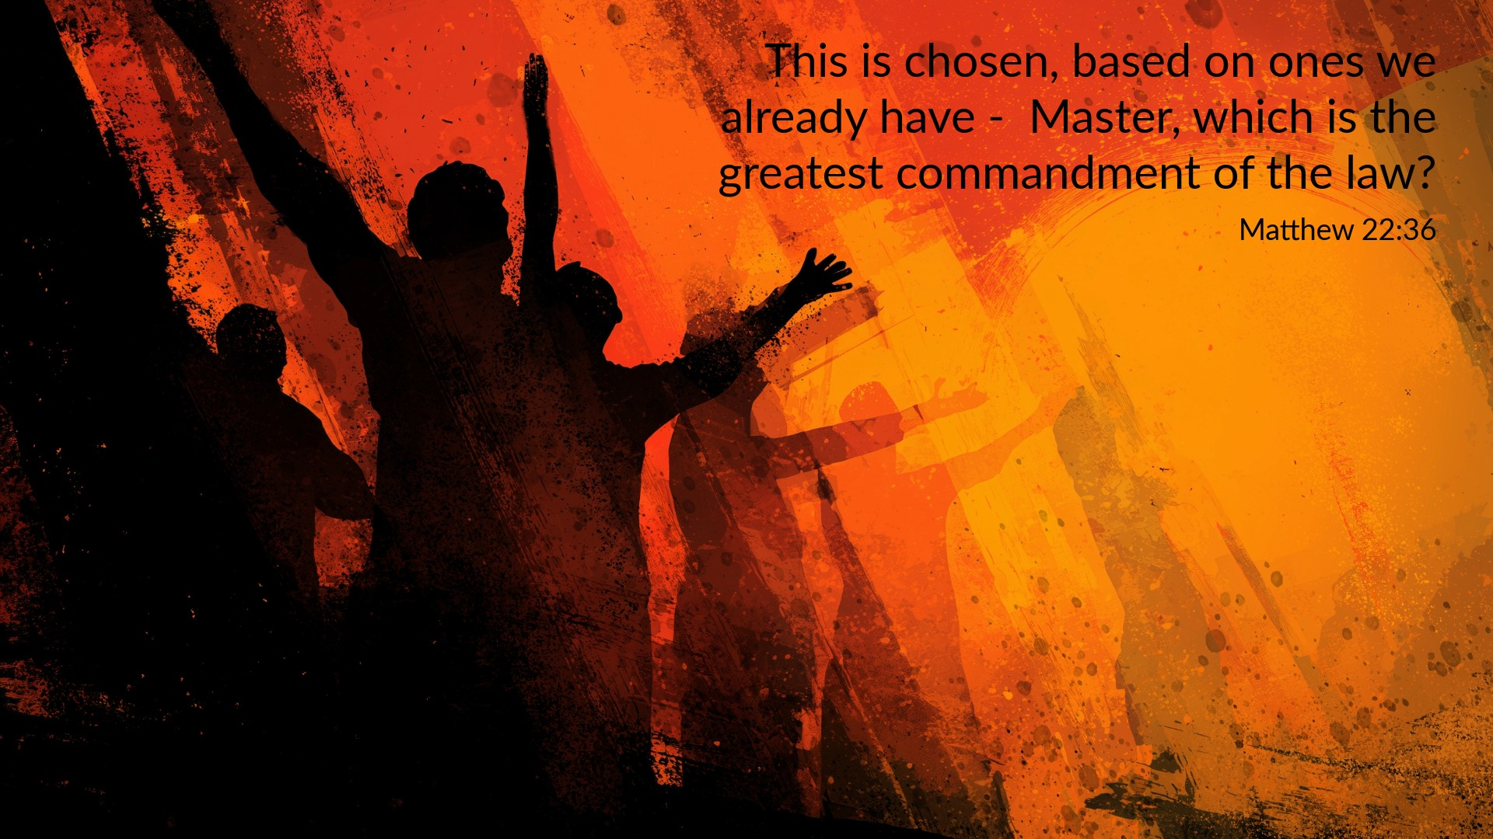

Slide 24
Nicene Creed
I believe in one God, the Father almighty, maker of heaven and earth, of all things visible and invisible. I believe in one Lord, Jesus Christ, the Only Begotten Son of God, born of the Father before all ages. God from God, Light from Light, true God from true God, begotten, not made, consubstantial with the Father; through Him all things were made.

Slide 25
For us men and for our salvation. He came down from heaven, and by the Holy Spirit was incarnate of the Virgin Mary, and became man.
For our sake He was crucified under Pontius Pilate, He suffered death and was buried, and rose again on the third day in accordance with the Scriptures. He ascended into heaven and is seated at the right hand of the Father. He will come again in glory to judge the living and the dead, and His Kingdom will have no end.

Slide 26
I believe in the Holy Spirit, the Lord, the giver of life, who proceeds from the Father and the Son, who with the Father and the Son is adored and glorified, who has spoken through the prophets.
I believe in one, Holy, Catholic and Apostolic Church. I confess one Baptism for the forgiveness of sins and I look forward to the resurrection of the dead, and the life of the world to come. Amen.

Slide 27
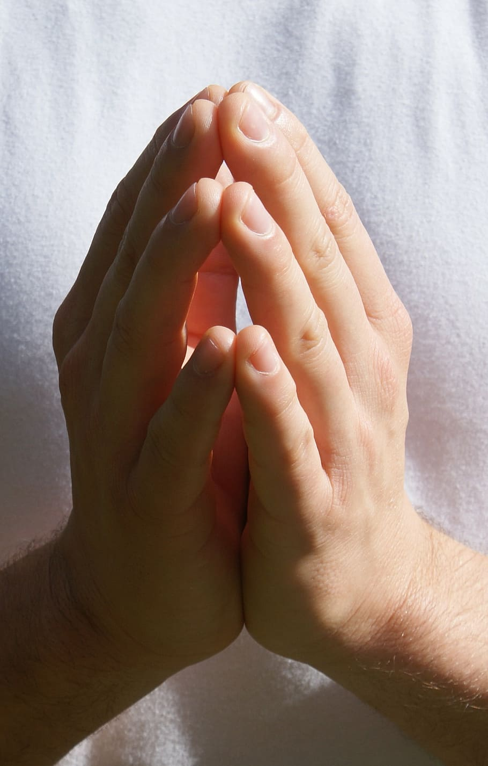
Reader: We pray for…
Let us pray to the Lord.
People: Lord hear our prayer.

Slide 28
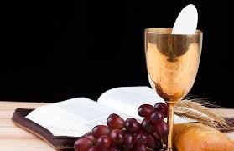

Slide 29
OFFERTORY SONGS

Slide 30
The Liturgy of the Eucharist
C: Pray, brethren that my sacrifice and yours may be acceptable to God, the almighty Father.
A: May the Lord accept the sacrifice at your hands for the praise and glory of his name, for our good the good of all his holy Church.

Slide 31
The Eucharistic Prayer
C: The Lord be with you.
A: And with your spirit.
C: Lift up your hearts.
A: We lift them up to the Lord.
C: Let us give thanks to the Lord our God.
A: It is right and just.

Slide 32
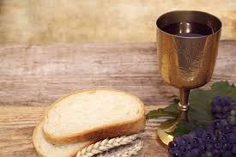

Slide 33

SANCTUS
Holy, holy, holy Lord God of hosts.
Heaven and earth are full of your glory
Hosanna in the highest,
blessed is he who comes in the name of the Lord
Hosanna in the highest…

Slide 34
MYSTERY OF FAITH
We proclaim your death O Lord
And profess your resurrection
Until you come again…

Slide 35
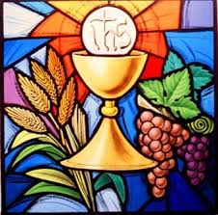

Slide 36

1 of 2
LORD’S PRAYER
Our Father, who art in heaven hallowed be Thy name. Thy Kingdom come, Thy will be done, on earth as it is in Heaven.
Give us this day our daily bread. And forgive us our trespasses, as we forgive those who trespass against us. And lead us not into temptation, but deliver us from evil.

Slide 37
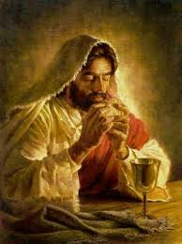
2 of 2
For thy Kingdom, the Power and the Glory are Yours
Now and forever.

Slide 38
C: Lord Jesus Christ, who said to your Apostles…..
….Who live and reign for ever and ever
A: Amen
C: The peace of the Lord be with you always.
A: And with your spirit.

Slide 39


Slide 40
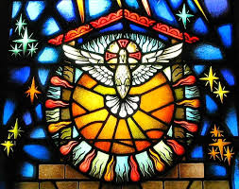
Lamb of God
Lamb of God, you take away the sins of the world, Have mercy on us.
Lamb of God, you take away the sins of the world, Have mercy on us.
Lamb of God, you take away the sins of the world,Grant us peace…

Slide 41
C: Behold the Lamb of God, behold him who takes away the sins of the world. Blessed are those called to the supper of the lamb.
A: Lord, I am not worthy that you should enter under my roof, but only say the word and my soul shall be healed.

Slide 42
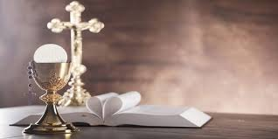

Slide 43
COMMUNION SONGS

Slide 44
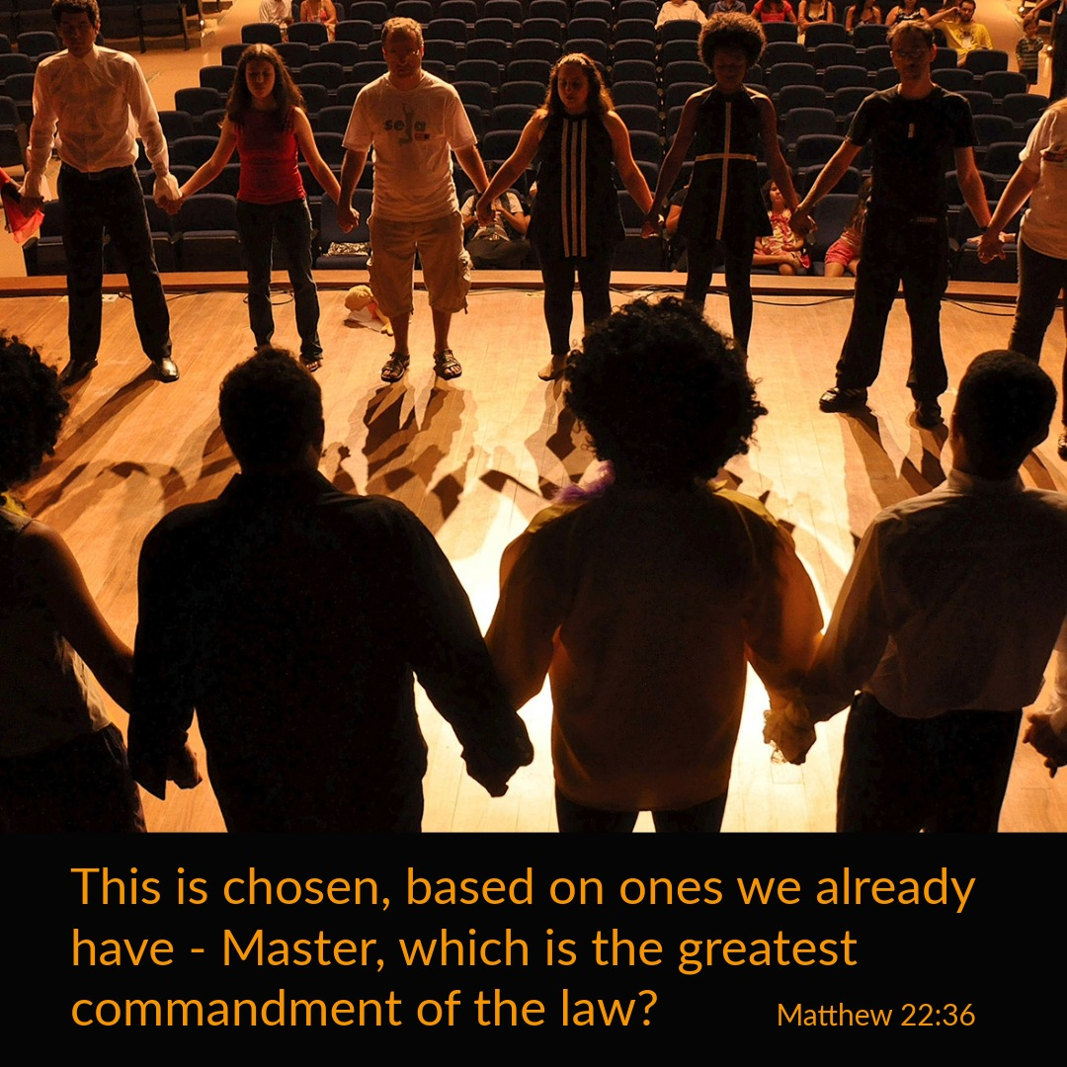

Slide 45
CONCLUDING RITES
C: The Lord be with you.
A : And with your spirit
C: May Almighty God Bless Us, Father and Son and Holy Spirit
A: Amen.
C: Go in Peace, glorifying the Lord by your life.
A: Thanks Be to God

Slide 46
FINAL SONGS

