Slide 1
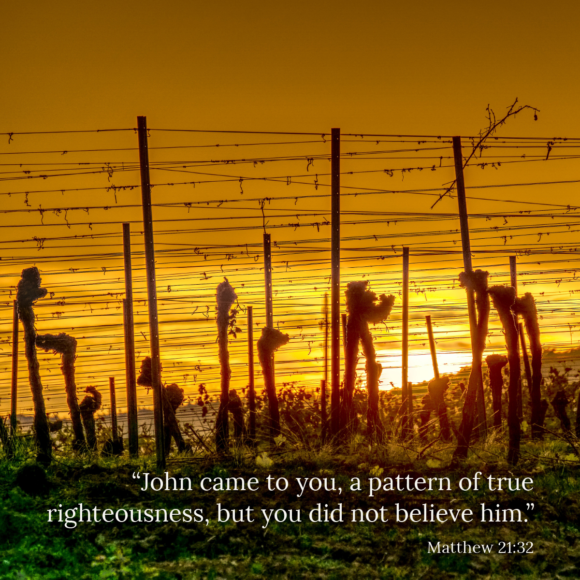

Welcome to St. Luke’s Church Lalor Parish
26th Sunday in Ordinary Time,
27 September 2026

Slide 2
ENTRANCE SONGS

Slide 3
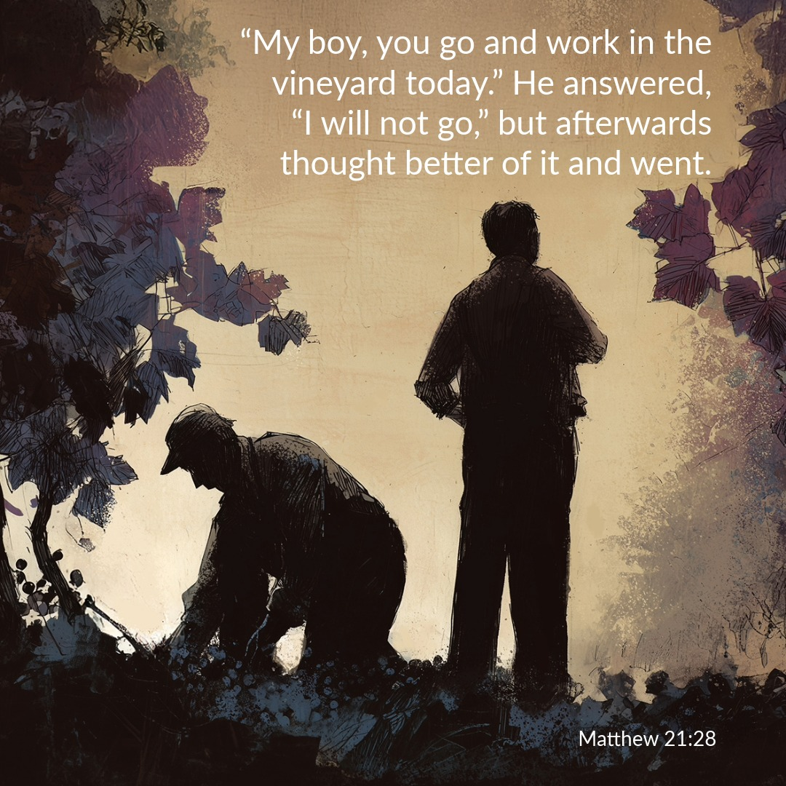

Slide 4
C: In the name of the Father, and of the Son and of the Holy Spirit.
A: Amen
C: The grace of our Lord Jesus Christ, and the love of God, and the communion of the Holy Spirit be with you all.
A: And with your Spirit

Slide 5
1 of 2
PENITENTIAL ACT
I confess to Almighty God, And to you, my brothers and sisters, That I have greatly sinned, in my thoughts and in my words, In what I have done and in what have failed to do. Through my fault, through my fault, Through my most grievous fault;

Slide 6
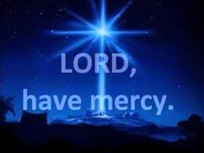
2 of 2
Therefore I ask blessed Mary ever-Virgin, All the Angels and Saints, And you, my brothers and sisters, To pray for me to the Lord our God.

Slide 7
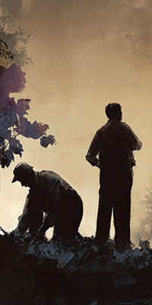
C- Lord have mercy
A- Lord have mercy
C - Christ have mercy
A - Christ have mercy
C- Lord have mercy
A- Lord have mercy

Slide 8

1 of 3
GLORY TO GOD
Glory to God in the highest
And on earth peace to people of good will
We praise You, we bless You, We adore You, we glorify You, We give You thanks for Your great glory. Lord God heavenly King, O God almighty Father.

Slide 9
2 of 3
Lord Jesus Christ, Only Begotten Son. Lord God, Lamb of God, Son of the Father, you take away the sins of the world, Have mercy on us; you take away the sins of the world, receive our prayer; You are seated at the right hand of the Father, Have mercy on us.

Slide 10

3 of 3
For You alone are the Holy One,
You alone are the Lord,
You alone are the Most High, Jesus Christ,
with the Holy Spirit, in the glory of God the Father. Amen….

Slide 11
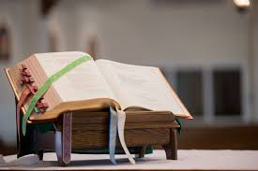

Slide 12
Liturgy of the Word
First Reading (Ezekiel 18:25-28)
A reading from the prophet Ezekiel
The word of the Lord was addressed to me as follows: ‘You object, “What the Lord does is unjust.” Listen, you House of Israel: is what I do unjust? Is it not what you do that is unjust? When the upright man renounces his integrity to commit sin and dies because of

Slide 13
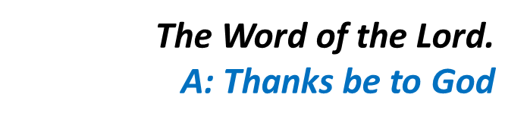
this, he dies because of the evil that he himself has committed. When the sinner renounces sin to become law-abiding and honest, he deserves to live. He has chosen to renounce all his previous sins; he shall certainly live; he shall not die.’

Slide 14
Responsorial Psalm (Ps 24:4-9. R. v.6)
(R.) Remember your mercies, O Lord
Lord, make me know your ways. Lord, teach me your paths. Make me walk in your truth, and teach me: for you are God my saviour. (R.)
2. Remember your mercy, Lord, and the love you have shown from of old. Do not remember the sins of my youth. In your love remember me, because of your goodness, O Lord. (R.)

Slide 15
(R.) Remember your mercies, O Lord
3. The Lord is good and upright. He shows the path to those who stray, he guides the humble in the right path; he teaches his way to the poor. (R.)

Slide 16
Second Reading (Philippians 2:1-5)
A reading from the letter of St Paul to the Philippians
If our life in Christ means anything to you, if love can persuade at all, or the Spirit that we have in common, or any tenderness and sympathy, then be united in your convictions and united in your love, with a common purpose and a common mind. That is the

Slide 17
one thing which would make me completely happy. There must be no competition among you, no conceit; but everybody is to be self-effacing. Always consider the other person to be better than yourself so that nobody thinks of his own interests first but everybody thinks of other people’s interests instead. In your minds you must be the same as Christ Jesus.

Slide 18
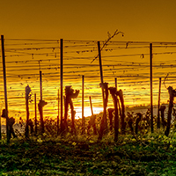
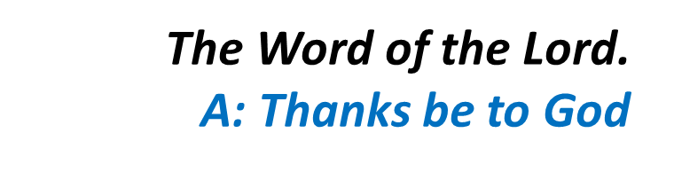

Slide 19
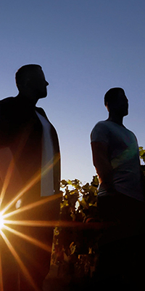
Gospel Acclamation
Alleluia, alleluia!
My sheep listen to my voice, says the Lord; I know them, and they follow me.
Alleluia!

Slide 20
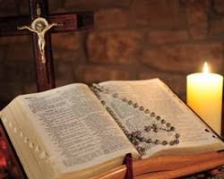
C: The Lord be with you.
A: And with your spirit
C: A reading from the holy Gospel according to Matthew
A: Glory to you Lord

Slide 21
Gospel (Matthew 21:28-32)
Jesus said to the chief priests and the elders of the people, ‘What is your opinion? A man had two sons. He went and said to the first, “My boy, you go and work in the vineyard today.” He answered, “I will not go,” but afterwards thought better of it and went. The man then went and said the same thing to

Slide 22
the second who answered, “Certainly, sir,” but did not go. Which of the two did the father’s will?’ ‘The first’ they said. Jesus said to them, ‘I tell you solemnly, tax collectors and prostitutes are making their way into the kingdom of God before you. For John came to you, a pattern of true righteousness, but you did not believe him, and yet the tax collectors and prostitutes did. Even after

Slide 23

seeing that, you refused to think better of it and believe in him.’

Slide 24
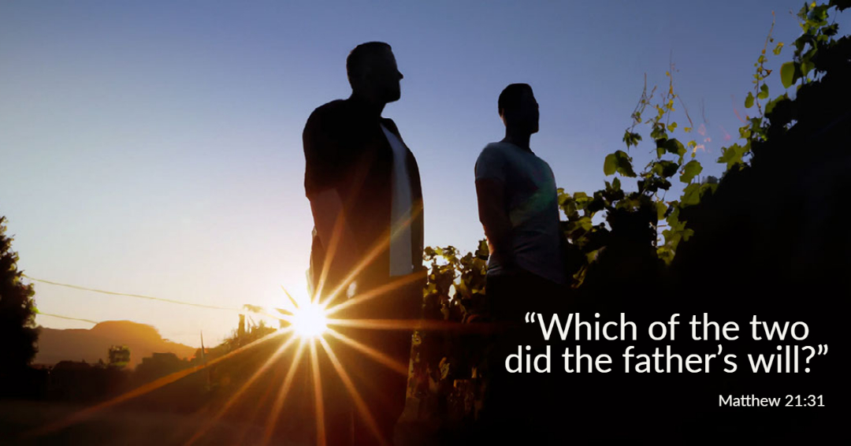

Slide 25
Nicene Creed
I believe in one God, the Father almighty, maker of heaven and earth, of all things visible and invisible. I believe in one Lord, Jesus Christ, the Only Begotten Son of God, born of the Father before all ages. God from God, Light from Light, true God from true God, begotten, not made, consubstantial with the Father; through Him all things were made.

Slide 26
For us men and for our salvation. He came down from heaven, and by the Holy Spirit was incarnate of the Virgin Mary, and became man.
For our sake He was crucified under Pontius Pilate, He suffered death and was buried, and rose again on the third day in accordance with the Scriptures. He ascended into heaven and is seated at the right hand of the Father. He will come again in glory to judge the living and the dead, and His Kingdom will have no end.

Slide 27
I believe in the Holy Spirit, the Lord, the giver of life, who proceeds from the Father and the Son, who with the Father and the Son is adored and glorified, who has spoken through the prophets.
I believe in one, Holy, Catholic and Apostolic Church. I confess one Baptism for the forgiveness of sins and I look forward to the resurrection of the dead, and the life of the world to come. Amen.

Slide 28
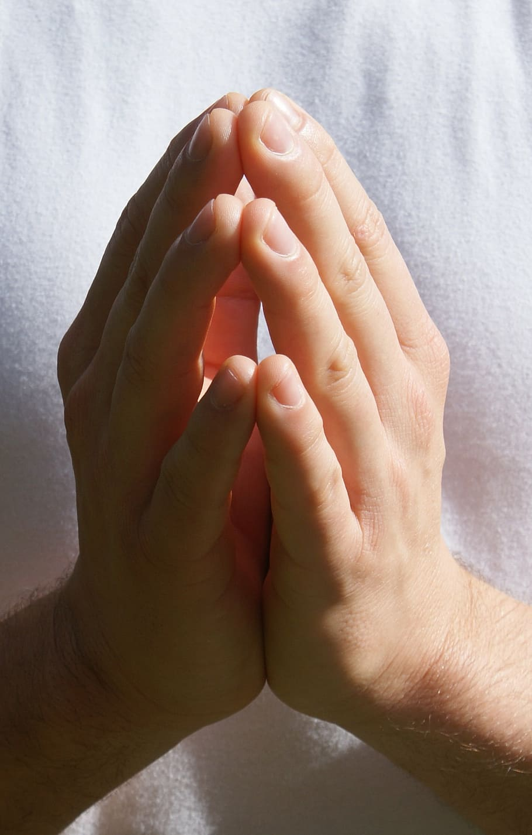
Reader: We pray for…
Let us pray to the Lord.
People: Lord hear our prayer.

Slide 29
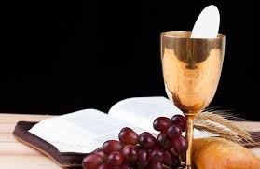

Slide 30
OFFERTORY SONGS

Slide 31
The Liturgy of the Eucharist
C: Pray, brethren that my sacrifice and yours may be acceptable to God, the almighty Father.
A: May the Lord accept the sacrifice at your hands for the praise and glory of his name, for our good the good of all his holy Church.

Slide 32
The Eucharistic Prayer
C: The Lord be with you.
A: And with your spirit.
C: Lift up your hearts.
A: We lift them up to the Lord.
C: Let us give thanks to the Lord our God.
A: It is right and just.

Slide 33
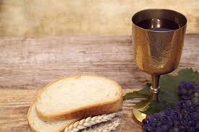

Slide 34

SANCTUS
Holy, holy, holy Lord God of hosts.
Heaven and earth are full of your glory
Hosanna in the highest,
blessed is he who comes in the name of the Lord
Hosanna in the highest…

Slide 35
MYSTERY OF FAITH
We proclaim your death O Lord
And profess your resurrection
Until you come again…

Slide 36
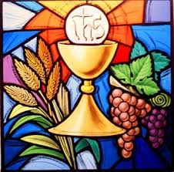

Slide 37

1 of 2
LORD’S PRAYER
Our Father, who art in heaven hallowed be Thy name. Thy Kingdom come, Thy will be done, on earth as it is in Heaven.
Give us this day our daily bread. And forgive us our trespasses, as we forgive those who trespass against us. And lead us not into temptation, but deliver us from evil.

Slide 38
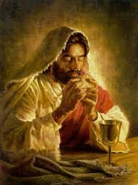
2 of 2
For thy Kingdom, the Power and the Glory are Yours
Now and forever.

Slide 39
C: Lord Jesus Christ, who said to your Apostles…..
….Who live and reign for ever and ever
A: Amen
C: The peace of the Lord be with you always.
A: And with your spirit.

Slide 40
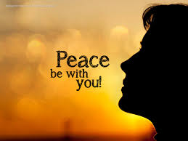

Slide 41
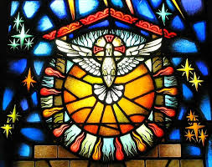
Lamb of God
Lamb of God, you take away the sins of the world, Have mercy on us.
Lamb of God, you take away the sins of the world, Have mercy on us.
Lamb of God, you take away the sins of the world,Grant us peace…

Slide 42
C: Behold the Lamb of God, behold him who takes away the sins of the world. Blessed are those called to the supper of the lamb.
A: Lord, I am not worthy that you should enter under my roof, but only say the word and my soul shall be healed.

Slide 43
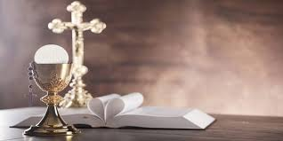

Slide 44
COMMUNION SONGS

Slide 45
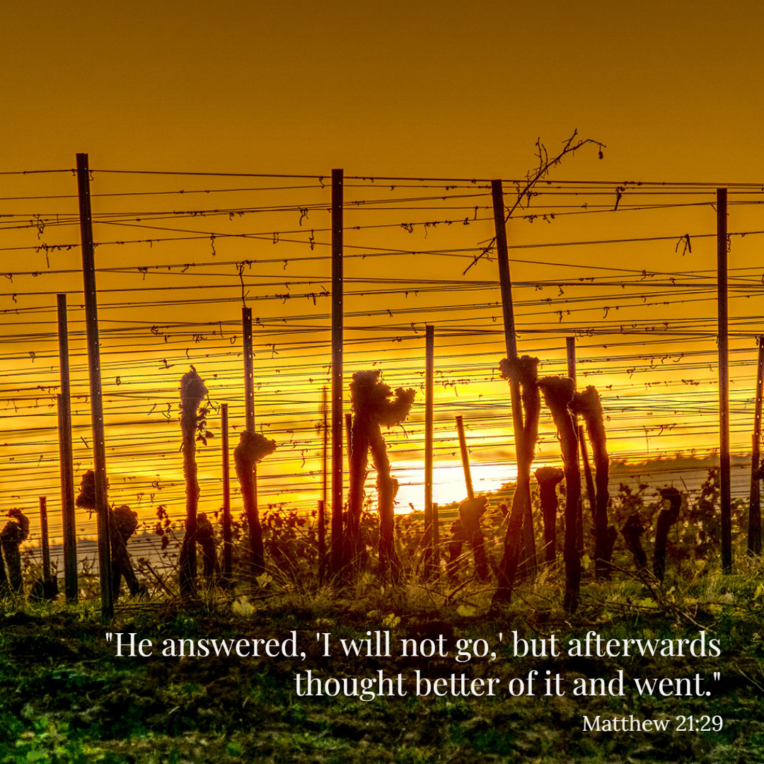

Slide 46
CONCLUDING RITES
C: The Lord be with you.
A : And with your spirit
C: May Almighty God Bless Us, Father and Son and Holy Spirit
A: Amen.
C: Go in Peace, glorifying the Lord by your life.
A: Thanks Be to God

Slide 47
FINAL SONGS

