Slide 1
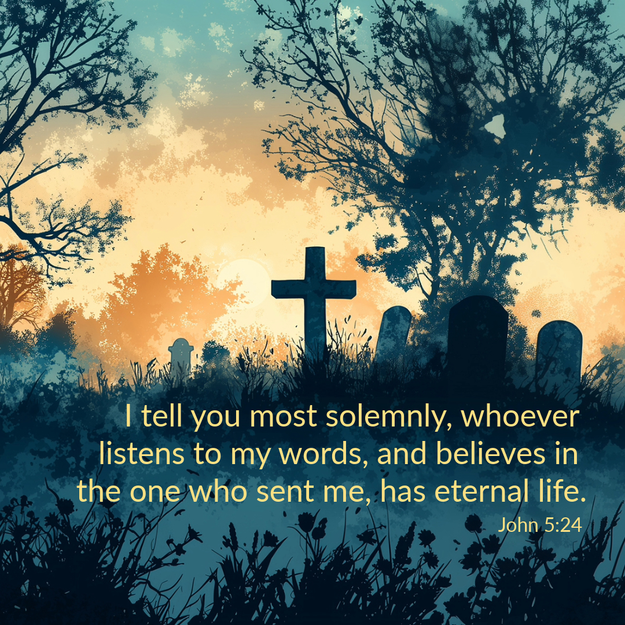

Welcome to St. Luke’s Church – Lalor Parish
All Souls’ Day
2nd November 2026

Slide 2
ENTRANCE SONGS

Slide 3
C: In the name of the Father, and of the Son and of the Holy Spirit.
A: Amen
C: The grace of our Lord Jesus Christ, and the love of God, and the communion of the Holy Spirit be with you all.
A: And with your Spirit

Slide 4


Slide 5
PENITENTIAL ACT
I confess to Almighty God, And to you, my brothers and sisters, That I have greatly sinned, in my thoughts and in my words, In what I have done and in what have failed to do. Through my fault, through my fault, Through my most grievous fault;
1 of 2

Slide 6
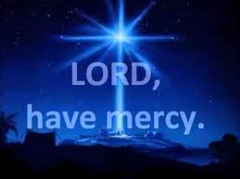
2 of 2
Therefore I ask blessed Mary ever-Virgin, All the Angels and Saints, And you, my brothers and sisters, To pray for me to the Lord our God.

Slide 7
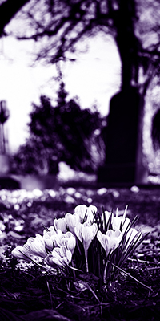
C- Lord have mercy
A- Lord have mercy
C - Christ have mercy
A - Christ have mercy
C- Lord have mercy
A- Lord have mercy

Slide 8

1 of 3
GLORY TO GOD
Glory to God in the highest
And on earth peace to people of good will
We praise You, we bless You, We adore You, we glorify You, We give You thanks for Your great glory. Lord God heavenly King, O God almighty Father.

Slide 9
2 of 3
Lord Jesus Christ, Only Begotten Son. Lord God, Lamb of God, Son of the Father, you take away the sins of the world, Have mercy on us; you take away the sins of the world, receive our prayer; You are seated at the right hand of the Father, Have mercy on us.

Slide 10

3 of 3
For You alone are the Holy One,
You alone are the Lord,
You alone are the Most High, Jesus Christ,
with the Holy Spirit, in the glory of God the Father. Amen….

Slide 11
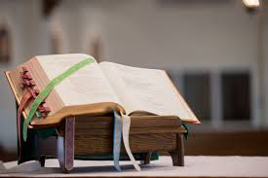

Slide 12
Liturgy of the Word
First Reading (Wis 3:1-6. 9)
A reading from the book of Wisdom
The souls of the virtuous are in the hands of God, no torment shall ever touch them. In the eyes of the unwise, they did appear to die, their going looked like a disaster, their leaving us, like annihilation; but they are in

Slide 13
peace. If they experienced punishment as men see it, their hope was rich with immortality; slight was their affliction, great will their blessing be. God has put them to the test and proved them worthy to be with him; he has tested them like gold in a furnace, and accepted them as a holocaust. They who trust in him will understand the truth, those

Slide 14
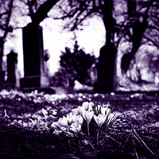
who are faithful will live with him in love; for grace and mercy await those he has chosen.
The Word of the Lord.
A: Thanks be to God

Slide 15

Responsorial Psalm (Ps 32:1. 12. 18-20. 22. R. v.12)
(R.) The Lord is my shepherd;
there is nothing I shall want.
The Lord is my shepherd; there is nothing I shall want. Fresh and green are the pastures where he gives me repose. Near restful waters he leads me, to revive my drooping spirit. (R.)
He guides me along the right path; he is true to his name. If I should walk in the valley of darkness no evil would I fear. You are there with your crook and your staff; with these you give me comfort. (R.)

Slide 16
(R.) The Lord is my shepherd;
there is nothing I shall want.
You have prepared a banquet for me in the sight of my foes. My head you have anointed with oil; my cup is overflowing. (R.)
Surely goodness and kindness shall follow me all the days of my life. In the Lord’s own house shall I dwell for ever and ever. (R.)

Slide 17
Second Reading (Romans 5:17-21)
A reading from the letter of St Paul to the Romans
If it is certain that death reigned over everyone as the consequence of one man’s fall, it is even more certain that one man, Jesus Christ, will cause everyone to reign in life who receives the free gift that he does not deserve, of being made righteous. Again,

Slide 18
as one man’s fall brought condemnation on everyone, so the good act of one man brings everyone life and makes them justified. As by one man's disobedience many were made sinners, so by one man's obedience many will be made righteous. When law came, it was to multiply the opportunities of falling, but however great the number of sins committed, grace was even greater; and so,

Slide 19
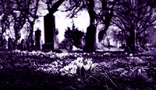
just as sin reigned wherever there was death, so grace will reign to bring eternal life, thanks to the righteousness that comes through Jesus Christ our Lord.
The Word of the Lord.
A: Thanks be to God

Slide 20
Gospel Acclamation
Alleluia, alleluia!
Blessed are you, Father,
Lord of heaven and earth;
you have revealed to little ones the mysteries of the kingdom.
Alleluia!

Slide 21
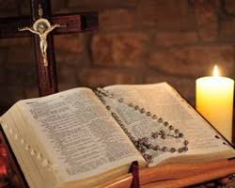
C: The Lord be with you.
A: And with your spirit
C: A reading from the holy Gospel according to Matthew
A: Glory to you Lord

Slide 22
Gospel (Matthew 5:1-12)
Seeing the crowds, Jesus went up the hill. There he sat down and was joined by his disciples. Then he began to speak. This is what he taught them: ‘How happy are the poor in spirit: theirs is the kingdom of heaven. Happy the gentle: they shall have the earth for their heritage. Happy those

Slide 23
who mourn: they shall be comforted. Happy those who hunger and thirst for what is right: they shall be satisfied. Happy the merciful: they shall have mercy shown them. Happy the pure in heart: they shall see God. Happy the peacemakers: they shall be called sons of God. Happy those who are persecuted in the cause of right: theirs is the

Slide 24
kingdom of heaven. ‘Happy are you when people abuse you and persecute you and speak all kinds of calumny against you on my account. Rejoice and be glad, for your reward will be great in heaven.’
The Gospel of the Lord.
Praise to you, Lord Jesus Christ

Slide 25
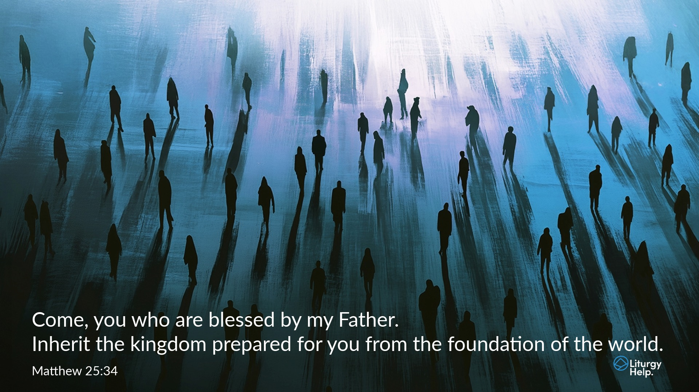

Slide 26
Nicene Creed
I believe in one God, the Father almighty, maker of heaven and earth, of all things visible and invisible. I believe in one Lord, Jesus Christ, the Only Begotten Son of God, born of the Father before all ages. God from God, Light from Light, true God from true God, begotten, not made, consubstantial with the Father; through Him all things were made.

Slide 27
For us men and for our salvation. He came down from heaven, and by the Holy Spirit was incarnate of the Virgin Mary, and became man.
For our sake He was crucified under Pontius Pilate, He suffered death and was buried, and rose again on the third day in accordance with the Scriptures. He ascended into heaven and is seated at the right hand of the Father. He will come again in glory to judge the living and the dead, and His Kingdom will have no end.

Slide 28
I believe in the Holy Spirit, the Lord, the giver of life, who proceeds from the Father and the Son, who with the Father and the Son is adored and glorified, who has spoken through the prophets.
I believe in one, Holy, Catholic and Apostolic Church. I confess one Baptism for the forgiveness of sins and I look forward to the resurrection of the dead, and the life of the world to come. Amen.

Slide 29
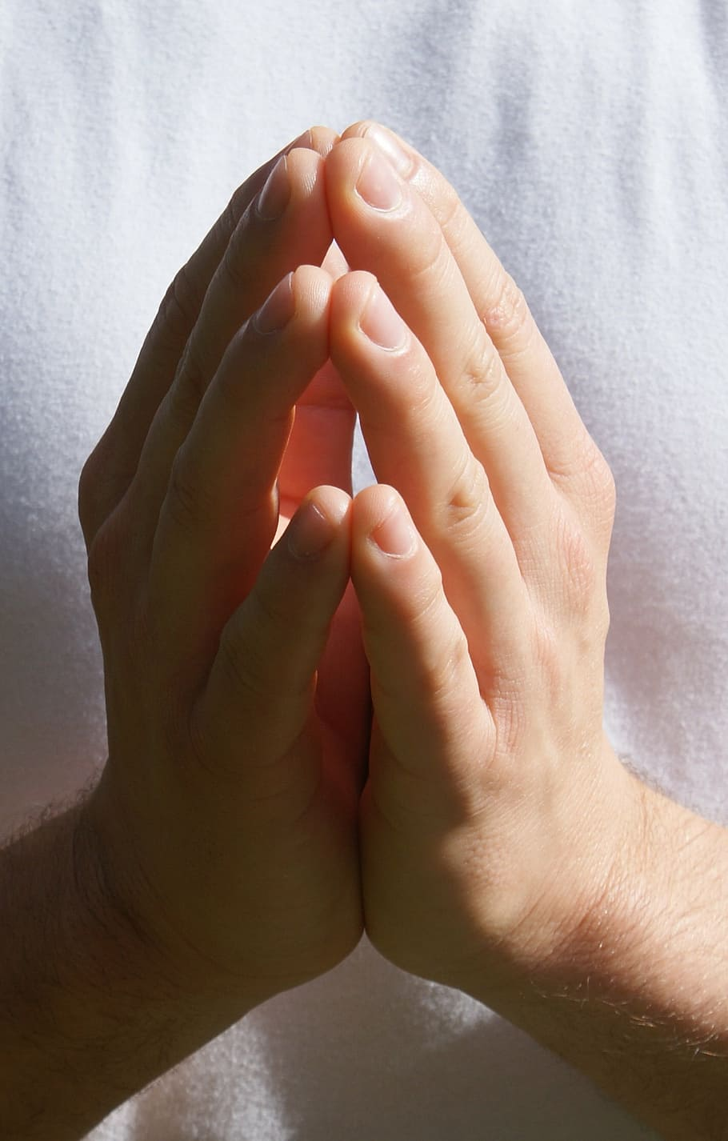
Reader: We pray for…
Let us pray to the Lord.
People: Lord hear our prayer.

Slide 30
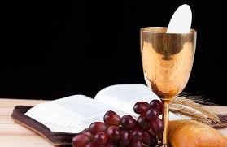

Slide 31
OFFERTORY SONGS

Slide 33
The Liturgy of the Eucharist
C: Pray, brethren that my sacrifice and yours may be acceptable to God, the almighty Father.
A: May the Lord accept the sacrifice at your hands for the praise and glory of his name, for our good the good of all his holy Church.

Slide 34
The Eucharistic Prayer
C: The Lord be with you.
A: And with your spirit.
C: Lift up your hearts.
A: We lift them up to the Lord.
C: Let us give thanks to the Lord our God.
A: It is right and just.

Slide 35
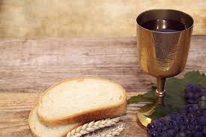

Slide 36

SANCTUS
Holy, holy, holy Lord God of hosts.
Heaven and earth are full of your glory
Hosanna in the highest,
blessed is he who comes in the name of the Lord
Hosanna in the highest…

Slide 37
MYSTERY OF FAITH
We proclaim your death O Lord
And profess your resurrection
Until you come again…

Slide 38
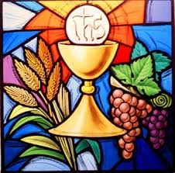

Slide 39

1 of 2
LORD’S PRAYER
Our Father, who art in heaven hallowed be Thy name. Thy Kingdom come, Thy will be done, on earth as it is in Heaven.
Give us this day our daily bread. And forgive us our trespasses, as we forgive those who trespass against us.
And lead us not into temptation, but deliver us from evil.

Slide 40
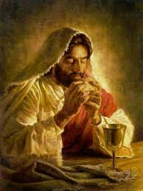
2 of 2
For thy Kingdom, the Power and the Glory are Yours
Now and forever.

Slide 41
C: Lord Jesus Christ, who said to your Apostles…..
….Who live and reign for ever and ever
A: Amen
C: The peace of the Lord be with you always.
A: And with your spirit.

Slide 42
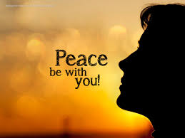

Slide 43
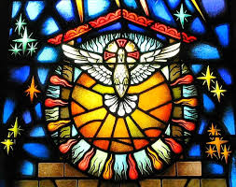
Lamb of God
Lamb of God, you take away the sins of the world, Have mercy on us.
Lamb of God, you take away the sins of the world, Have mercy on us.
Lamb of God, you take away the sins of the world,Grant us peace…

Slide 44
C: Behold the Lamb of God, behold him who takes away the sins of the world. Blessed are those called to the supper of the lamb.
A: Lord, I am not worthy that you should enter under my roof, but only say the word and my soul shall be healed.

Slide 45
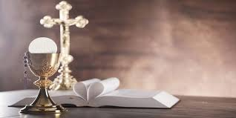

Slide 46
COMMUNION SONGS

Slide 48
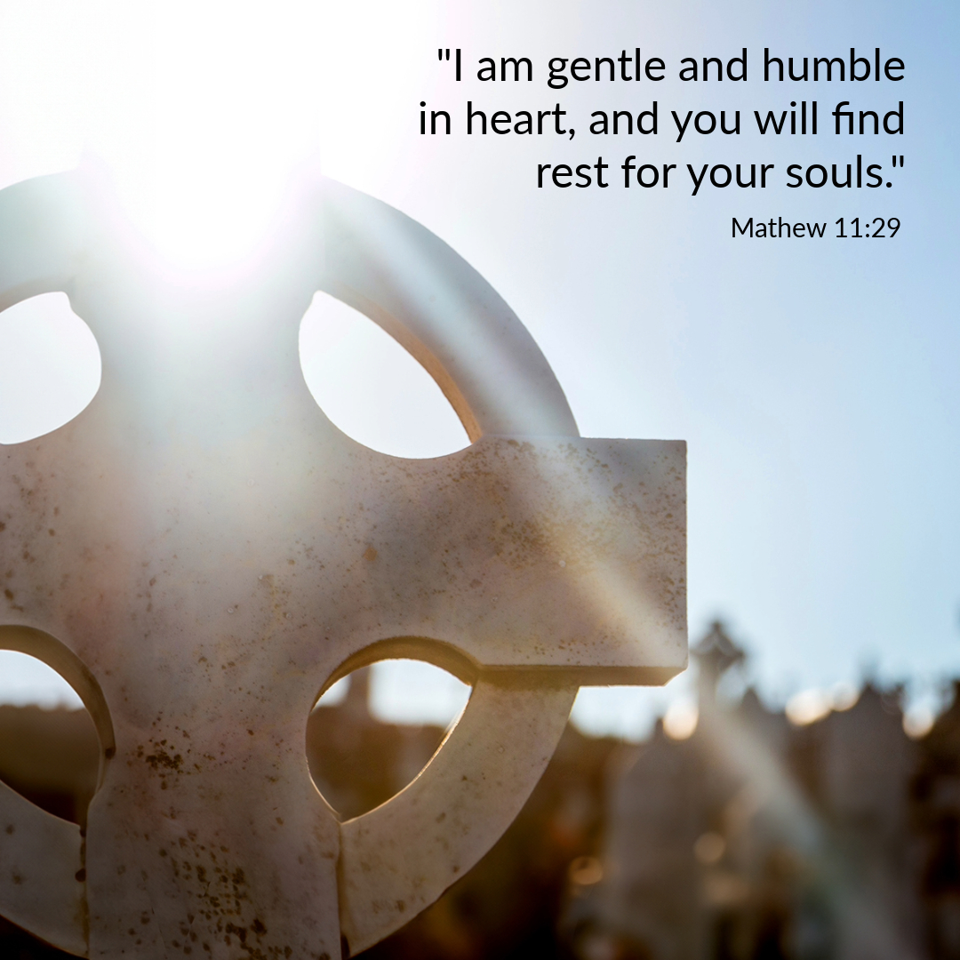

Slide 49
CONCLUDING RITES
C: The Lord be with you.
A : And with your spirit
C: May Almighty God Bless Us, Father and Son and Holy Spirit
A: Amen.
C: Go in Peace, glorifying the Lord by your life.
A: Thanks Be to God

Slide 50
FINAL SONGS

