Slide 1
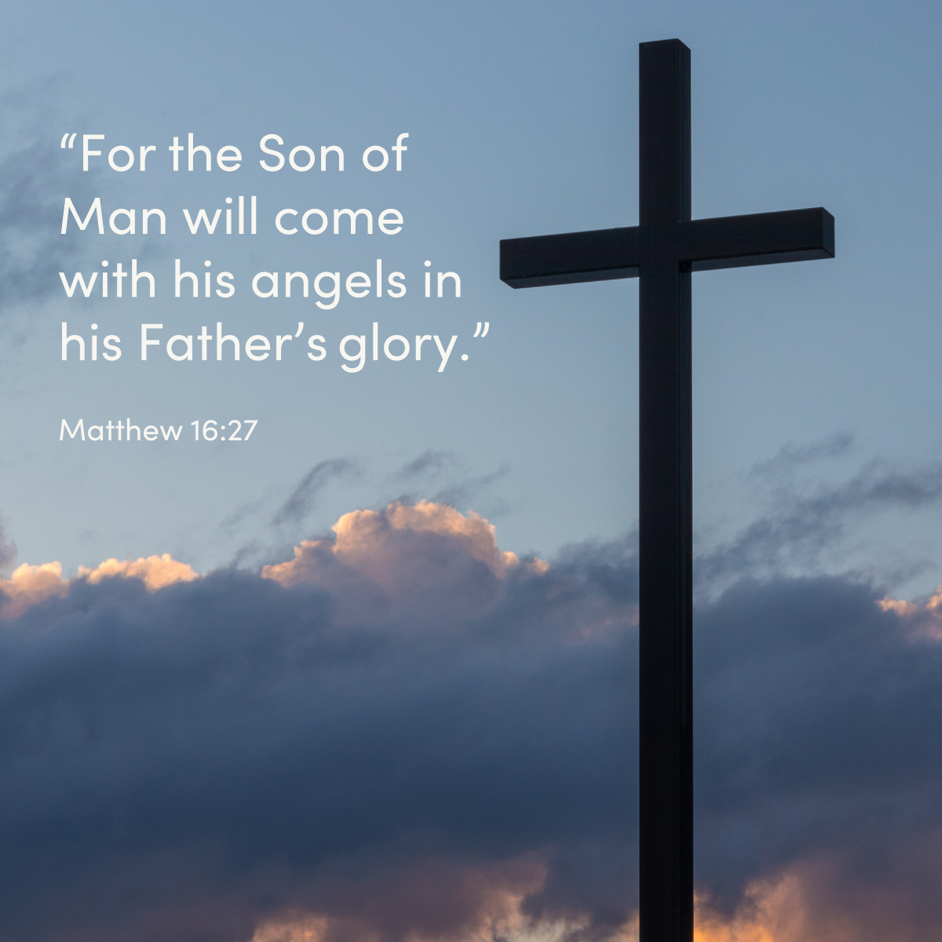

Welcome to St. Luke’s Church Lalor Parish 22nd Sunday in Ordinary Time,
30 August 2026

Slide 2
ENTRANCE SONGS

Slide 3
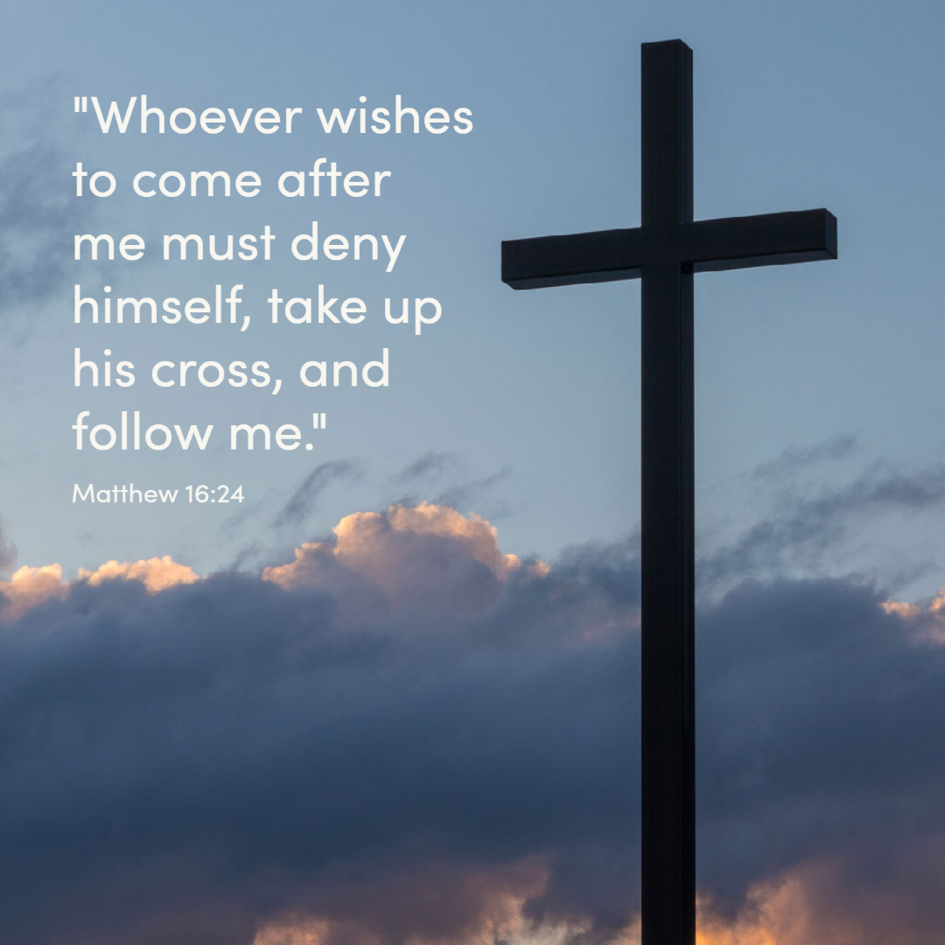

Slide 4
C: In the name of the Father, and of the Son and of the Holy Spirit.
A: Amen
C: The grace of our Lord Jesus Christ, and the love of God, and the communion of the Holy Spirit be with you all.
A: And with your Spirit

Slide 5
1 of 2
PENITENTIAL ACT
I confess to Almighty God, And to you, my brothers and sisters, That I have greatly sinned, in my thoughts and in my words, In what I have done and in what have failed to do. Through my fault, through my fault, Through my most grievous fault;

Slide 6
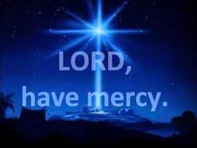
2 of 2
Therefore I ask blessed Mary ever-Virgin, All the Angels and Saints, And you, my brothers and sisters, To pray for me to the Lord our God.

Slide 7

C- Lord have mercy
A- Lord have mercy
C - Christ have mercy
A - Christ have mercy
C- Lord have mercy
A- Lord have mercy

Slide 8

1 of 3
GLORY TO GOD
Glory to God in the highest
And on earth peace to people of good will
We praise You, we bless You, We adore You, we glorify You, We give You thanks for Your great glory. Lord God heavenly King, O God almighty Father.

Slide 9
2 of 3
Lord Jesus Christ, Only Begotten Son. Lord God, Lamb of God, Son of the Father, you take away the sins of the world, Have mercy on us; you take away the sins of the world, receive our prayer; You are seated at the right hand of the Father, Have mercy on us.

Slide 10

3 of 3
For You alone are the Holy One,
You alone are the Lord,
You alone are the Most High, Jesus Christ,
with the Holy Spirit, in the glory of God the Father. Amen….

Slide 11
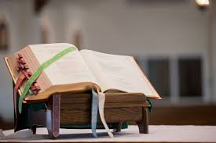

Slide 12
Liturgy of the Word
First Reading (Jeremiah 20:7-9)
A reading from the prophet Jeremiah
You have seduced me, Lord, and I have let myself be seduced; you have overpowered me: you were the stronger. I am a daily laughing-stock, everybody's butt. Each time I speak the word, I have to howl and proclaim: ‘Violence and ruin!’ The word of the Lord has

Slide 13
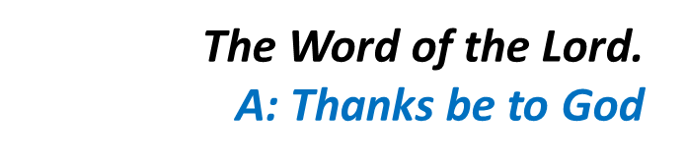
meant for me insult, derision, all day long. I used to say, I will not think about him, I will not speak in his name any more. Then there seemed to be a fire burning in my heart, imprisoned in my bones. The effort to restrain it wearied me, I could not bear it.

Slide 14
Responsorial Psalm (Ps 62:2-6. 8-9. R. v.2)
(R.) My soul is thirsting for you,
O Lord my God.
1. O God, you are my God, for you I long; for you my soul is thirsting. My body pines for you like a dry, weary land without water. (R.)
2. So I gaze on you in the sanctuary to see your strength and your glory. For your love is better than life, my lips will speak your praise. (R.)

Slide 15
(R.) My soul is thirsting for you,
O Lord my God.
3. So I will bless you all my life, in your name I will lift up my hands. My soul shall be filled as with a banquet, my mouth shall praise you with joy. (R.)
4. For you have been my help; in the shadow of your wings I rejoice. My soul clings to you; your right hand holds me fast. (R.)

Slide 16
Second Reading (Romans 12:1-2)
A reading from the letter of St Paul to the Romans
Think of God’s mercy, my brothers, and worship him, I beg you, in a way that is worthy of thinking beings, by offering your living bodies as a holy sacrifice, truly pleasing to God. Do not model yourselves on the behaviour of the world around you, but let

Slide 17
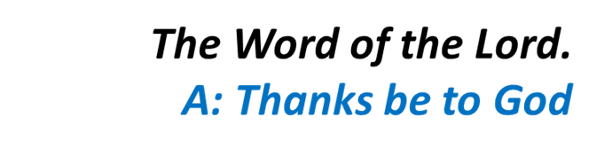
your behaviour change, modelled by your new mind. This is the only way to discover the will of God and know what is good, what it is that God wants, what is the perfect thing to do.

Slide 18
Gospel Acclamation
Alleluia, alleluia!
May the Father of our Lord Jesus Christ
enlighten the eyes of our heart,
that we might see how great is the hope
to which we are called.
Alleluia!

Slide 19
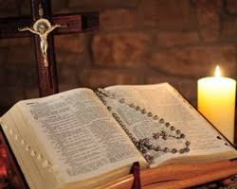
C: The Lord be with you.
A: And with your spirit
C: A reading from the holy Gospel according to Matthew
A: Glory to you Lord

Slide 20
Gospel (Matthew 16:21-27)
Jesus began to make it clear to his disciples that he was destined to go to Jerusalem and suffer grievously at the hands of the elders and chief priests and scribes, to be put to death and to be raised up on the third day. Then, taking him aside, Peter started to remonstrate with him. ‘Heaven preserve you,

Slide 21
Lord,’ he said. ‘This must not happen to you.’ But he turned and said to Peter, ‘Get behind me, Satan! You are an obstacle in my path, because the way you think is not God’s way but man’s.’ Then Jesus said to his disciples, ‘If anyone wants to be a follower of mine, let him renounce himself and take up his cross and follow me. For anyone who wants to save his life will lose it; but anyone who loses his

Slide 22

life for my sake will find it. What, then, will a man gain if he wins the whole world and ruins his life? Or what has a man to offer in exchange for his life? ‘For the Son of Man is going to come in the glory of his Father with his angels, and, when he does, he will reward each one according to his behaviour.’

Slide 23
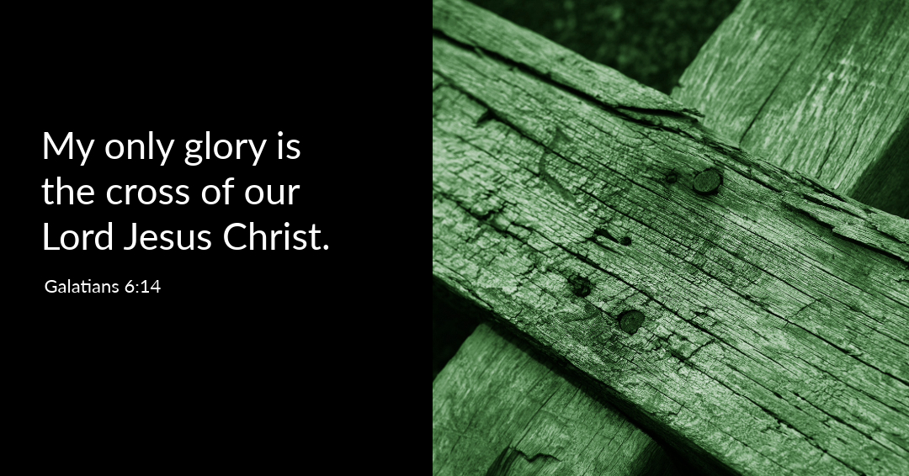

Slide 24
Nicene Creed
I believe in one God, the Father almighty, maker of heaven and earth, of all things visible and invisible. I believe in one Lord, Jesus Christ, the Only Begotten Son of God, born of the Father before all ages. God from God, Light from Light, true God from true God, begotten, not made, consubstantial with the Father; through Him all things were made.

Slide 25
For us men and for our salvation. He came down from heaven, and by the Holy Spirit was incarnate of the Virgin Mary, and became man.
For our sake He was crucified under Pontius Pilate, He suffered death and was buried, and rose again on the third day in accordance with the Scriptures. He ascended into heaven and is seated at the right hand of the Father. He will come again in glory to judge the living and the dead, and His Kingdom will have no end.

Slide 26
I believe in the Holy Spirit, the Lord, the giver of life, who proceeds from the Father and the Son, who with the Father and the Son is adored and glorified, who has spoken through the prophets.
I believe in one, Holy, Catholic and Apostolic Church. I confess one Baptism for the forgiveness of sins and I look forward to the resurrection of the dead, and the life of the world to come. Amen.

Slide 27
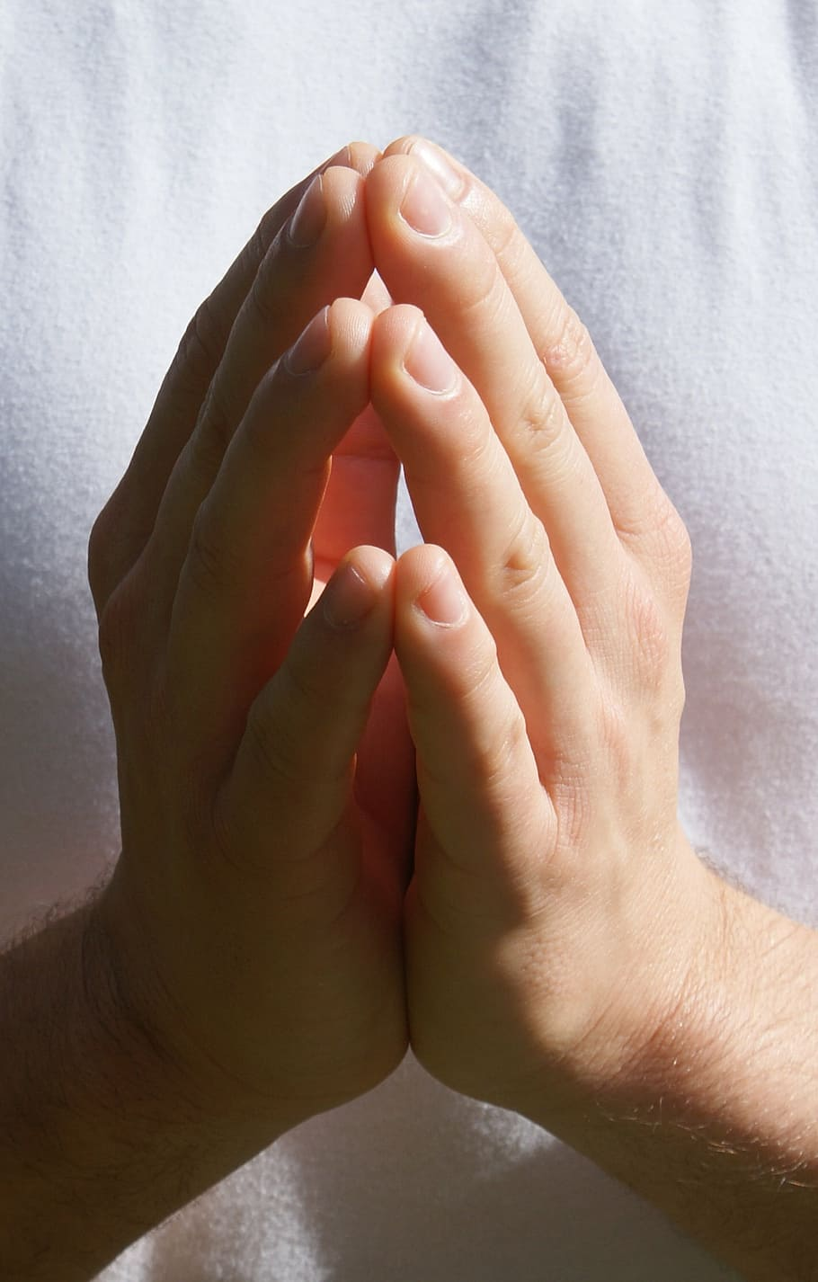
Reader: We pray for…
Let us pray to the Lord.
People: Lord hear our prayer.

Slide 28
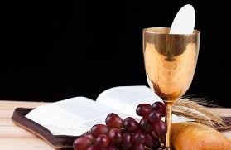

Slide 29
OFFERTORY SONGS

Slide 30
The Liturgy of the Eucharist
C: Pray, brethren that my sacrifice and yours may be acceptable to God, the almighty Father.
A: May the Lord accept the sacrifice at your hands for the praise and glory of his name, for our good the good of all his holy Church.

Slide 31
The Eucharistic Prayer
C: The Lord be with you.
A: And with your spirit.
C: Lift up your hearts.
A: We lift them up to the Lord.
C: Let us give thanks to the Lord our God.
A: It is right and just.

Slide 32
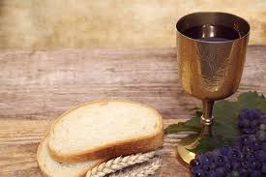

Slide 33

SANCTUS
Holy, holy, holy Lord God of hosts.
Heaven and earth are full of your glory
Hosanna in the highest,
blessed is he who comes in the name of the Lord
Hosanna in the highest…

Slide 34
MYSTERY OF FAITH
We proclaim your death O Lord
And profess your resurrection
Until you come again…

Slide 35
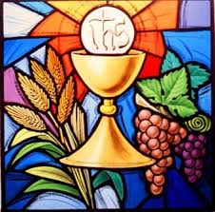

Slide 36

1 of 2
LORD’S PRAYER
Our Father, who art in heaven hallowed be Thy name. Thy Kingdom come, Thy will be done, on earth as it is in Heaven.
Give us this day our daily bread. And forgive us our trespasses, as we forgive those who trespass against us. And lead us not into temptation, but deliver us from evil.

Slide 37
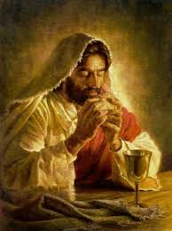
2 of 2
For thy Kingdom, the Power and the Glory are Yours
Now and forever.

Slide 38
C: Lord Jesus Christ, who said to your Apostles…..
….Who live and reign for ever and ever
A: Amen
C: The peace of the Lord be with you always.
A: And with your spirit.

Slide 39
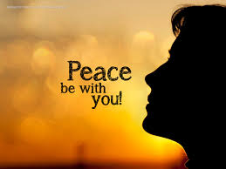

Slide 40
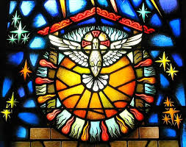
Lamb of God
Lamb of God, you take away the sins of the world, Have mercy on us.
Lamb of God, you take away the sins of the world, Have mercy on us.
Lamb of God, you take away the sins of the world,Grant us peace…

Slide 41
C: Behold the Lamb of God, behold him who takes away the sins of the world. Blessed are those called to the supper of the lamb.
A: Lord, I am not worthy that you should enter under my roof, but only say the word and my soul shall be healed.

Slide 42
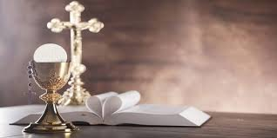

Slide 43
COMMUNION SONGS

Slide 44
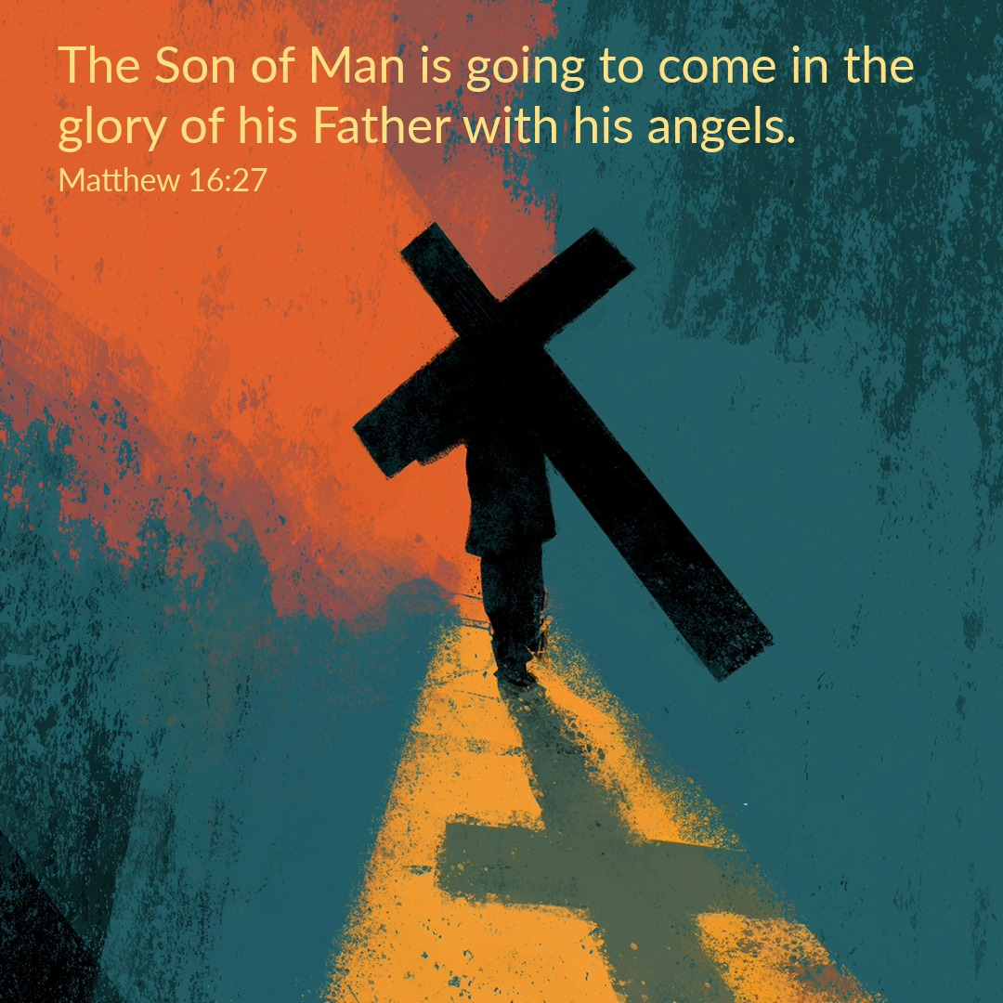

Slide 45
CONCLUDING RITES
C: The Lord be with you.
A : And with your spirit
C: May Almighty God Bless Us, Father and Son and Holy Spirit
A: Amen.
C: Go in Peace, glorifying the Lord by your life.
A: Thanks Be to God

Slide 46
FINAL SONGS

