Slide 1
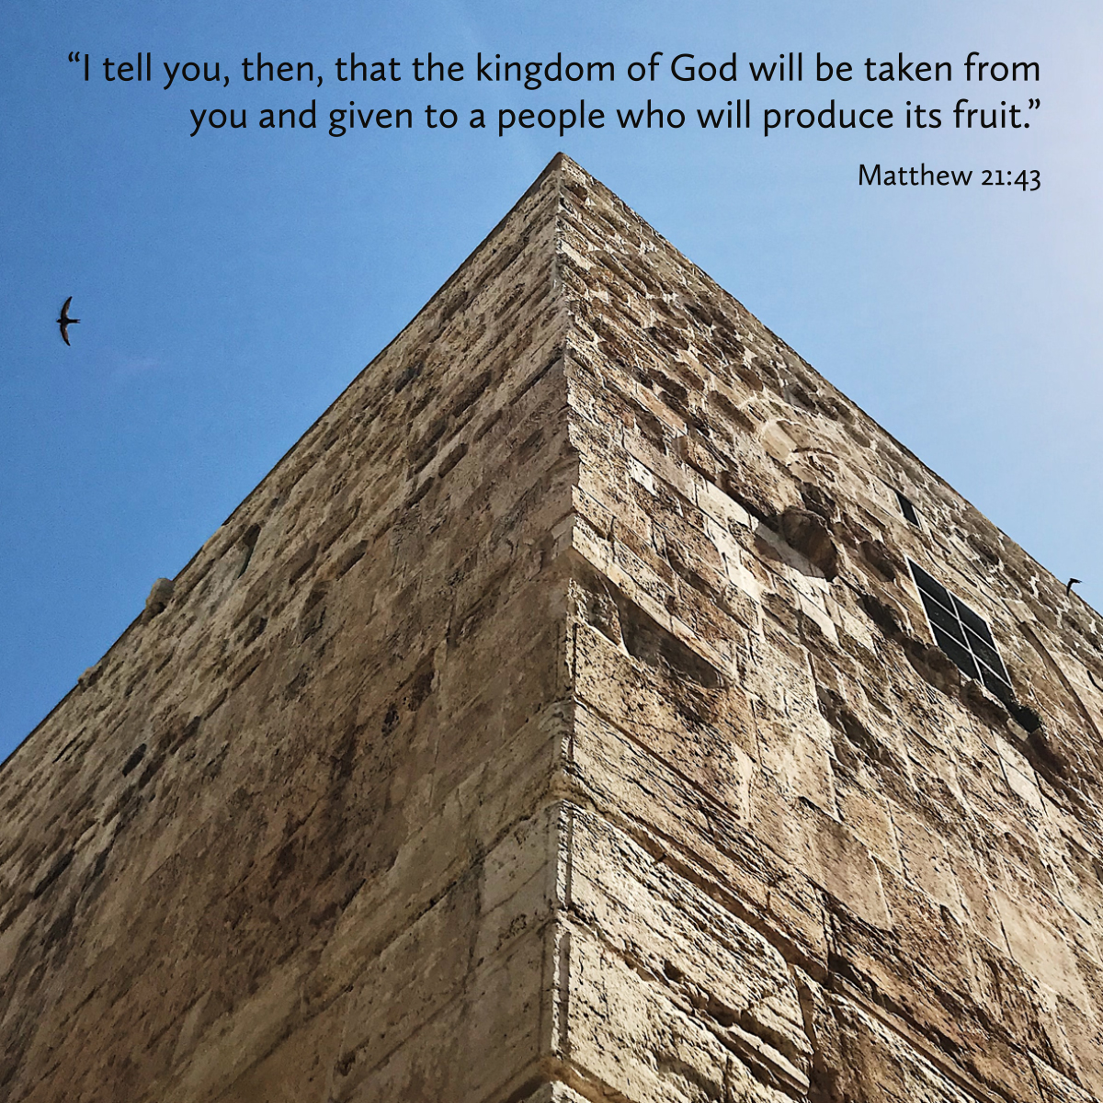

Welcome to St. Luke’s Church Lalor Parish
27th Sunday in Ordinary Time,
4 October 2026

Slide 2
ENTRANCE SONGS

Slide 3
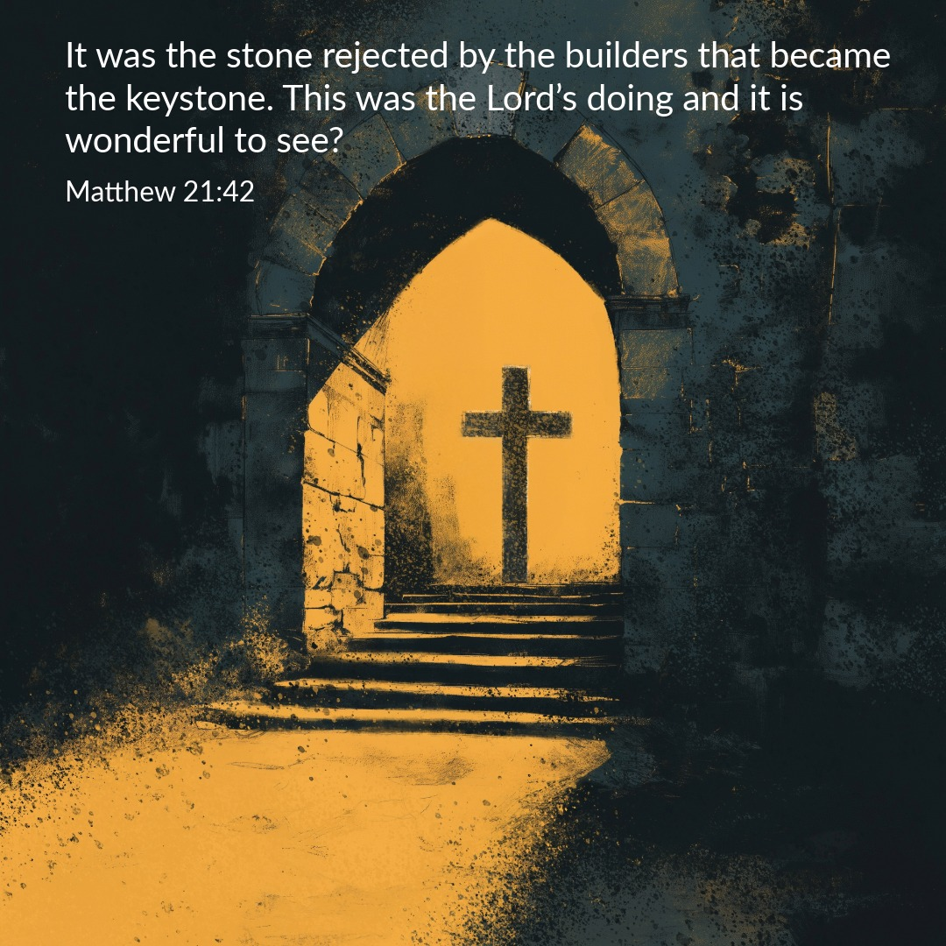

Slide 4
C: In the name of the Father, and of the Son and of the Holy Spirit.
A: Amen
C: The grace of our Lord Jesus Christ, and the love of God, and the communion of the Holy Spirit be with you all.
A: And with your Spirit

Slide 5
1 of 2
PENITENTIAL ACT
I confess to Almighty God, And to you, my brothers and sisters, That I have greatly sinned, in my thoughts and in my words, In what I have done and in what have failed to do. Through my fault, through my fault, Through my most grievous fault;

Slide 6
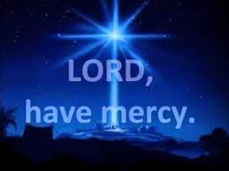
2 of 2
Therefore I ask blessed Mary ever-Virgin, All the Angels and Saints, And you, my brothers and sisters, To pray for me to the Lord our God.

Slide 7

C- Lord have mercy
A- Lord have mercy
C - Christ have mercy
A - Christ have mercy
C- Lord have mercy
A- Lord have mercy

Slide 8

1 of 3
GLORY TO GOD
Glory to God in the highest
And on earth peace to people of good will
We praise You, we bless You, We adore You, we glorify You, We give You thanks for Your great glory. Lord God heavenly King, O God almighty Father.

Slide 9
2 of 3
Lord Jesus Christ, Only Begotten Son. Lord God, Lamb of God, Son of the Father, you take away the sins of the world, Have mercy on us; you take away the sins of the world, receive our prayer; You are seated at the right hand of the Father, Have mercy on us.

Slide 10

3 of 3
For You alone are the Holy One,
You alone are the Lord,
You alone are the Most High, Jesus Christ,
with the Holy Spirit, in the glory of God the Father. Amen….

Slide 11
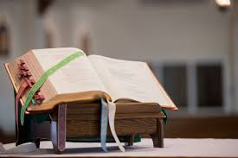

Slide 12
Liturgy of the Word
First Reading (Isaiah 5:1-7)
A reading from the prophet Isaiah
Let me sing to my friend the song of his love for his vineyard. My friend had a vineyard on a fertile hillside. He dug the soil, cleared it of stones, and planted choice vines in it. In the middle he built a tower, he dug a press there too. He expected it to yield grapes, but sour

Slide 13
grapes were all that it gave. And now, inhabitants of Jerusalem and men of Judah, I ask you to judge between my vineyard and me. What could I have done for my vineyard that I have not done? I expected it to yield grapes. Why did it yield sour grapes instead? Very well, I will tell you what I am going to do to my vineyard: I will take away its hedge for it to be grazed on, and knock down its wall

Slide 14
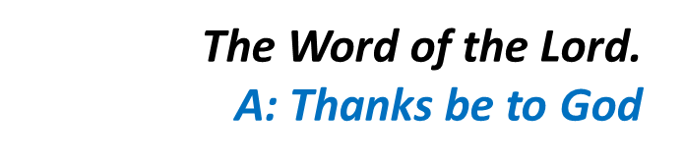
for it to be trampled on. I will lay it waste, unpruned, undug; overgrown by the briar and the thorn. I will command the clouds to rain no rain on it. Yes, the vineyard of the Lord of hosts is the House of Israel, and the men of Judah that chosen plant. He expected justice, but found bloodshed, integrity, but only a cry of distress.

Slide 15
Responsorial Psalm (Ps 79:9. 12-16. 19-20. R. Is 5:7)
(R.) The vineyard of the Lord is the House of Israel.
1. You brought a vine out of Egypt; to plant it you drove out the nations. It stretched out its branches to the sea, to the Great River it stretched out its shoots. (R.)
2. Then why have you broken down its walls? It is plucked by all who pass by. It is ravaged by the boar of the forest, devoured by the beasts of the field. (R.)

Slide 16
(R.) The vineyard of the Lord is the House of Israel.
3. God of hosts, turn again, we implore, look down from heaven and see. Visit this vine and protect it, the vine your right hand has planted. (R.)
4. And we shall never forsake you again: give us life that we may call upon your name. God of hosts, bring us back; let your face shine on us and we shall be saved. (R.)

Slide 17
Second Reading (Philippians 4:6-9)
A reading from the letter of St Paul to the Philippians
There is no need to worry; but if there is anything you need, pray for it, asking God for it with prayer and thanksgiving, and that peace of God, which is so much greater than we can understand, will guard your hearts

Slide 18
and your thoughts, in Christ Jesus. Finally, brothers, fill your minds with everything that is true, everything that is noble, everything that is good and pure, everything that we love and honour, and everything that can be thought virtuous or worthy of praise. Keep doing all the things that you learnt from me and have been taught by me and have heard

Slide 19
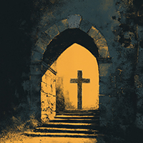
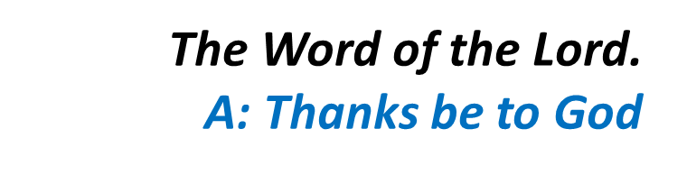
or seen that I do. Then the God of peace will be with you.

Slide 20
Gospel Acclamation
Alleluia, alleluia!
I call you friends, says the Lord, because I have made known to you everything I have learnt from my Father.
Alleluia!

Slide 21
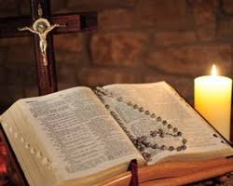
C: The Lord be with you.
A: And with your spirit
C: A reading from the holy Gospel according to Matthew
A: Glory to you Lord

Slide 22
Gospel (Matthew 21:33-43)
Jesus said to the chief priests and the elders of the people, ‘Listen to another parable. There was a man, a landowner, who planted a vineyard; he fenced it round, dug a winepress in it and built a tower; then he leased it to tenants and went abroad. When vintage time drew near he sent his servants

Slide 23
to the tenants to collect his produce. But the tenants seized his servants, thrashed one, killed another and stoned a third. Next he sent some more servants, this time a larger number, and they dealt with them in the same way. Finally he sent his son to them. “They will respect my son,” he said. But when the tenants saw the son, they said to each other, “This is the heir. Come on, let us

Slide 24
kill him and take over his inheritance.” So they seized him and threw him out of the vineyard and killed him. Now when the owner of the vineyard comes, what will he do to those tenants?’ They answered, ‘He will bring those wretches to a wretched end and lease the vineyard to other tenants who will deliver the produce to him when the season arrives.’ Jesus said to them, ‘Have you

Slide 25

never read in the scriptures: It was the stone rejected by the builders that became the keystone. This was the Lord’s doing and it is wonderful to see? ‘I tell you, then, that the kingdom of God will be taken from you and given to a people who will produce its fruit.’

Slide 26
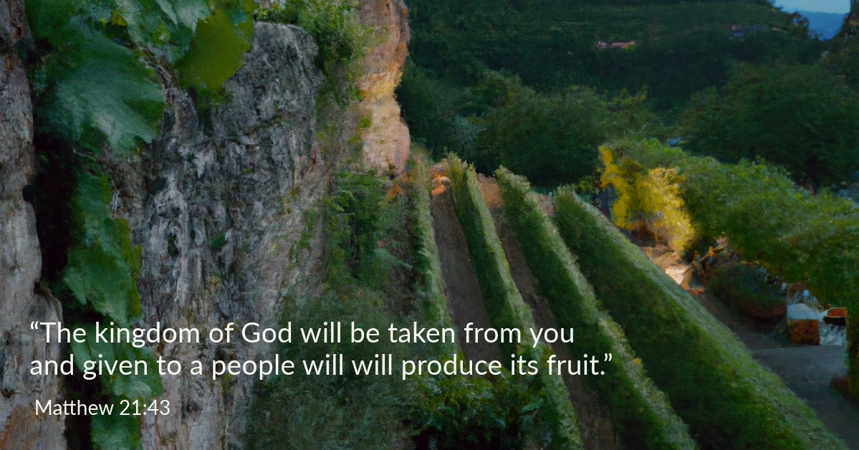

Slide 27
Nicene Creed
I believe in one God, the Father almighty, maker of heaven and earth, of all things visible and invisible. I believe in one Lord, Jesus Christ, the Only Begotten Son of God, born of the Father before all ages. God from God, Light from Light, true God from true God, begotten, not made, consubstantial with the Father; through Him all things were made.

Slide 28
For us men and for our salvation. He came down from heaven, and by the Holy Spirit was incarnate of the Virgin Mary, and became man.
For our sake He was crucified under Pontius Pilate, He suffered death and was buried, and rose again on the third day in accordance with the Scriptures. He ascended into heaven and is seated at the right hand of the Father. He will come again in glory to judge the living and the dead, and His Kingdom will have no end.

Slide 29
I believe in the Holy Spirit, the Lord, the giver of life, who proceeds from the Father and the Son, who with the Father and the Son is adored and glorified, who has spoken through the prophets.
I believe in one, Holy, Catholic and Apostolic Church. I confess one Baptism for the forgiveness of sins and I look forward to the resurrection of the dead, and the life of the world to come. Amen.

Slide 30
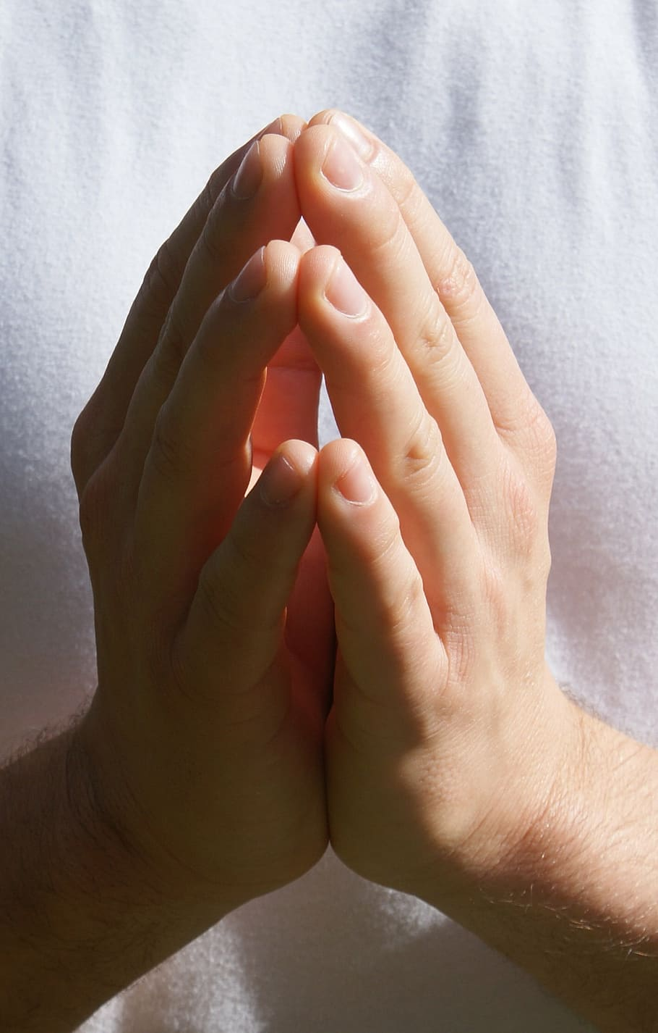
Reader: We pray for…
Let us pray to the Lord.
People: Lord hear our prayer.

Slide 31
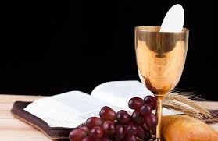

Slide 32
OFFERTORY SONGS

Slide 33
The Liturgy of the Eucharist
C: Pray, brethren that my sacrifice and yours may be acceptable to God, the almighty Father.
A: May the Lord accept the sacrifice at your hands for the praise and glory of his name, for our good the good of all his holy Church.

Slide 34
The Eucharistic Prayer
C: The Lord be with you.
A: And with your spirit.
C: Lift up your hearts.
A: We lift them up to the Lord.
C: Let us give thanks to the Lord our God.
A: It is right and just.

Slide 35
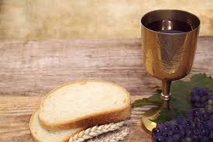

Slide 36

SANCTUS
Holy, holy, holy Lord God of hosts.
Heaven and earth are full of your glory
Hosanna in the highest,
blessed is he who comes in the name of the Lord
Hosanna in the highest…

Slide 37
MYSTERY OF FAITH
We proclaim your death O Lord
And profess your resurrection
Until you come again…

Slide 38
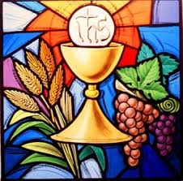

Slide 39

1 of 2
LORD’S PRAYER
Our Father, who art in heaven hallowed be Thy name. Thy Kingdom come, Thy will be done, on earth as it is in Heaven.
Give us this day our daily bread. And forgive us our trespasses, as we forgive those who trespass against us. And lead us not into temptation, but deliver us from evil.

Slide 40
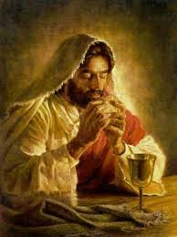
2 of 2
For thy Kingdom, the Power and the Glory are Yours
Now and forever.

Slide 41
C: Lord Jesus Christ, who said to your Apostles…..
….Who live and reign for ever and ever
A: Amen
C: The peace of the Lord be with you always.
A: And with your spirit.

Slide 42
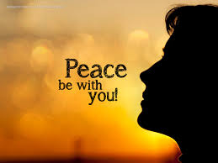

Slide 43
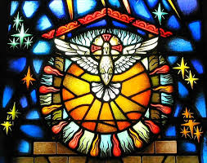
Lamb of God
Lamb of God, you take away the sins of the world, Have mercy on us.
Lamb of God, you take away the sins of the world, Have mercy on us.
Lamb of God, you take away the sins of the world,Grant us peace…

Slide 44
C: Behold the Lamb of God, behold him who takes away the sins of the world. Blessed are those called to the supper of the lamb.
A: Lord, I am not worthy that you should enter under my roof, but only say the word and my soul shall be healed.

Slide 45
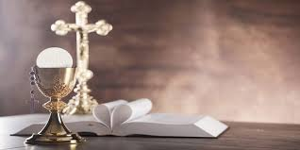

Slide 46
COMMUNION SONGS

Slide 47
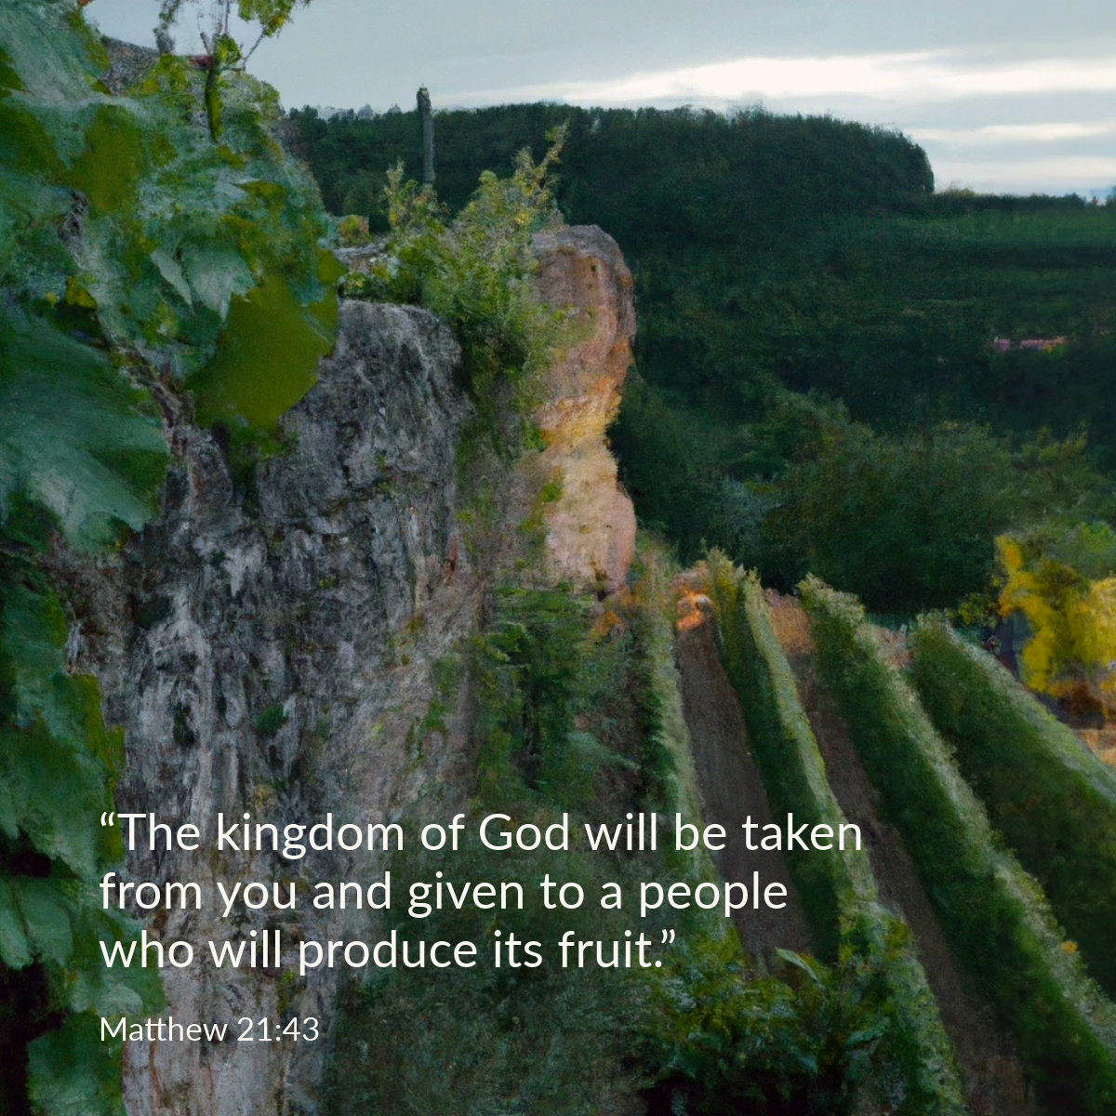

Slide 48
CONCLUDING RITES
C: The Lord be with you.
A : And with your spirit
C: May Almighty God Bless Us, Father and Son and Holy Spirit
A: Amen.
C: Go in Peace, glorifying the Lord by your life.
A: Thanks Be to God

Slide 49
FINAL SONGS

