Slide 1
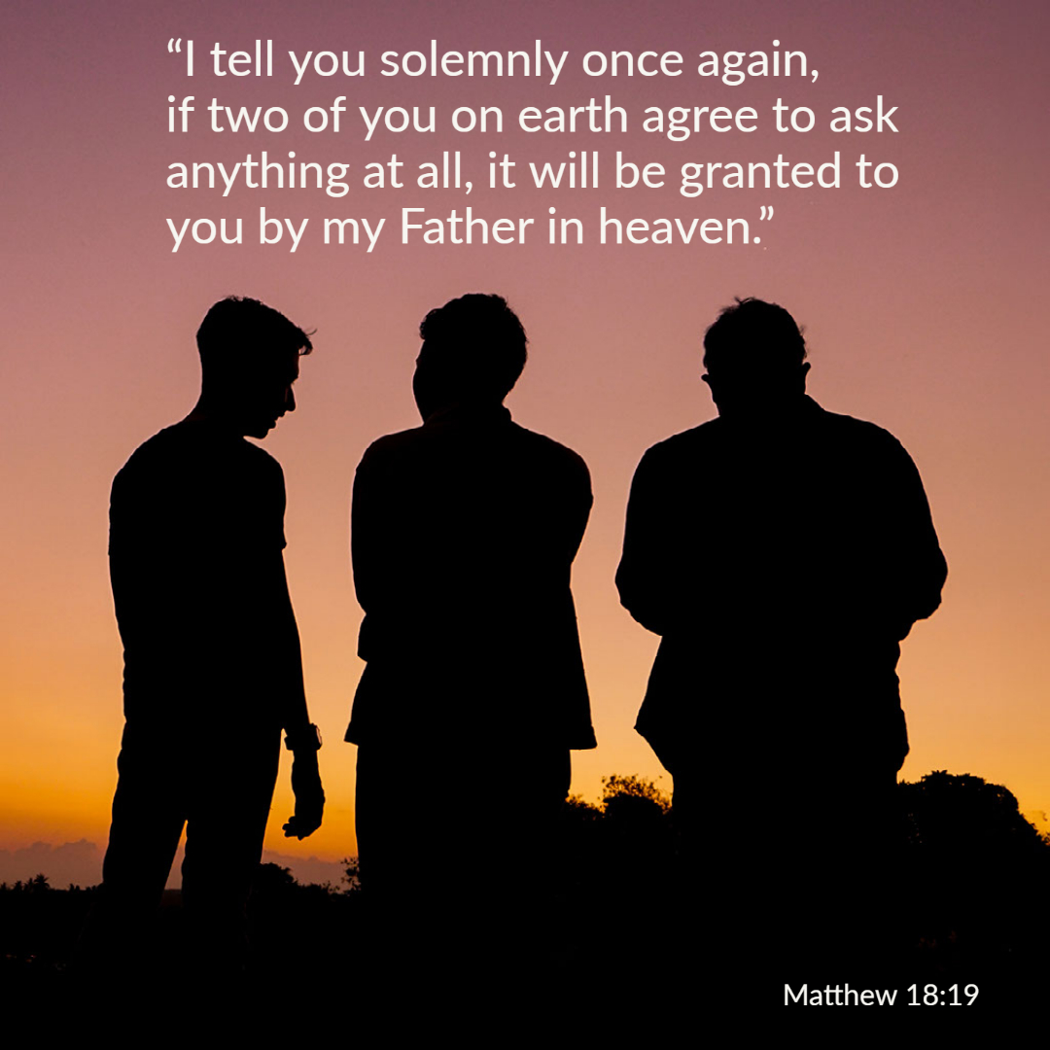

Welcome to St. Luke’s Church Lalor Parish
23rd Sunday in Ordinary Time,
6 September 2026

Slide 2
ENTRANCE SONGS

Slide 3
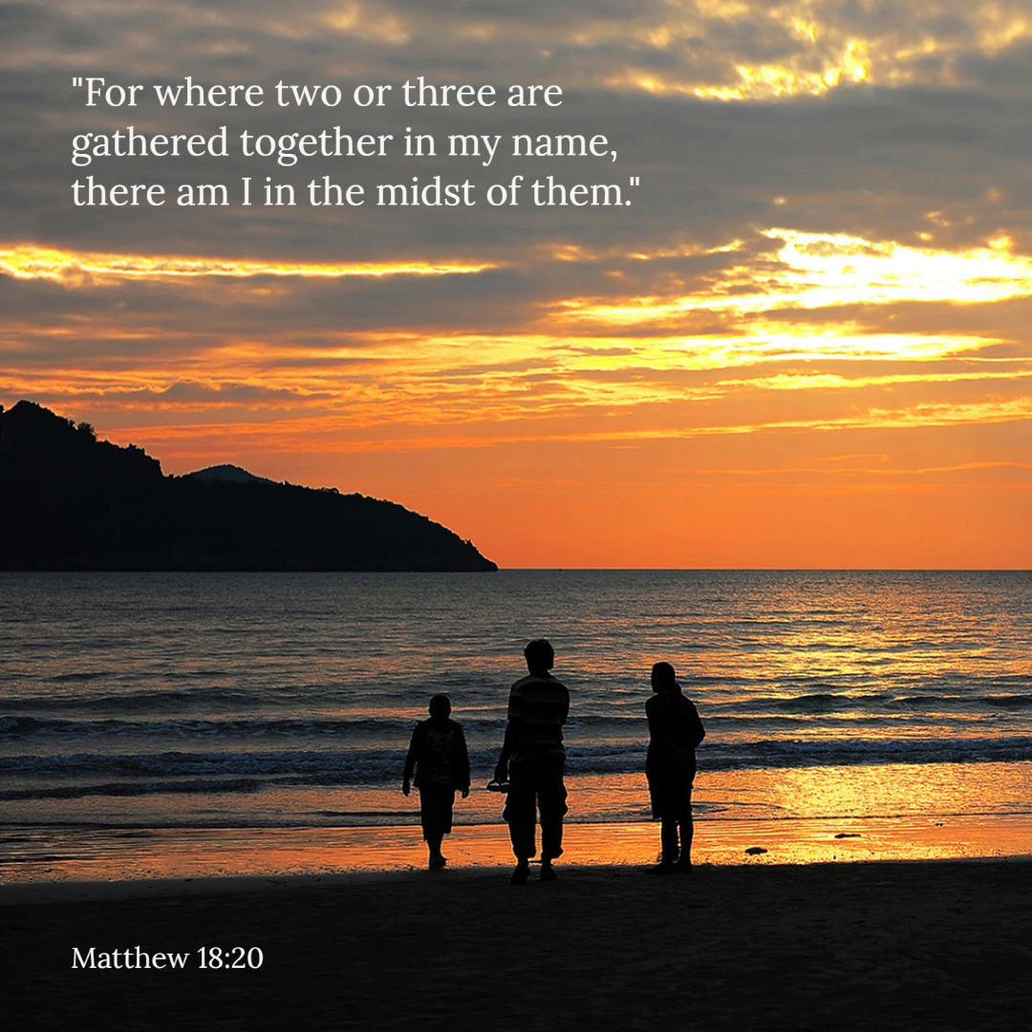

Slide 4
C: In the name of the Father, and of the Son and of the Holy Spirit.
A: Amen
C: The grace of our Lord Jesus Christ, and the love of God, and the communion of the Holy Spirit be with you all.
A: And with your Spirit

Slide 5
1 of 2
PENITENTIAL ACT
I confess to Almighty God, And to you, my brothers and sisters, That I have greatly sinned, in my thoughts and in my words, In what I have done and in what have failed to do. Through my fault, through my fault, Through my most grievous fault;

Slide 6
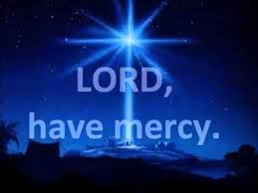
2 of 2
Therefore I ask blessed Mary ever-Virgin, All the Angels and Saints, And you, my brothers and sisters, To pray for me to the Lord our God.

Slide 7
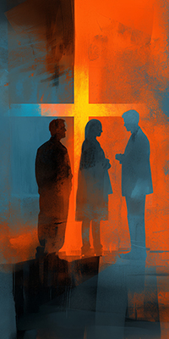
C- Lord have mercy
A- Lord have mercy
C - Christ have mercy
A - Christ have mercy
C- Lord have mercy
A- Lord have mercy

Slide 8

1 of 3
GLORY TO GOD
Glory to God in the highest
And on earth peace to people of good will
We praise You, we bless You, We adore You, we glorify You, We give You thanks for Your great glory. Lord God heavenly King, O God almighty Father.

Slide 9
2 of 3
Lord Jesus Christ, Only Begotten Son. Lord God, Lamb of God, Son of the Father, you take away the sins of the world, Have mercy on us; you take away the sins of the world, receive our prayer; You are seated at the right hand of the Father, Have mercy on us.

Slide 10

3 of 3
For You alone are the Holy One,
You alone are the Lord,
You alone are the Most High, Jesus Christ,
with the Holy Spirit, in the glory of God the Father. Amen….

Slide 11
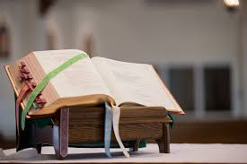

Slide 12
Liturgy of the Word
First Reading (Ezekiel 33:7-9)
A reading from the prophet Ezekiel
The word of the Lord was addressed to me as follows, ‘Son of man, I have appointed you as sentry to the House of Israel. When you hear a word from my mouth, warn them in my name. If I say to a wicked man: Wicked

Slide 13
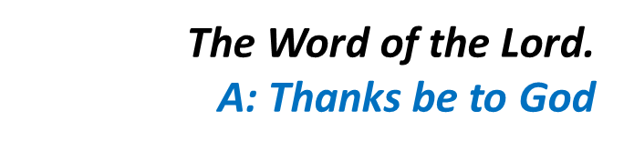
wretch, you are to die, and you do not speak to warn the wicked man to renounce his ways, then he shall die for his sin, but I will hold you responsible for his death. If, however, you do warn a wicked man to renounce his ways and repent, and he does not repent, then he shall die for his sin, but you yourself will have saved your life.’

Slide 14
Responsorial Psalm (Ps 94:1-2.6-9. R. v.8)
(R.) O that today you would listen to his voice! Harden not your hearts.
Come, ring out our joy to the Lord; hail the rock who saves us. Let us come before him, giving thanks, with songs let us hail the Lord. (R.)
Come in; let us bow and bend low; let us kneel before the God who made us for he is our God and we the people who belong to his pasture, the flock that is led by his hand. (R.)

Slide 15
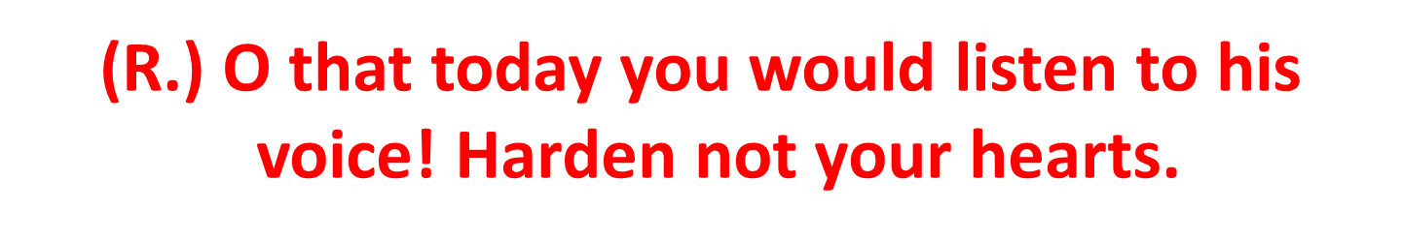
3. O that today you would listen to his voice! ‘Harden not your hearts as at Meribah, as on that day at Massah in the desert when your fathers put me to the test; when they tried me, though they saw my work.’ (R.)

Slide 16
Second Reading (Romans 13:8-10)
A reading from the letter of St Paul to the Romans
Avoid getting into debt, except the debt of mutual love. If you love your fellow men you have carried out your obligations. All the commandments: You shall not commit adultery, you shall not kill, you shall not steal,

Slide 17
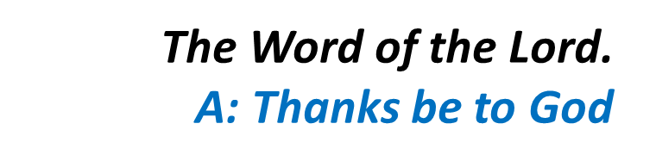
you shall not covet, and so on, are summed up in this single command: You must love your neighbour as yourself. Love is the one thing that cannot hurt your neighbour; that is why it is the answer to every one of the commandments.

Slide 18
Gospel Acclamation
Alleluia, alleluia!
God was in Christ, to reconcile the world to himself; and the Good News of reconciliation he has entrusted to us.
Alleluia!

Slide 19
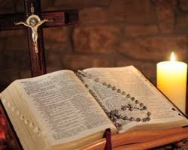
C: The Lord be with you.
A: And with your spirit
C: A reading from the holy Gospel according to Matthew
A: Glory to you Lord

Slide 20
Gospel (Matthew 18:15-20)
Jesus said to his disciples: ‘If your brother does something wrong, go and have it out with him alone, between your two selves. If he listens to you, you have won back your brother. If he does not listen, take one or two others with you: the evidence of two or three witnesses is required to sustain any charge. But if he refuses to listen to these,

Slide 21
report it to the community; and if he refuses to listen to the community, treat him like a pagan or a tax collector. ‘I tell you solemnly, whatever you bind on earth shall be considered bound in heaven; whatever you loose on earth shall be considered loosed in heaven. ‘I tell you solemnly once again, if two of you on earth agree to ask anything at all, it will be granted to you by my Father in

Slide 22
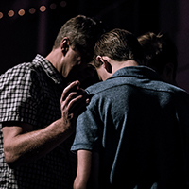

heaven. For where two or three meet in my name, I shall be there with them.’

Slide 23
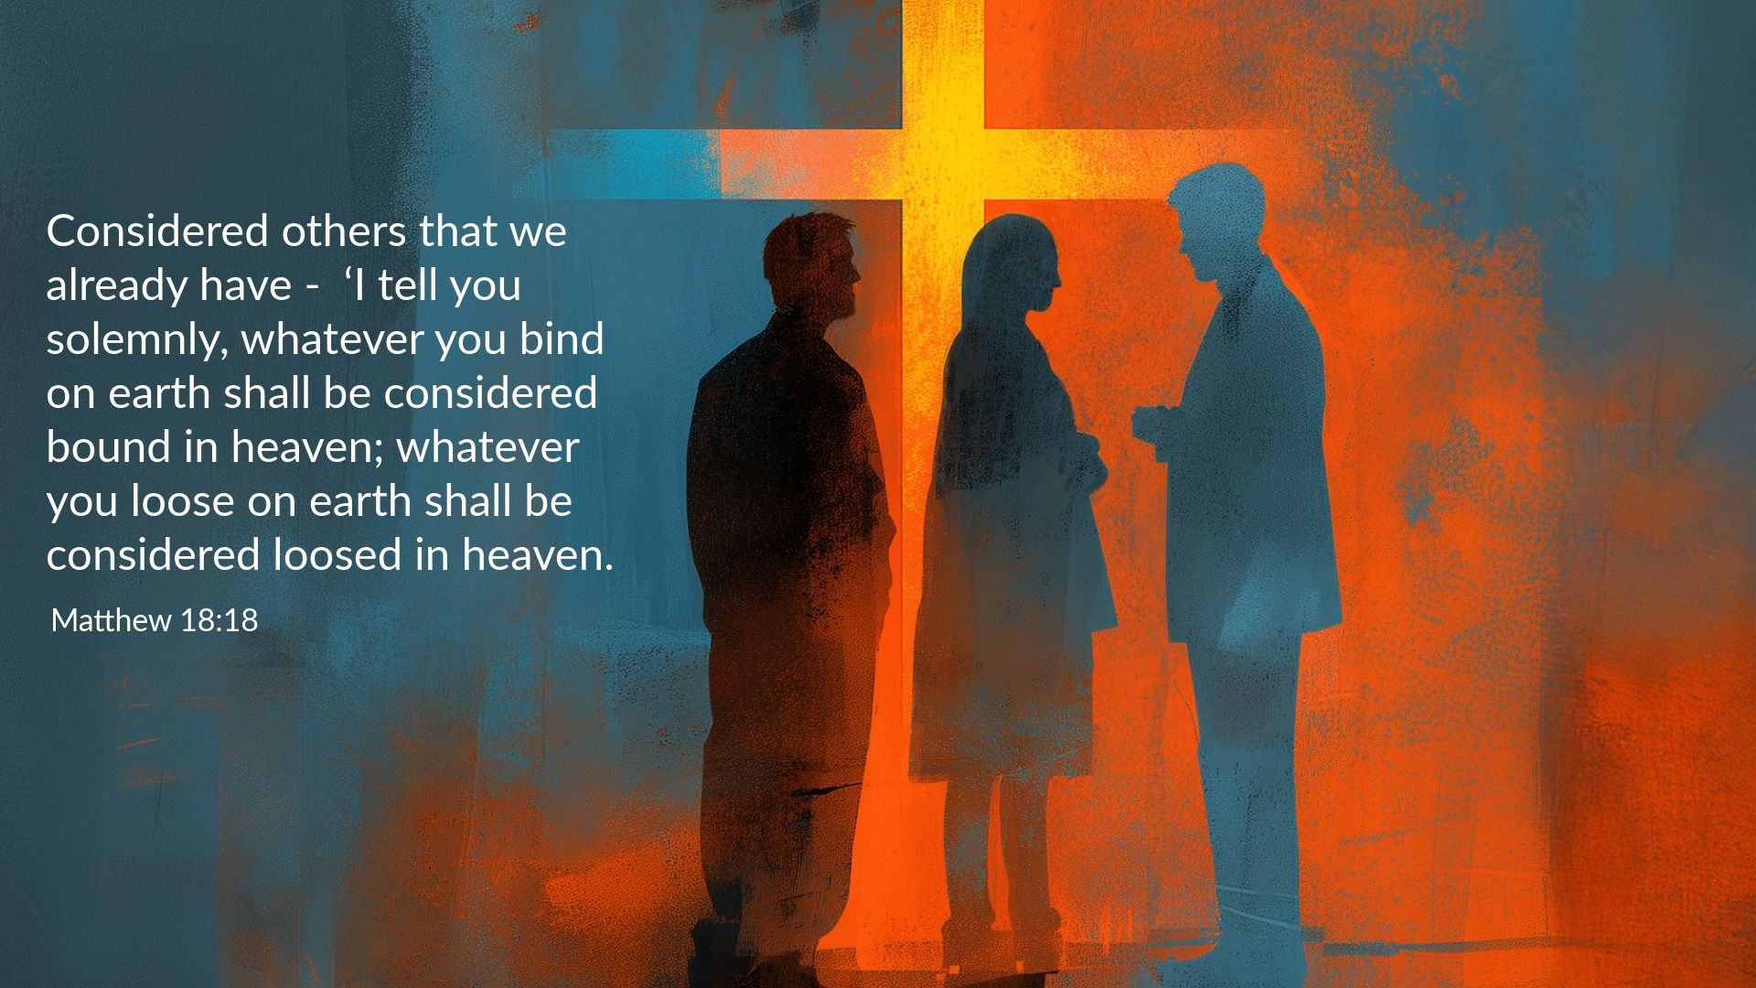

Slide 24
Nicene Creed
I believe in one God, the Father almighty, maker of heaven and earth, of all things visible and invisible. I believe in one Lord, Jesus Christ, the Only Begotten Son of God, born of the Father before all ages. God from God, Light from Light, true God from true God, begotten, not made, consubstantial with the Father; through Him all things were made.

Slide 25
For us men and for our salvation. He came down from heaven, and by the Holy Spirit was incarnate of the Virgin Mary, and became man.
For our sake He was crucified under Pontius Pilate, He suffered death and was buried, and rose again on the third day in accordance with the Scriptures. He ascended into heaven and is seated at the right hand of the Father. He will come again in glory to judge the living and the dead, and His Kingdom will have no end.

Slide 26
I believe in the Holy Spirit, the Lord, the giver of life, who proceeds from the Father and the Son, who with the Father and the Son is adored and glorified, who has spoken through the prophets.
I believe in one, Holy, Catholic and Apostolic Church. I confess one Baptism for the forgiveness of sins and I look forward to the resurrection of the dead, and the life of the world to come. Amen.

Slide 27
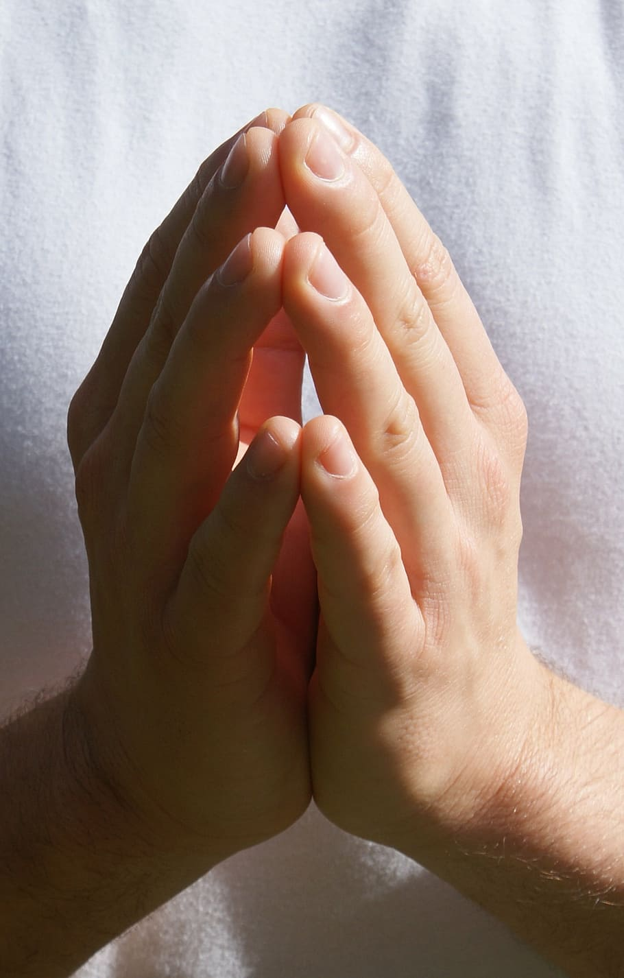
Reader: We pray for…
Let us pray to the Lord.
People: Lord hear our prayer.

Slide 28
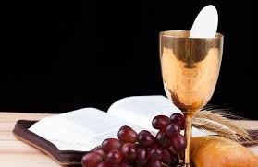

Slide 29
OFFERTORY SONGS

Slide 30
The Liturgy of the Eucharist
C: Pray, brethren that my sacrifice and yours may be acceptable to God, the almighty Father.
A: May the Lord accept the sacrifice at your hands for the praise and glory of his name, for our good the good of all his holy Church.

Slide 31
The Eucharistic Prayer
C: The Lord be with you.
A: And with your spirit.
C: Lift up your hearts.
A: We lift them up to the Lord.
C: Let us give thanks to the Lord our God.
A: It is right and just.

Slide 32
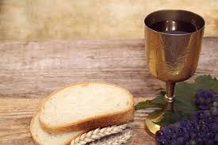

Slide 33

SANCTUS
Holy, holy, holy Lord God of hosts.
Heaven and earth are full of your glory
Hosanna in the highest,
blessed is he who comes in the name of the Lord
Hosanna in the highest…

Slide 34
MYSTERY OF FAITH
We proclaim your death O Lord
And profess your resurrection
Until you come again…

Slide 35
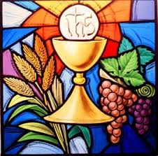

Slide 36

1 of 2
LORD’S PRAYER
Our Father, who art in heaven hallowed be Thy name. Thy Kingdom come, Thy will be done, on earth as it is in Heaven.
Give us this day our daily bread. And forgive us our trespasses, as we forgive those who trespass against us. And lead us not into temptation, but deliver us from evil.

Slide 37
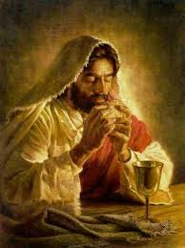
2 of 2
For thy Kingdom, the Power and the Glory are Yours
Now and forever.

Slide 38
C: Lord Jesus Christ, who said to your Apostles…..
….Who live and reign for ever and ever
A: Amen
C: The peace of the Lord be with you always.
A: And with your spirit.

Slide 39
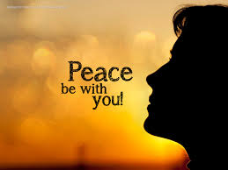

Slide 40
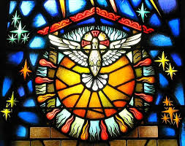
Lamb of God
Lamb of God, you take away the sins of the world, Have mercy on us.
Lamb of God, you take away the sins of the world, Have mercy on us.
Lamb of God, you take away the sins of the world,Grant us peace…

Slide 41
C: Behold the Lamb of God, behold him who takes away the sins of the world. Blessed are those called to the supper of the lamb.
A: Lord, I am not worthy that you should enter under my roof, but only say the word and my soul shall be healed.

Slide 42
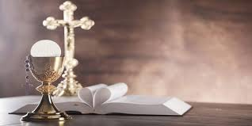

Slide 43
COMMUNION SONGS

Slide 44
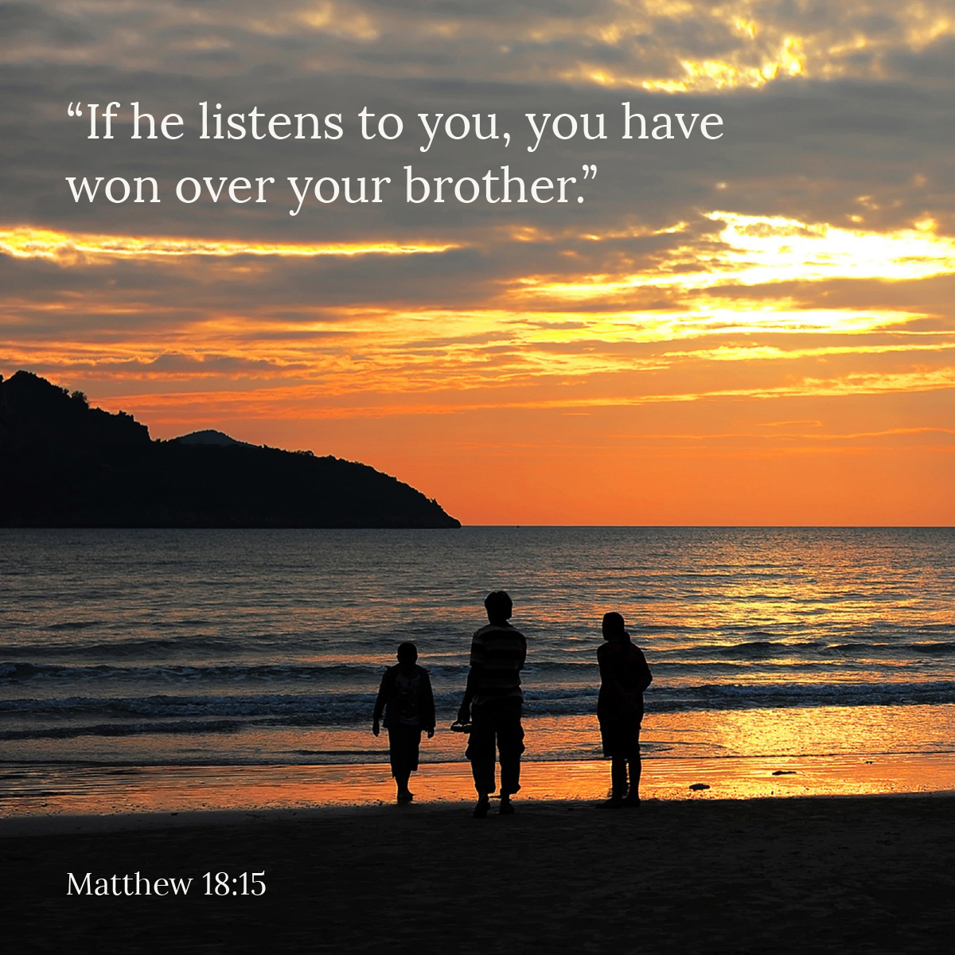

Slide 45
CONCLUDING RITES
C: The Lord be with you.
A : And with your spirit
C: May Almighty God Bless Us, Father and Son and Holy Spirit
A: Amen.
C: Go in Peace, glorifying the Lord by your life.
A: Thanks Be to God

Slide 46
FINAL SONGS

