Slide 1
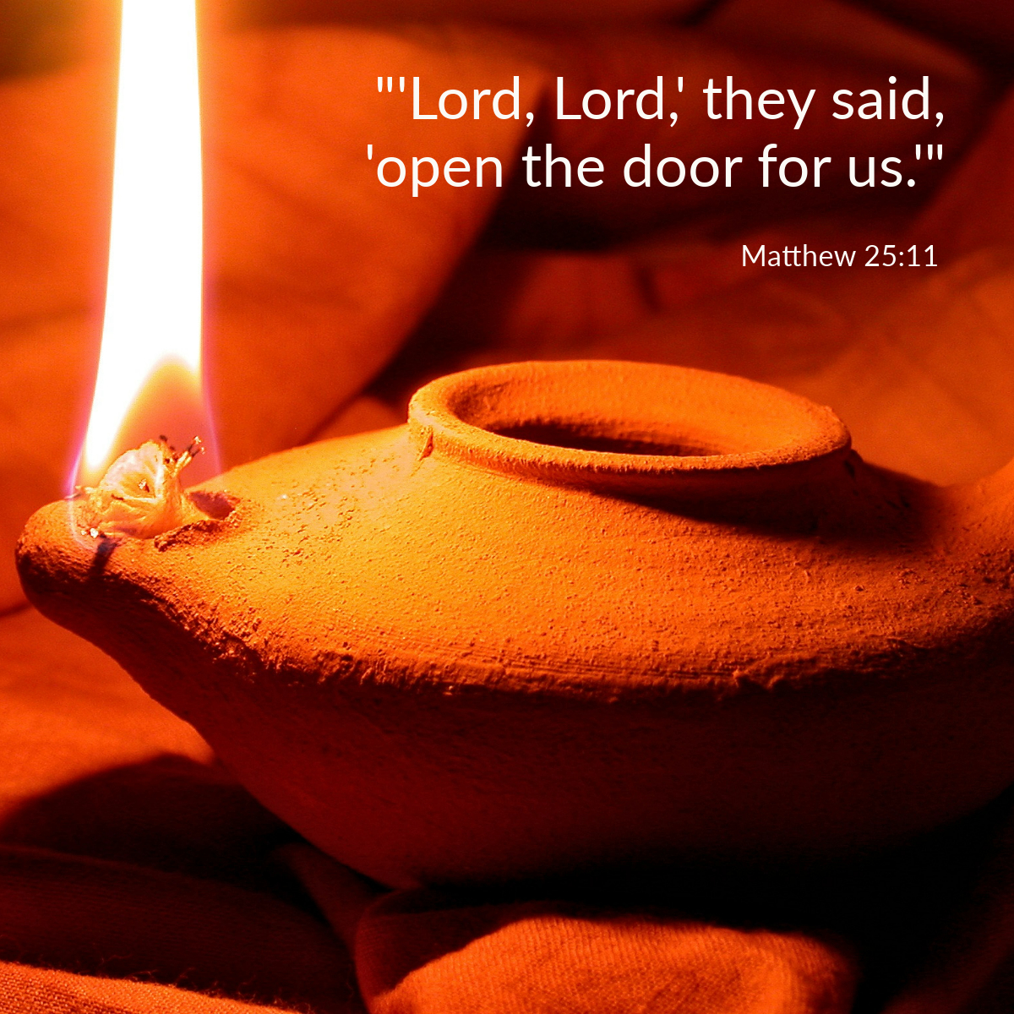

Welcome to St. Luke’s Church Lalor Parish 32nd Sunday in Ordinary Time,
8 November 2026

Slide 2
ENTRANCE SONGS

Slide 3
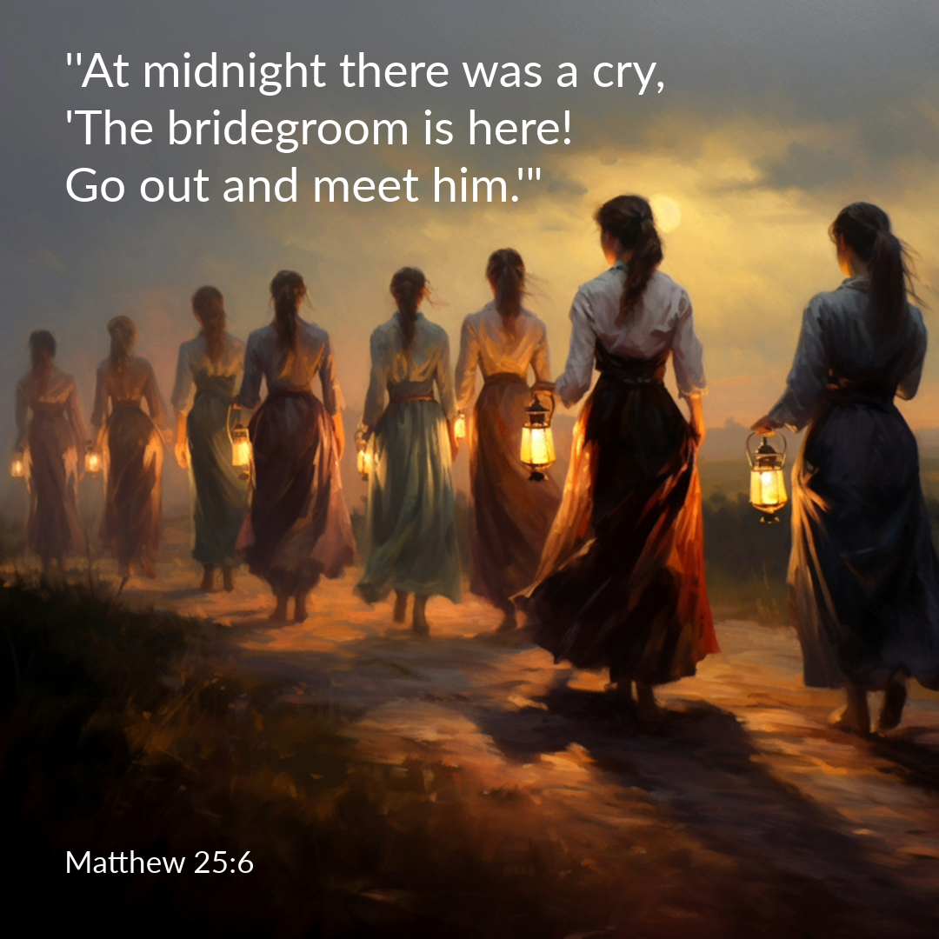

Slide 4
C: In the name of the Father, and of the Son and of the Holy Spirit.
A: Amen
C: The grace of our Lord Jesus Christ, and the love of God, and the communion of the Holy Spirit be with you all.
A: And with your Spirit

Slide 5
1 of 2
PENITENTIAL ACT
I confess to Almighty God, And to you, my brothers and sisters, That I have greatly sinned, in my thoughts and in my words, In what I have done and in what have failed to do. Through my fault, through my fault, Through my most grievous fault;

Slide 6
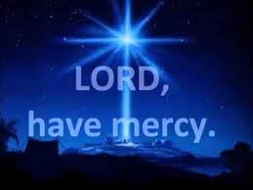
2 of 2
Therefore I ask blessed Mary ever-Virgin, All the Angels and Saints, And you, my brothers and sisters, To pray for me to the Lord our God.

Slide 7
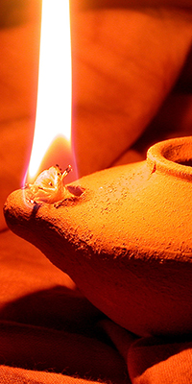
C- Lord have mercy
A- Lord have mercy
C - Christ have mercy
A - Christ have mercy
C- Lord have mercy
A- Lord have mercy

Slide 8

1 of 3
GLORY TO GOD
Glory to God in the highest
And on earth peace to people of good will
We praise You, we bless You, We adore You, we glorify You, We give You thanks for Your great glory. Lord God heavenly King, O God almighty Father.

Slide 9
2 of 3
Lord Jesus Christ, Only Begotten Son. Lord God, Lamb of God, Son of the Father, you take away the sins of the world, Have mercy on us; you take away the sins of the world, receive our prayer; You are seated at the right hand of the Father, Have mercy on us.

Slide 10

3 of 3
For You alone are the Holy One,
You alone are the Lord,
You alone are the Most High, Jesus Christ,
with the Holy Spirit, in the glory of God the Father. Amen….

Slide 11
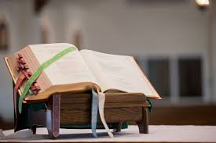

Slide 12
Liturgy of the Word
First Reading (Wisdom 6:12-16)
A reading from the book of Wisdom
Wisdom is bright, and does not grow dim. By those who love her she is readily seen, and found by those who look for her. Quick to anticipate those who desire her, she makes herself known to them. Watch for her early and you will have no trouble; you will find

Slide 13
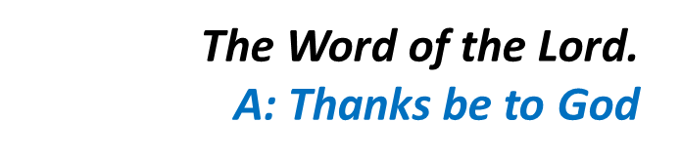
her sitting at your gates. Even to think about her is understanding fully grown; be on the alert for her and anxiety will quickly leave you. She herself walks about looking for those who are worthy of her and graciously shows herself to them as they go, in every thought of theirs coming to meet them.

Slide 14
Responsorial Psalm (Ps 62:2-8. R. v.2)
(R.) My soul is thirsting for you,
O Lord my God.
1. O God, you are my God, for you I long; for you my soul is thirsting. My body pines for you like a dry, weary land without water. (R.)
2. So I gaze on you in the sanctuary to see your strength and your glory. For your love is better than life, my lips will speak your praise. (R.)

Slide 15
(R.) My soul is thirsting for you,
O Lord my God.
3. So I will bless you all my life, in your name I will lift up my hands. My soul shall be filled as with a banquet, my mouth shall praise you with joy. (R.)
4. On my bed I remember you. On you I muse through the night for you have been my help; in the shadow of your wings I rejoice. (R.)

Slide 16
Second Reading (1 Thessalonians 4:13-14)
A reading from the first letter of St Paul to the Thessalonians
We want you to be quite certain, brothers, about those who have died, to make sure that you do not grieve about them, like the other people who have no hope. We believe that Jesus died and rose again, and that it

Slide 17
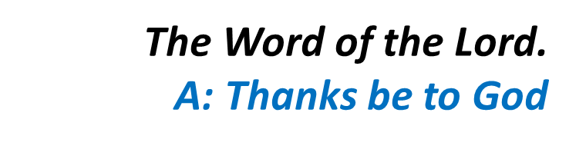
will be the same for those who have died in Jesus: God will bring them with him.

Slide 18

Gospel Acclamation
Alleluia, alleluia!
Be watchful and ready:
you know not when the Son of Man is coming.
Alleluia!

Slide 19
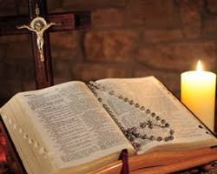
C: The Lord be with you.
A: And with your spirit
C: A reading from the holy Gospel according to Matthew
A: Glory to you Lord

Slide 20
Gospel (Matthew 25:1-13)
A reading from the holy Gospel according to Matthew
Jesus told this parable to his disciples: ‘The kingdom of heaven will be like this: Ten bridesmaids took their lamps and went to meet the bridegroom. Five of them were foolish and five of them were sensible: the

Slide 21
foolish ones did take their lamps, but they brought no oil, whereas the sensible ones took flasks of oil as well as their lamps. The bridegroom was late, and they all grew drowsy and fell asleep. But at midnight there was a cry, “The bridegroom is here! Go out and meet him.” At this, all those bridesmaids woke up and trimmed their lamps, and the foolish ones said to the sensible ones, “Give

Slide 22
us some of your oil: our lamps are going out.” But they replied, “There may not be enough for us and for you; you had better go to those who sell it and buy some for yourselves.” They had gone off to buy it when the bridegroom arrived. Those who were ready went in with him to the wedding hall and the door was closed. The other bridesmaids arrived later. “Lord, Lord,” they said, “open

Slide 23

the door for us.” But he replied, “I tell you solemnly, I do not know you.” So stay awake, because you do not know either the day or the hour.’

Slide 24
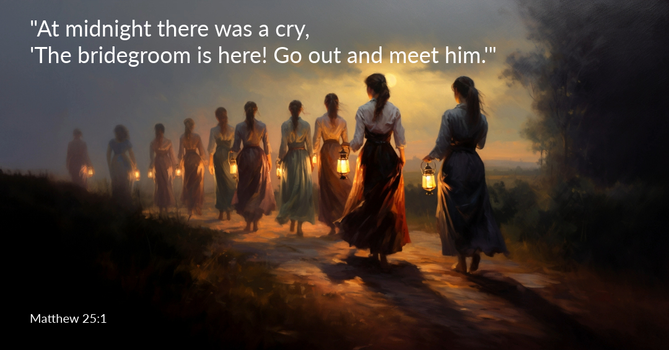

Slide 25
Nicene Creed
I believe in one God, the Father almighty, maker of heaven and earth, of all things visible and invisible. I believe in one Lord, Jesus Christ, the Only Begotten Son of God, born of the Father before all ages. God from God, Light from Light, true God from true God, begotten, not made, consubstantial with the Father; through Him all things were made.

Slide 26
For us men and for our salvation. He came down from heaven, and by the Holy Spirit was incarnate of the Virgin Mary, and became man.
For our sake He was crucified under Pontius Pilate, He suffered death and was buried, and rose again on the third day in accordance with the Scriptures. He ascended into heaven and is seated at the right hand of the Father. He will come again in glory to judge the living and the dead, and His Kingdom will have no end.

Slide 27
I believe in the Holy Spirit, the Lord, the giver of life, who proceeds from the Father and the Son, who with the Father and the Son is adored and glorified, who has spoken through the prophets.
I believe in one, Holy, Catholic and Apostolic Church. I confess one Baptism for the forgiveness of sins and I look forward to the resurrection of the dead, and the life of the world to come. Amen.

Slide 28
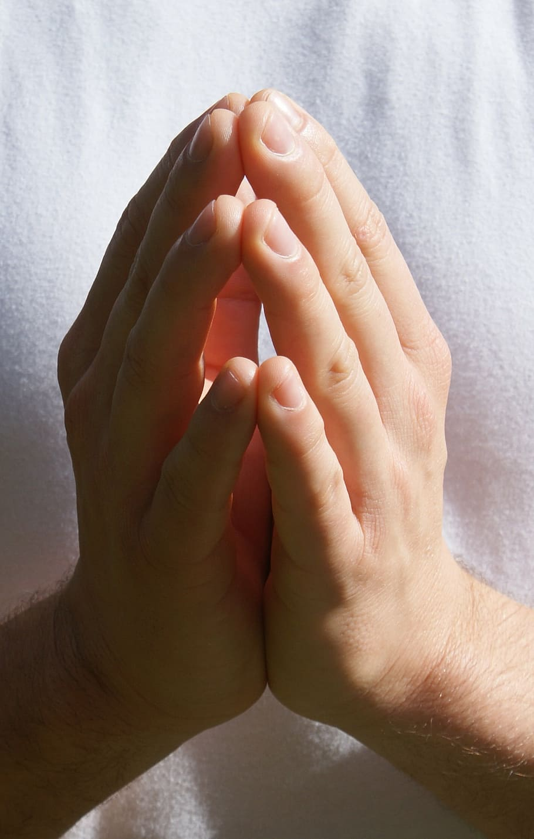
Reader: We pray for…
Let us pray to the Lord.
People: Lord hear our prayer.

Slide 29
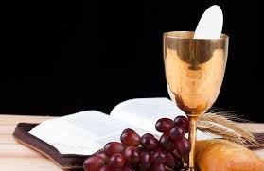

Slide 30
OFFERTORY SONGS

Slide 31
The Liturgy of the Eucharist
C: Pray, brethren that my sacrifice and yours may be acceptable to God, the almighty Father.
A: May the Lord accept the sacrifice at your hands for the praise and glory of his name, for our good the good of all his holy Church.

Slide 32
The Eucharistic Prayer
C: The Lord be with you.
A: And with your spirit.
C: Lift up your hearts.
A: We lift them up to the Lord.
C: Let us give thanks to the Lord our God.
A: It is right and just.

Slide 33
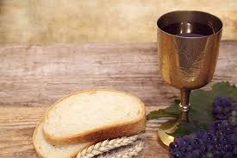

Slide 34

SANCTUS
Holy, holy, holy Lord God of hosts.
Heaven and earth are full of your glory
Hosanna in the highest,
blessed is he who comes in the name of the Lord
Hosanna in the highest…

Slide 35
MYSTERY OF FAITH
We proclaim your death O Lord
And profess your resurrection
Until you come again…

Slide 36
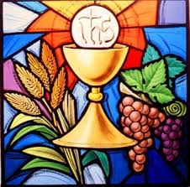

Slide 37

1 of 2
LORD’S PRAYER
Our Father, who art in heaven hallowed be Thy name. Thy Kingdom come, Thy will be done, on earth as it is in Heaven.
Give us this day our daily bread. And forgive us our trespasses, as we forgive those who trespass against us. And lead us not into temptation, but deliver us from evil.

Slide 38
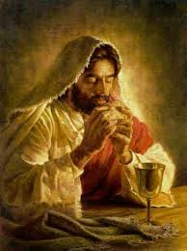
2 of 2
For thy Kingdom, the Power and the Glory are Yours
Now and forever.

Slide 39
C: Lord Jesus Christ, who said to your Apostles…..
….Who live and reign for ever and ever
A: Amen
C: The peace of the Lord be with you always.
A: And with your spirit.

Slide 40
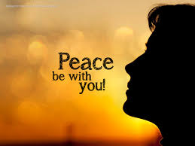

Slide 41
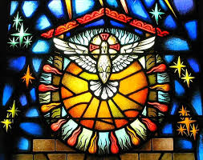
Lamb of God
Lamb of God, you take away the sins of the world, Have mercy on us.
Lamb of God, you take away the sins of the world, Have mercy on us.
Lamb of God, you take away the sins of the world,Grant us peace…

Slide 42
C: Behold the Lamb of God, behold him who takes away the sins of the world. Blessed are those called to the supper of the lamb.
A: Lord, I am not worthy that you should enter under my roof, but only say the word and my soul shall be healed.

Slide 43
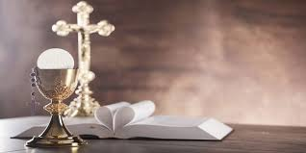

Slide 44
COMMUNION SONGS

Slide 45
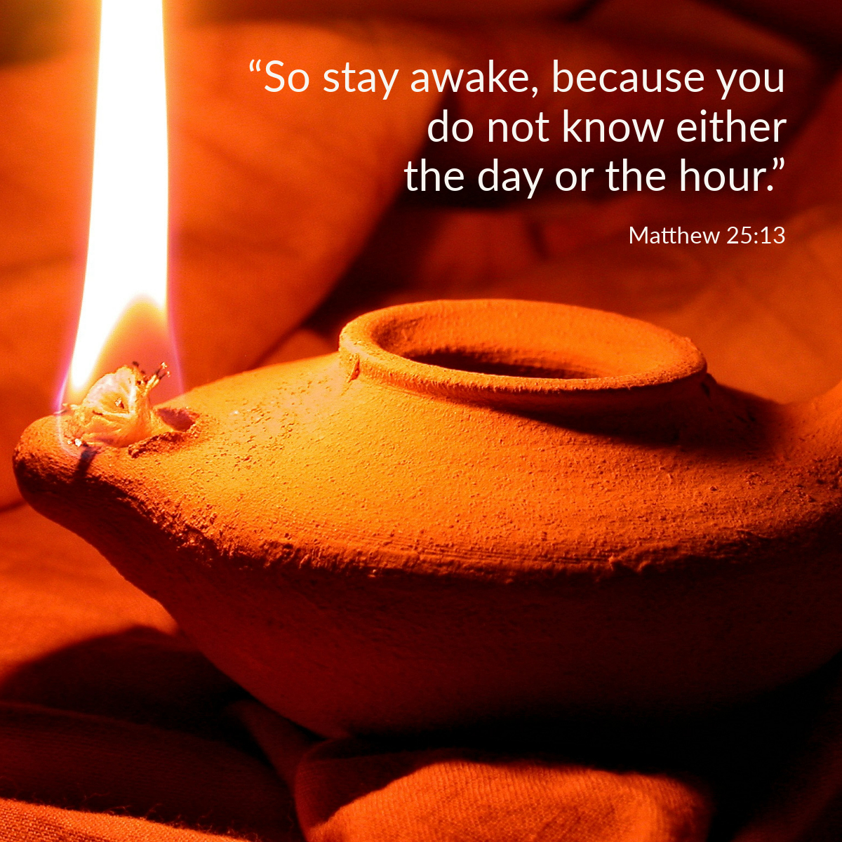

Slide 46
CONCLUDING RITES
C: The Lord be with you.
A : And with your spirit
C: May Almighty God Bless Us, Father and Son and Holy Spirit
A: Amen.
C: Go in Peace, glorifying the Lord by your life.
A: Thanks Be to God

Slide 47
FINAL SONGS

