Slide 1
Welcome to the
St.Mary’s
Annual General Meeting
June 1st, 2025

Slide 2
Overview
Our Parish At A Glance – 5 minutes
Our Strategic Plan – 10 minutes
Parish Finance Summary – 15 minutes
Question Time – 10 minutes

Slide 3
Our Parish
At A Glance
Presented by Frank Schobben

Slide 4
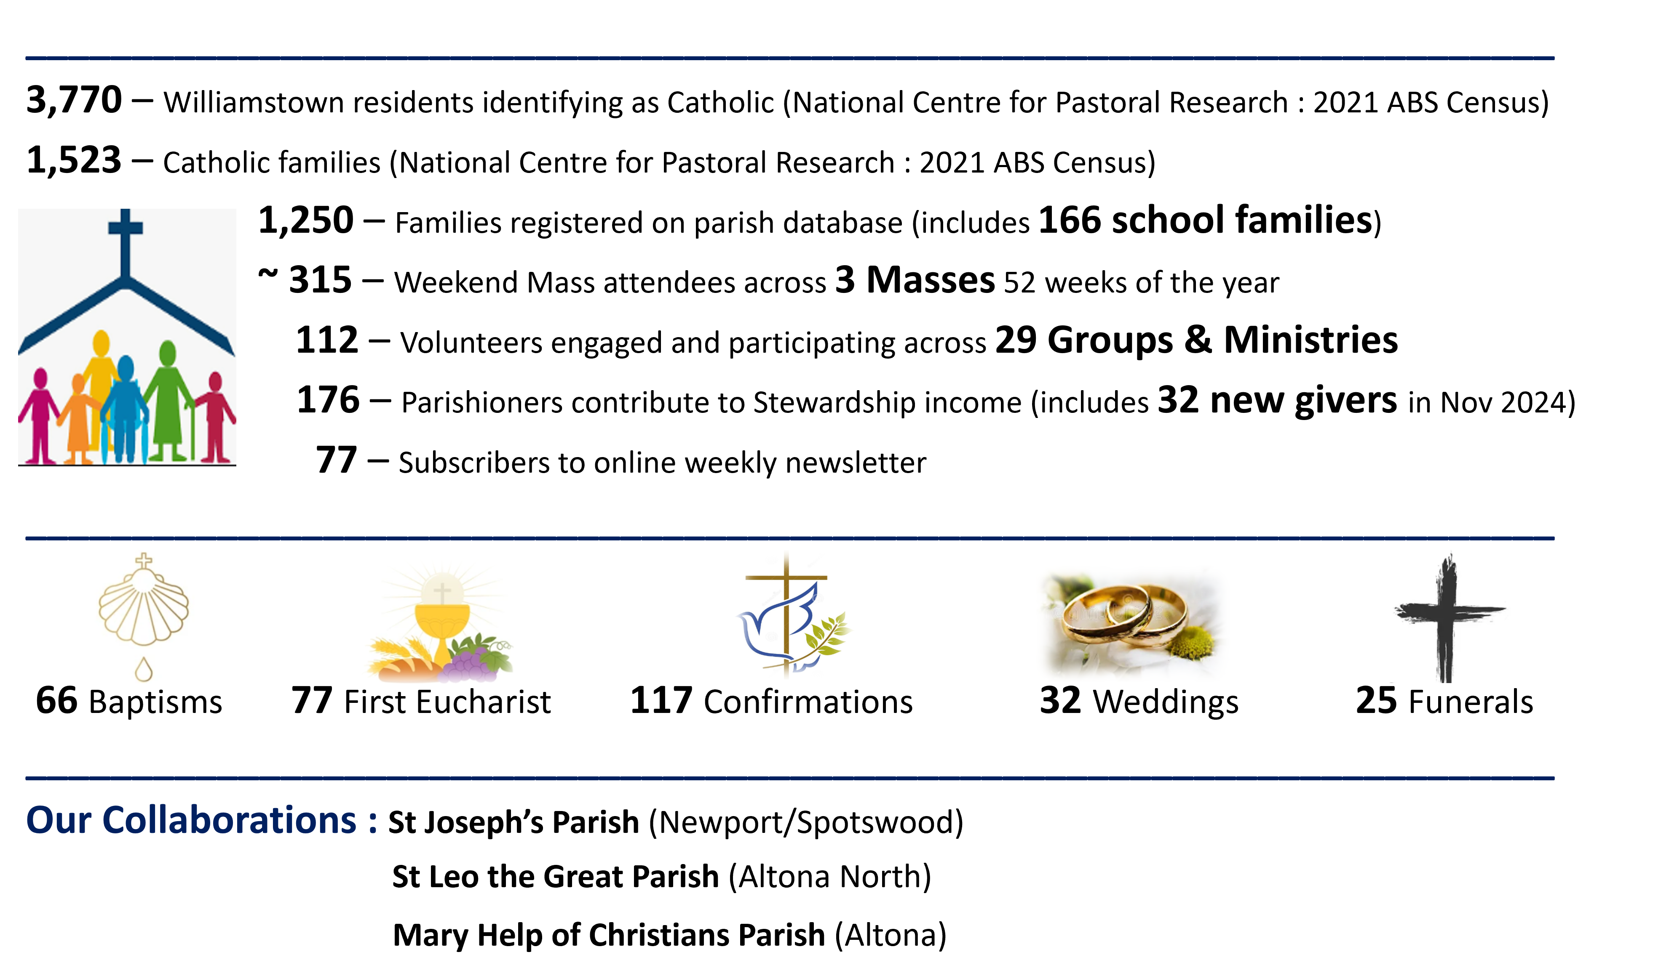
OUR PARISH AT A GLANCE

Slide 5
St.Mary’s
Strategic Plan
Presented by Joe Covelli

Slide 6
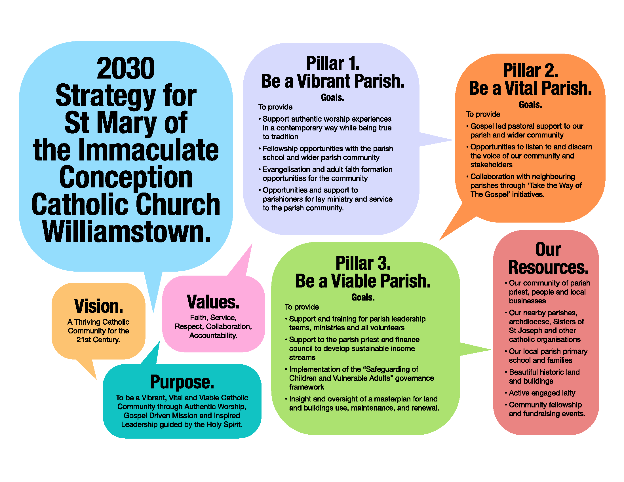

Slide 7
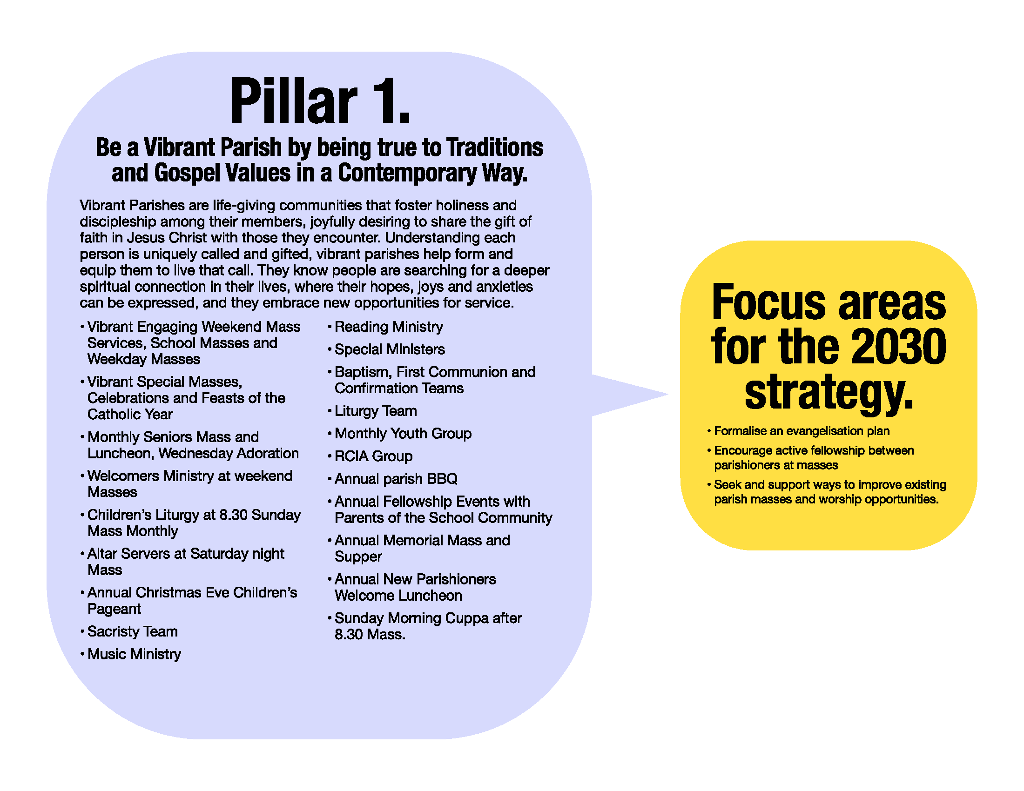

Slide 8
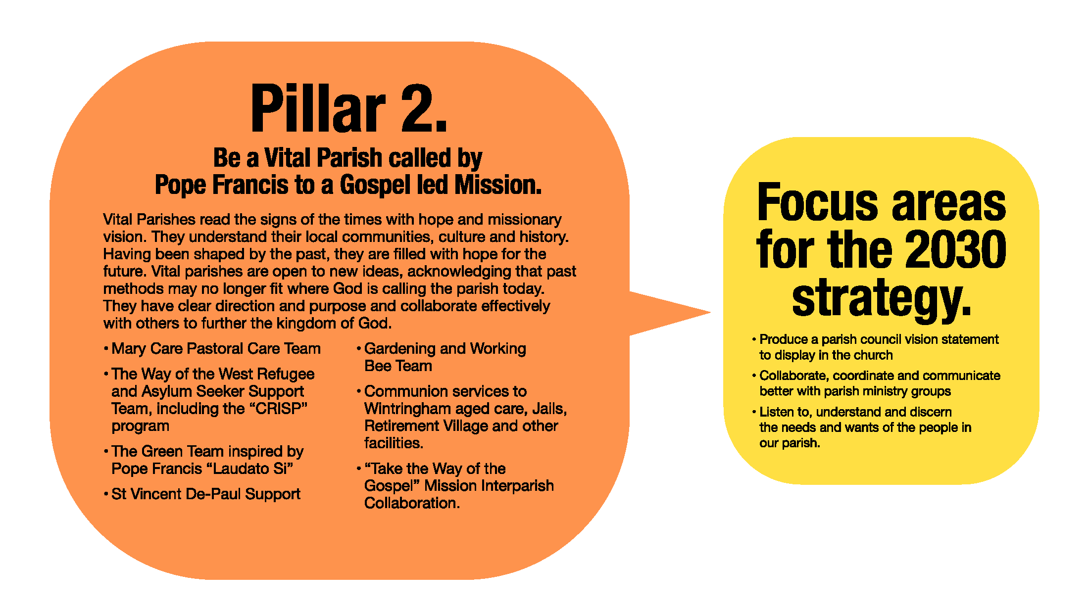

Slide 9
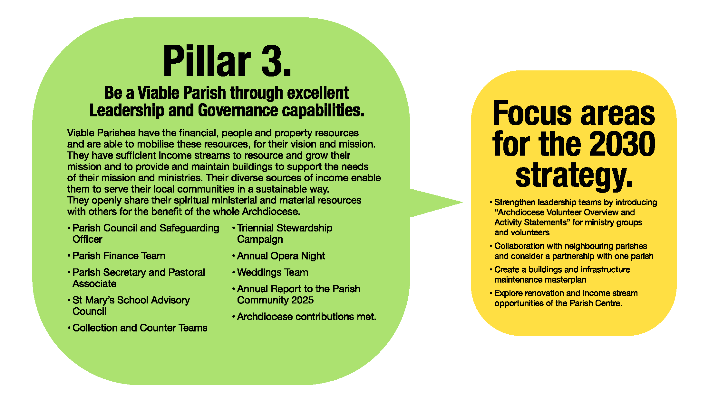

Slide 10
St.Mary’s
Parish Williamstown
Financial Overview
For Year Ending 31st of December 2024
Presented by Leanne Spiteri
& Matthew Muscat

Slide 11
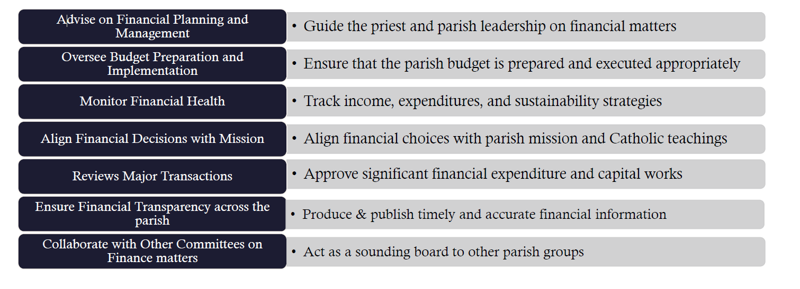
The Role of the Finance Committee

Slide 12
2024 Financial Position
Assets
Cash at bank
operating account $72,809
other bank account $14,135
Amounts receivable
inc. debtors, GST: $15,443
Prepayments (insurance) $19,492
  Church & associated physical assets
Total assets* $121,879
*not including the Church and associated plant
Liabilities
Creditors and Accrued expenses
$12,715
Staff entitlements $10,688
Total liabilities $23,404

Slide 13
2024 Operating Results
2024 Income $220,335
The greatest source of income of the Parish is stewardship contributions (63%), followed by service fees (13%) and the parish levy (10%).

Slide 14
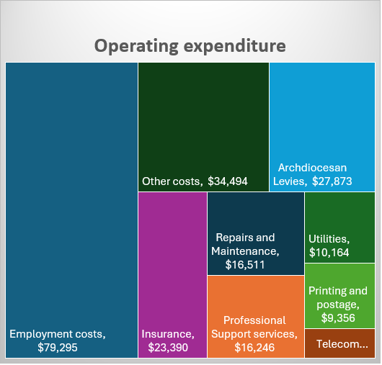
Operating Expenditure
2024 Expenditures $202,224
2024 Operating Surplus $18,111
(net operating cash flow -$37,713)

Slide 15
2025 Financial Outlook
Budgeted 2025 Net Operating Deficit $13,521

Slide 16
2025 Financial Outlook
Priorities
Operational support
Maintain church facilities
Program support
Diversification and growth of income streams
Cost saving measures
Transparency and accountability

Slide 17
Question Time

Slide 18
Thank you for attending.
This presentation is now available on the parish website.
Your feedback is welcomed, please contact Father Greg or the Parish Council.

